Slide 1


Year One
Welcome Meeting
July 2026

Slide 2
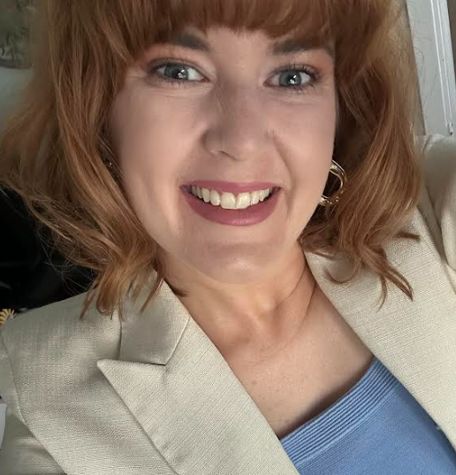
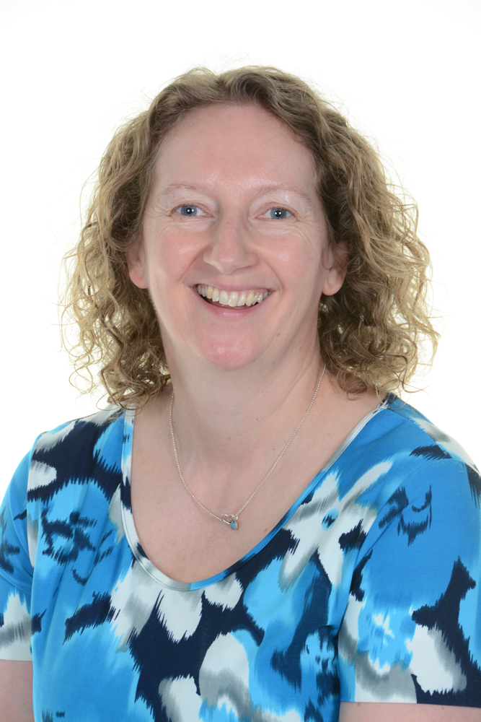
Meet the Year One Team…
Miss Kennedy
Class Teacher
Ms Wootton
Teaching Assistant
PPA Cover Afternoon
Support across KS1

Slide 3
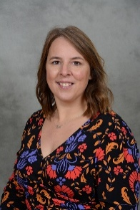
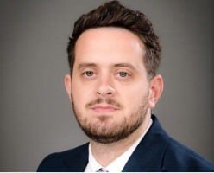
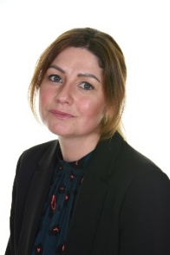
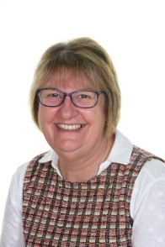
Safeguarding
Safeguarding children is a collective responsibility.
Staff are all trained to identify possible indicators of abuse.
If you have concerns about a child, even your own, please come and speak with us. Our role is to support families and there are a range of services that we can draw upon for support.
We are proud to be an Operation Encompass school. This means that if police are notified of a Domestic Incident at an address where one of our pupils is present or lives, we will be notified.
It is helpful for you to make us aware of any incidents that may impact on your child’s wellbeing so that we can support them in school.
Key Safeguarding Staff
Mrs Cahalan
Designated Safeguarding lead
Mr Morgan- Deputy
Designated Safeguarding lead
Mrs Hall- Deputy
Designated Safeguarding lead
Mrs Mayne- Deputy
Designated Safeguarding lead

Slide 4
Timings and Entrance
Timings for Year One:
Time in | 8.45am
Time out | 3.15pm
New entry and exit door: Front Slope to Office.
At the end of the school day we will bring the children to the front door- please line up along the wall, we will dismiss the children one by one.
We will only dismiss the children to a familiar adult. Please let us know if someone different is collecting your child.

Slide 5

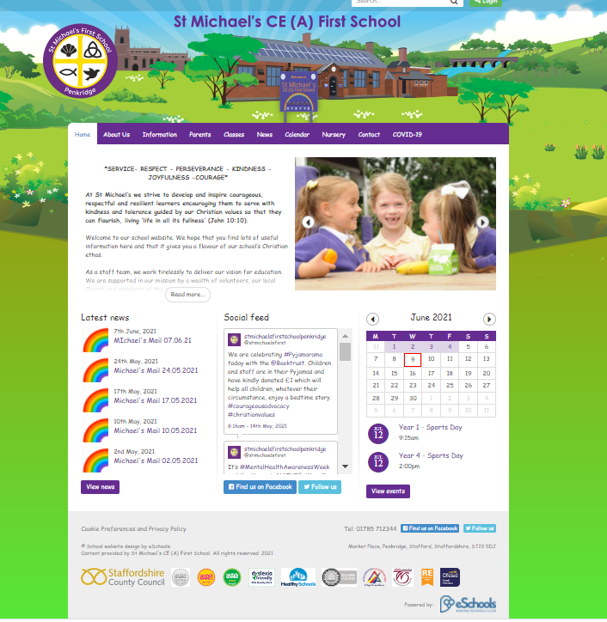

Communication
Notes:
Reminder of behaviour policy and feedback and assessment policy

Slide 6
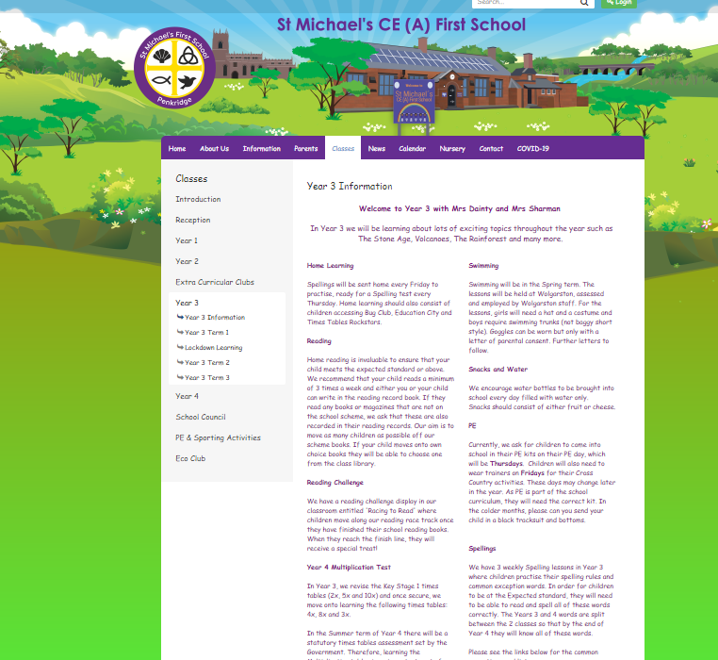
Communication
Everything you need to know will be located on our class web page.
It will have a key information page and then sub pages for each term.
To contact me directly please email
yearone2627@st-michaels-penkridge.staffs.sch.uk
For urgent emails during the school day email office@st-michaels-penkridge.staffs.sch.uk

Slide 7
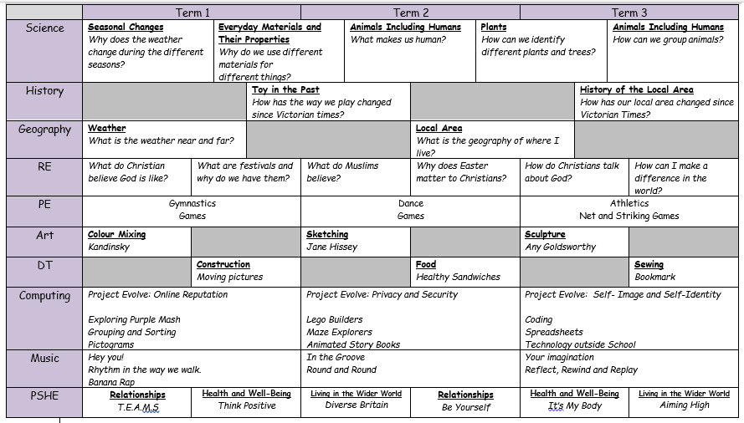
Year One Curriculum
Add a brief overview of the termly topics.

Slide 8
A Typical Day in Year One
English and Maths learning takes place in a morning.
Playtime on the KS1 playground
Daily phonics lesson
Topic based subjects, PE and RE taught in an afternoon
A timetable will be made available via the website in September
Notes:
Reminder of PE kits

Slide 9
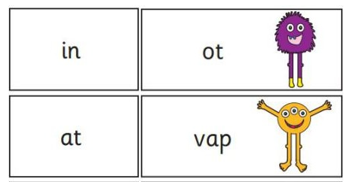
Year One Phonics
The children will continue with the Twinkl Phonics programme.
Lessons will be structured in the same way as in Reception.
Children will learn alternative vowel sounds such as (ai/ay)
Spelling quiz linked to that week's learning will take place on a Friday.
There is a statutory phonics assessment that takes place at the end of Year One, more information will be sent out during the Autumn and Spring terms.
Notes:
This tests the children’s ability to sound out and blend words. Intro at the start of the year. Chn unaware they are sitting a test. Supporting resources will be on class web page

Slide 10
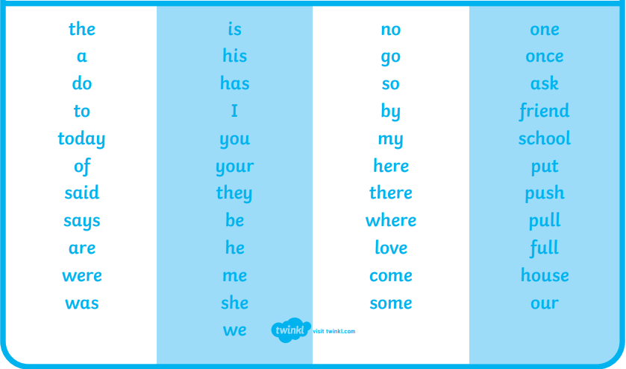
Year One CEW
Notes:
There are some words that aren’t phonetically decodable. These are called CEW. The children will learn these throughout the year. Inform spellings. Av on web page

Slide 11
Reading
Children will have their reading books changed once a week.
Children need to bring in their reading book and home contact book in every day.
Some children who need extra support with their reading will be a daily reader.
A volunteer reader will listen to your child each week.
Every child reads to their class teacher each week using the whole class reading text during their reading lessons in class.
Notes:
To support fluency it is important they reread their own reading books. Bug Club – remote learning package. Variety chn can choose. Monitored by teachers.

Slide 12

Numbots
Your child will come home with a login for Numbots
Programme that helps with fluency of mathematical skills.
Access this at home and at school.
Year One expectations is for children to know number bonds to and within 20. Count accurately in 2s, 5s and 10s.
Begin to understand basic multiplication facts. Such as 2 x 5 = 10

Slide 13
Home Learning
Read with your child at least 3 times each week and record this in their reading record book.
Access Numbots at least twice a week.
Weekly spellings.
Weekly Sound sheets sent home to support learning of spellings.
Notes:
Reminder to reread for fluency, sequence the story. Book review.

Slide 14





What could you support your child with this Summer?
Counting in multiples of 2
Take part in the Big Summer Read – more information coming soon!
Dressing themselves - PE change
Write us a postcard.

