Slide 1
The strange ways people used to live Stone Age Homes
By Freddie Wright

Slide 2
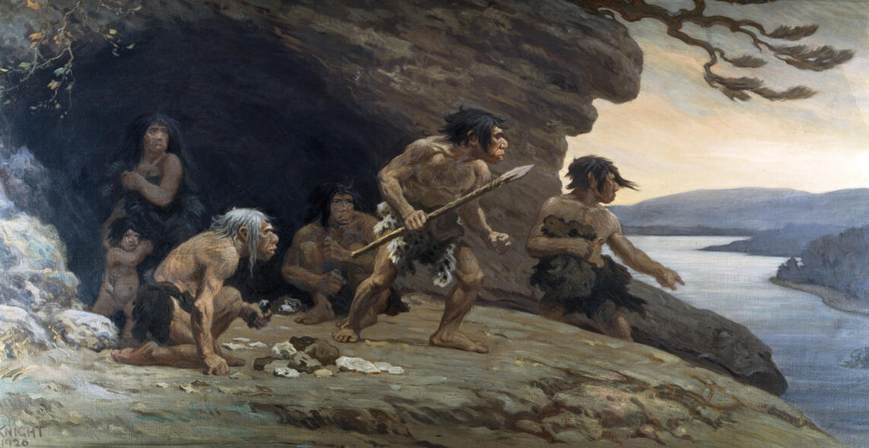
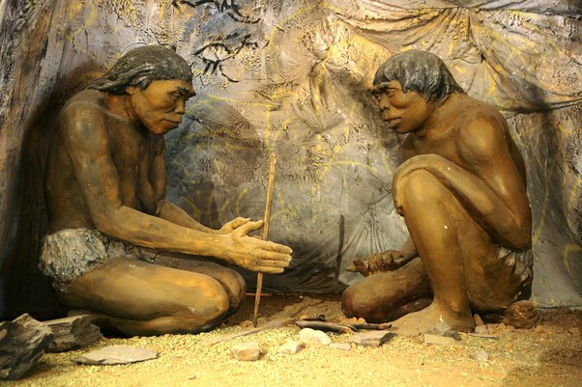
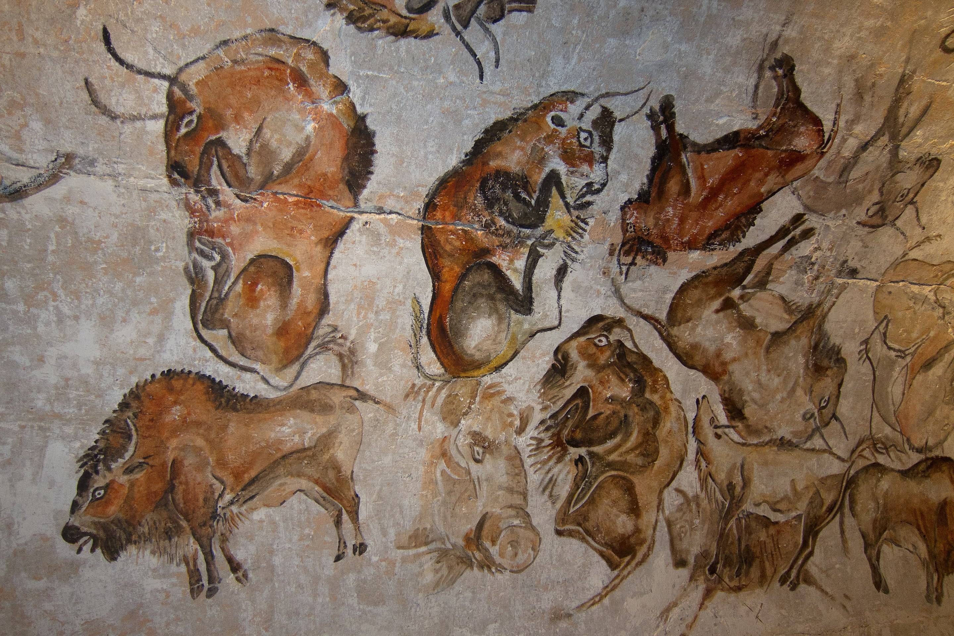
Houses - Palaeolithic
In the early Stone Age, people lived in caves.
Palaeolithic humans were hunters and gatherers and moved around, so they found caves for shelter.
Caves were places of living as well as spaces for rituals.
Cavemen drew paintings inside their caves which could have been for rituals.

Slide 3
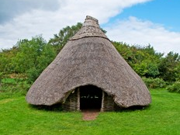
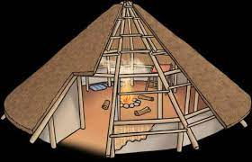
Houses - Mesolithic
During the Mesolithic period, huts became more advanced. Huts were thatched with reeds, mud and turf.
Huts were made from wooden posts in the shape like a tepee. The floor was covered with a layer of moss, reeds and soft plant materials.

Slide 4
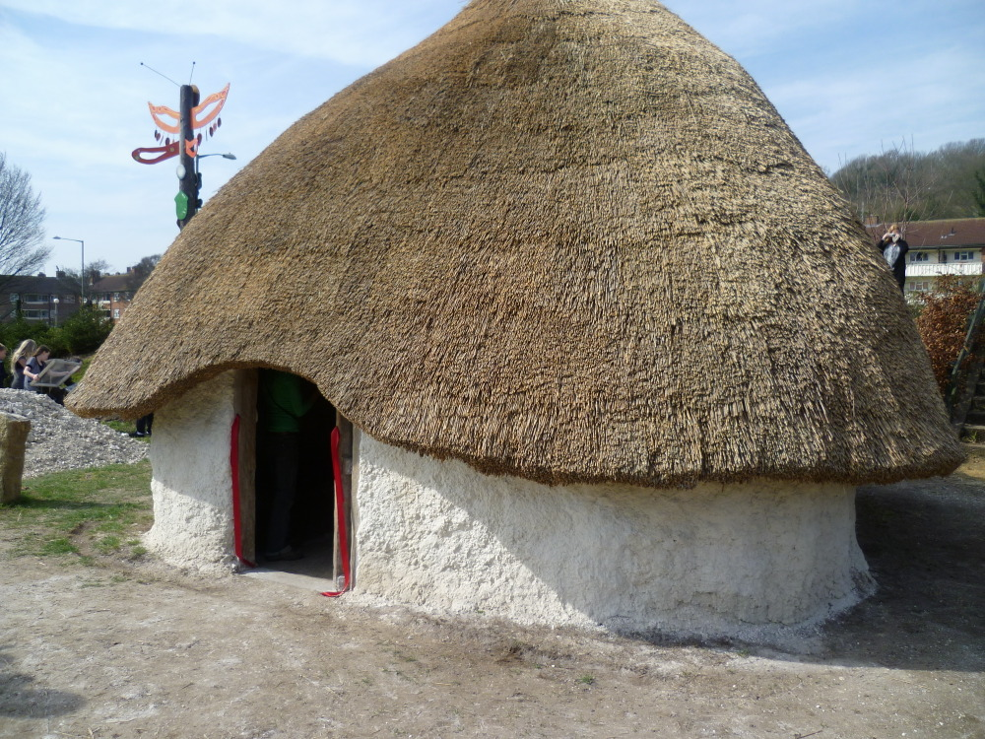
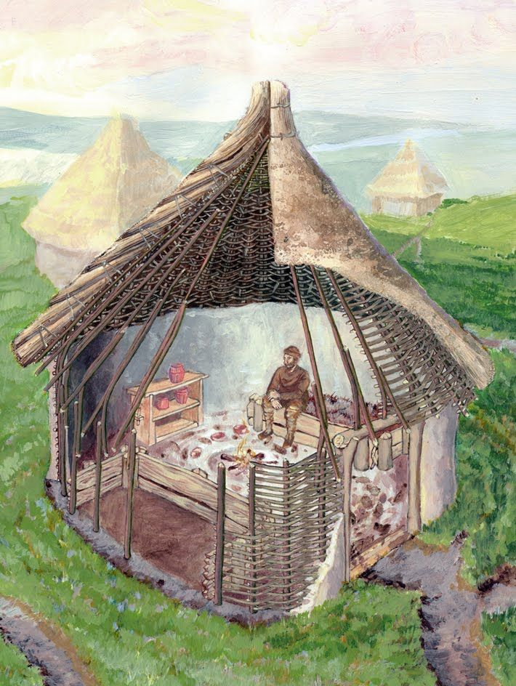
Houses - Neolithic
Because Neolithic people where more settled, they built stronger homes because they didn’t need to migrate around. They where made from clay and mud bricks with timber posts.
They held hearths, which are fireplaces made from bricks or stones, in a central location to heat the interior and serve as a cook fire.
The roofs where made from thatch but had doors what could be opened and used a chimney to get the smoke out.

Slide 5
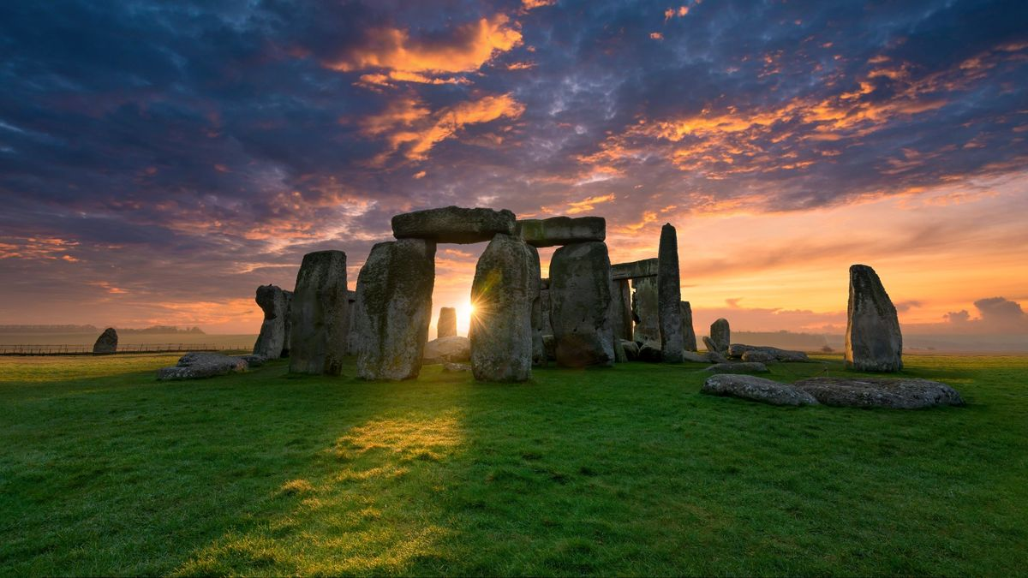
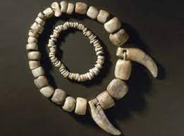
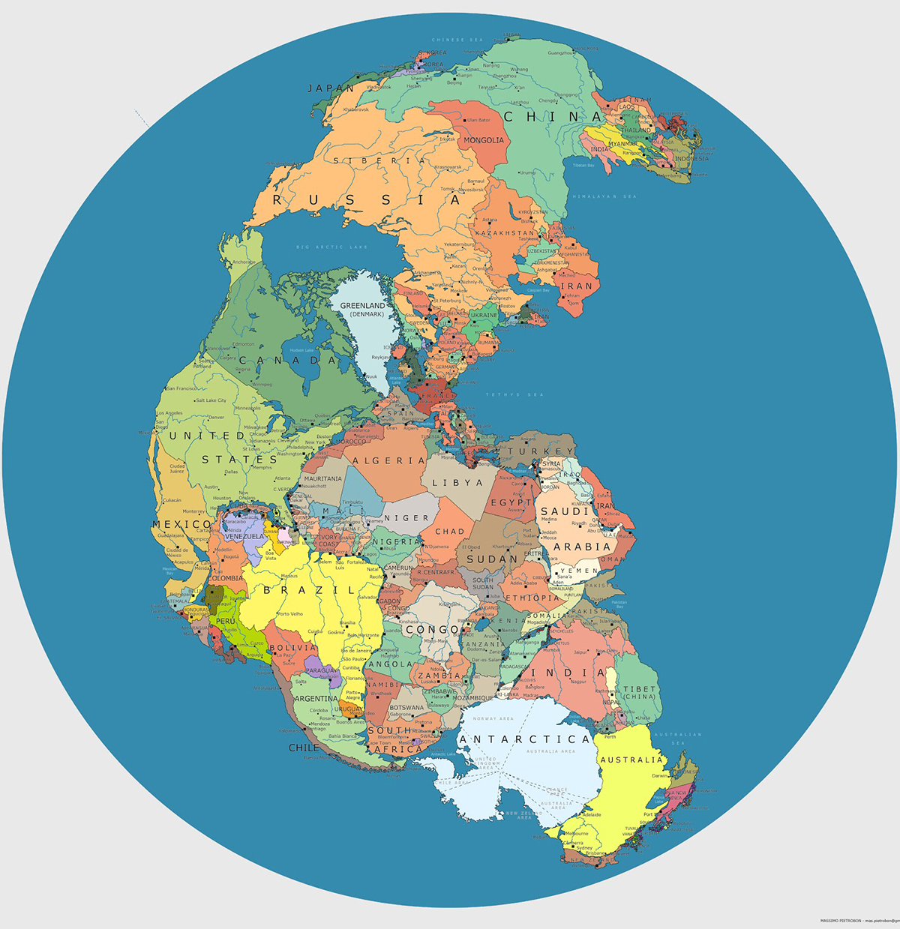
Strange Facts
Stonehenge was built in the Neolithic period. No one is quite sure why or how it was built, and it remains a mysteries even now.
People made jewellery from shells, animal claws and even teeth.
Continents where connected so stone age people could walk from Africa to England.

