Slide 1
Does Our Planet Belong To Us?
By Ivy Y4

Slide 2
I don’t think so, because the world was created millions of years before humans and animals came along.

Slide 3
Plants
Rivers
Trees
Oceans
Mountains
These were all here long before animals and humans arrived.

Slide 4
If humans weren’t on planet earth, there wouldn’t be any pollution, no towns or cities, and we wouldn’t be cutting any forests down.
Can you think of anything else harmful to our environment that wouldn’t happen if humans weren’t here?
the natural world would Thrive!!

Slide 5
However, if there were only humans, the human race would have no food or clothing and wouldn’t survive.
We need animals for food and clothing.
We need plants and trees for food and oxygen.
We need bees for pollination to help plants reproduce.
All of these things are needed for humans to live on earth.

Slide 6
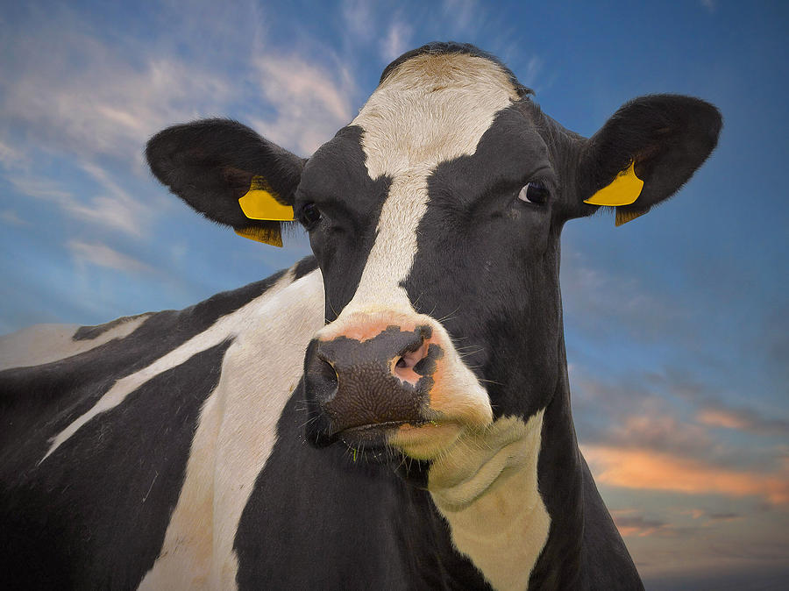
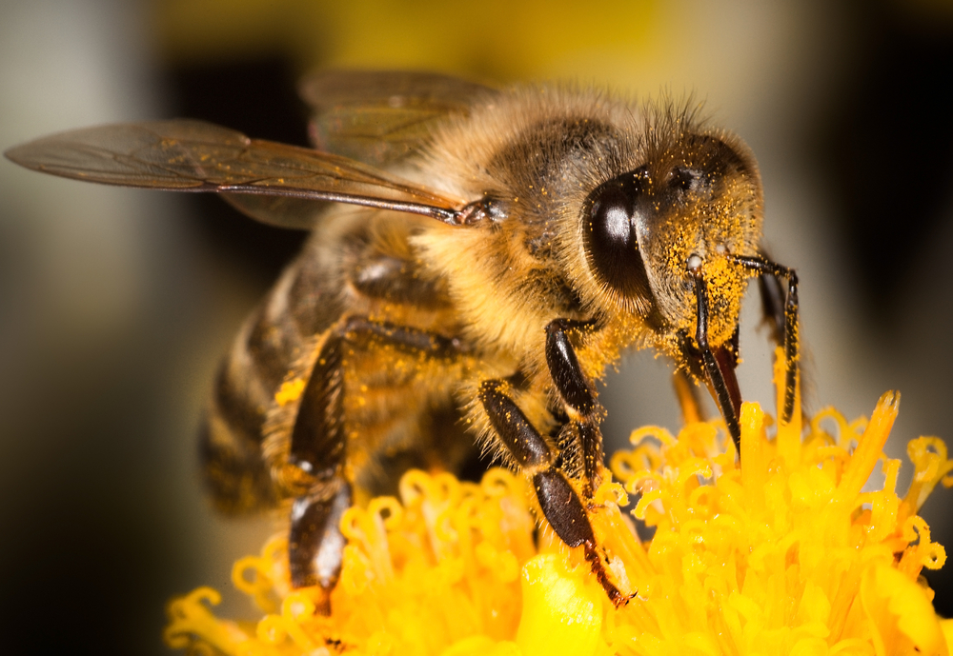
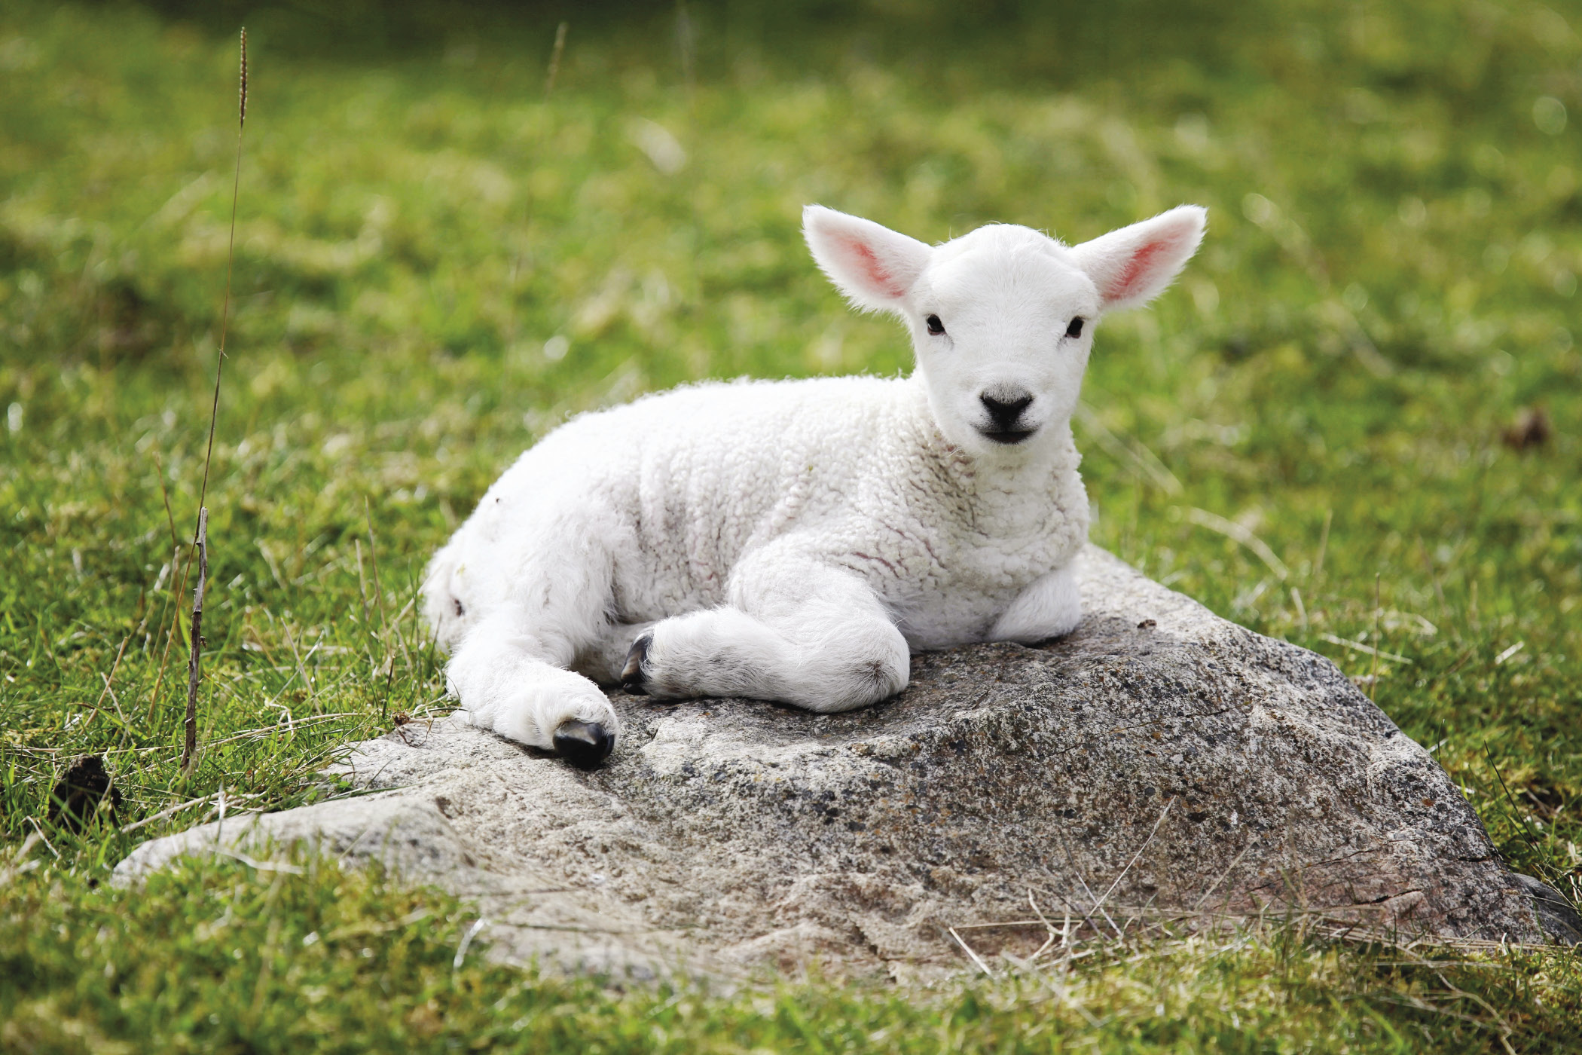
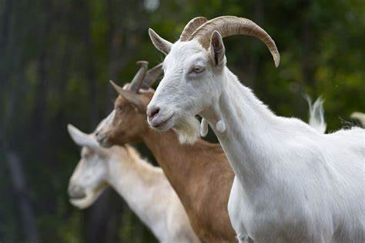
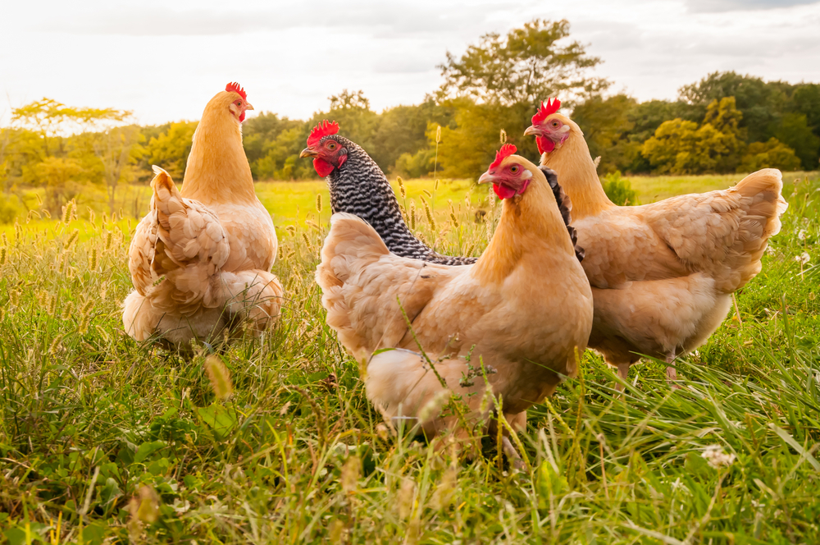
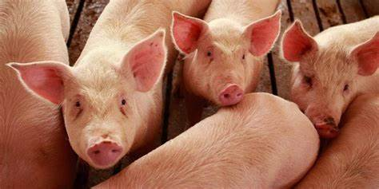
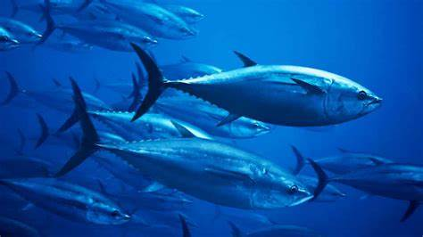
I think our planet belongs to nature as a whole, because we all live here and need to take care of our environment and live responsibly so we can all enjoy its beauty and wildlife.

