Slide 1
What is the strangest thing about how people lived in the past?
Isaac Wilkes
Wednesday 23rd October 2024

Slide 2
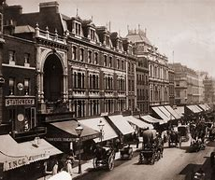
Introduction – Victorians
I am going to talk to you about some of the strangest things about how people lived in the Victorian times between 1837 and 1901.

Slide 3
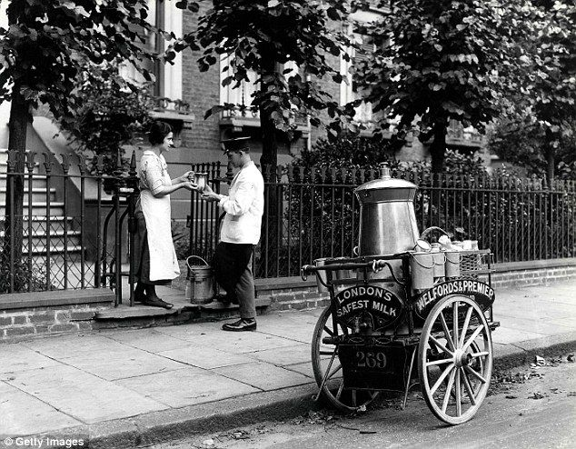
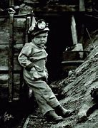
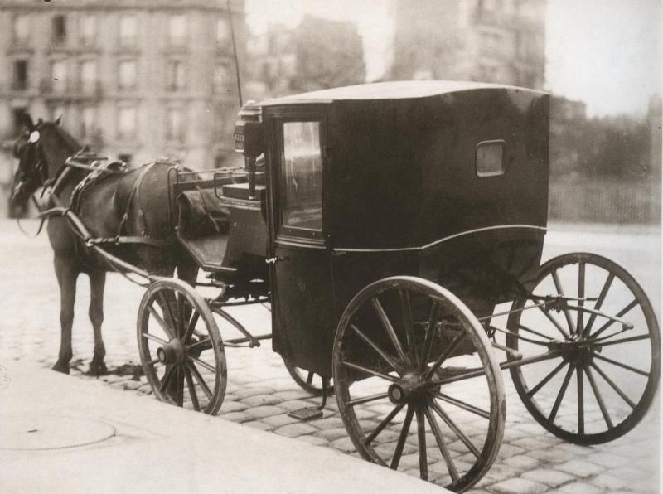
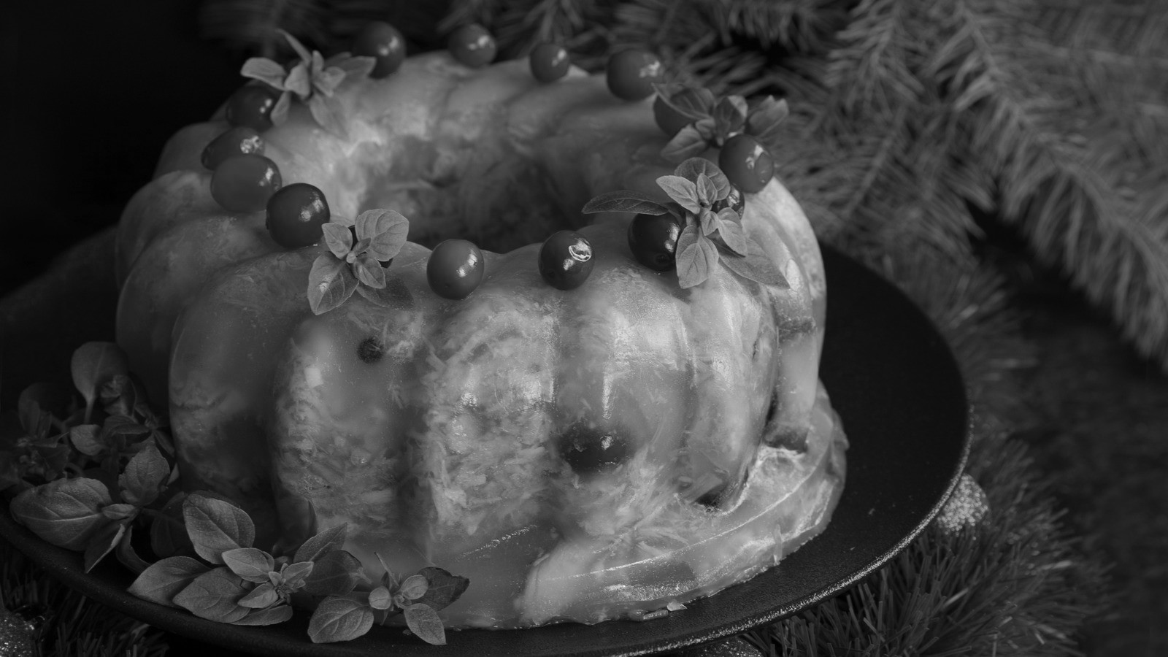
Some of the strange things…
milk
jobs
Transport​
Food
Milk was delivered 3 times a day. It had to be delivered fresh as there were no fridges
Children were sent down the mine to crawl into small tunnels. It was very dangerous!
Rich people had horse and carriages; poor people had to walk everywhere
A lot of food was covered in jelly to keep it fresh. Yuk!

Slide 4
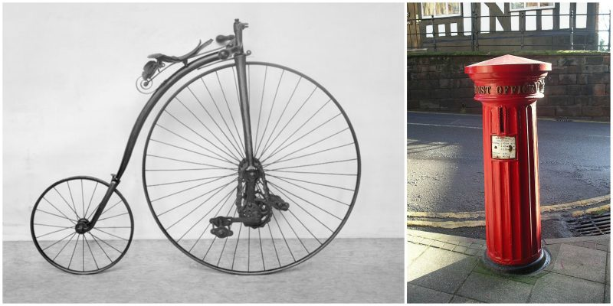
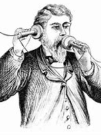
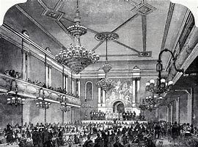
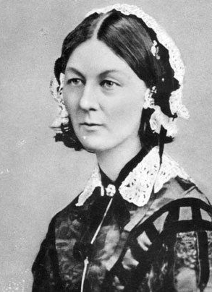
More strange things…
Bicycles
Telephone
No TV​
Hospitals
This was the first bicycle invented; it looks a little funny!
This was the first telephone invented; you had to put a piece to your ear and mouth!
People went to music halls for entertainment.
Hospitals were dirty! This is Florence Nightingale. She helped improve hospitals to make them clean and safe.

Slide 5
Thank You

