Slide 1
WHAT IF THE ANIMALS AROUND THE WORLD HAD A VOICE? WHAT WOULD THEY SAY?

Slide 2
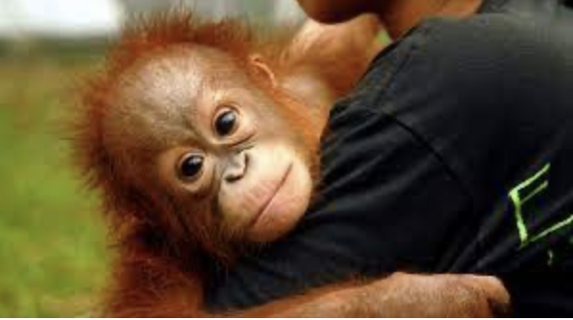
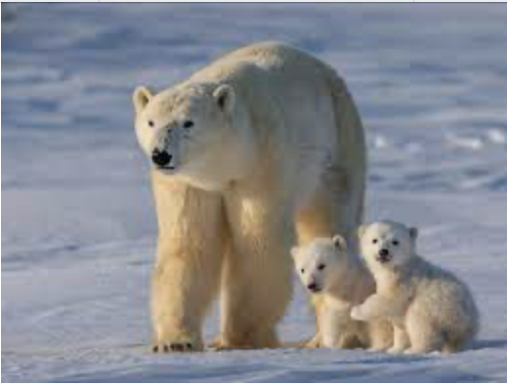
OUSTOP CHOPING DOWN R TREES!
STOP MELTING OUR ICE CAPS

Slide 3
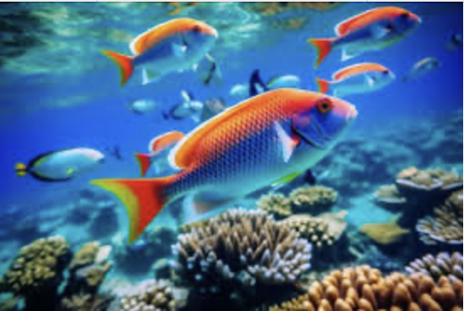
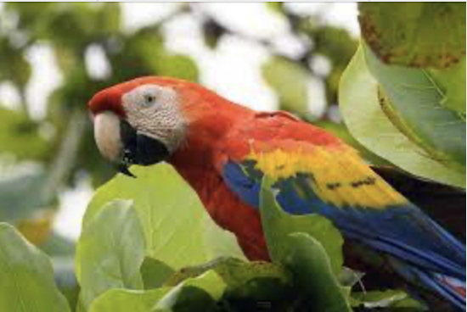
STOP POLLUTING THE OCEAN
STOP POLLUTING THE ATMOSPHERE

Slide 4
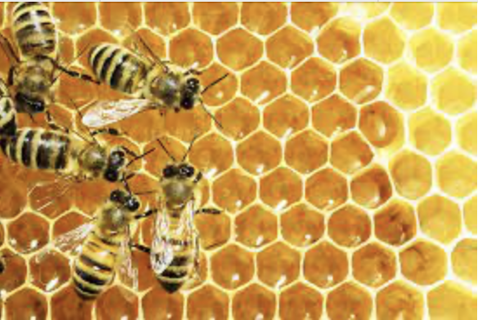
STOP USING PESTICIDES!

