Slide 1
By Dolores Witts
P4C
If animals had a voice what would they say?

Slide 2
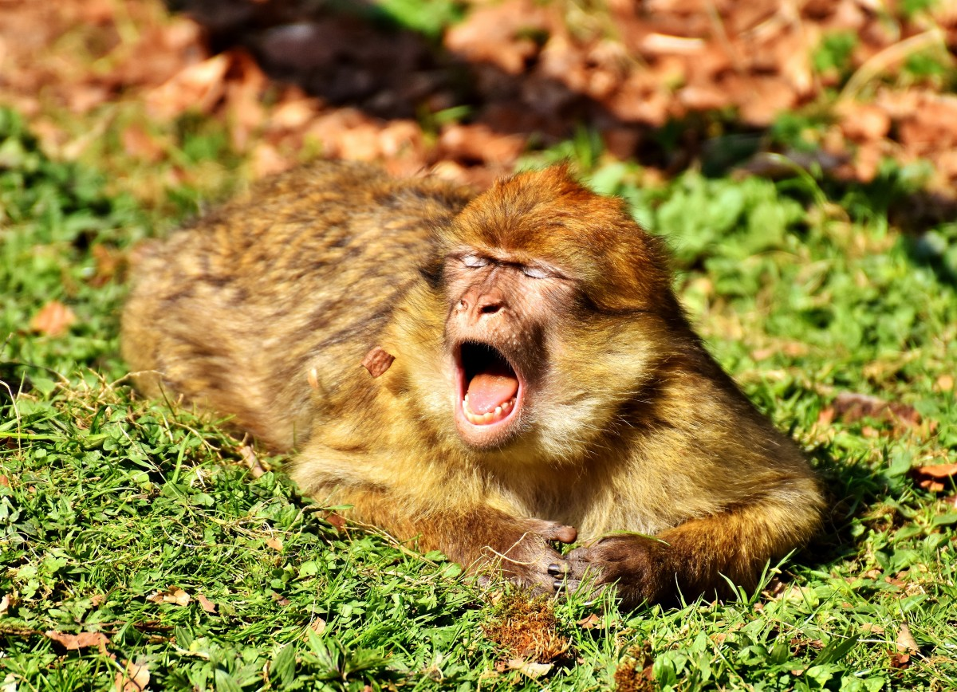
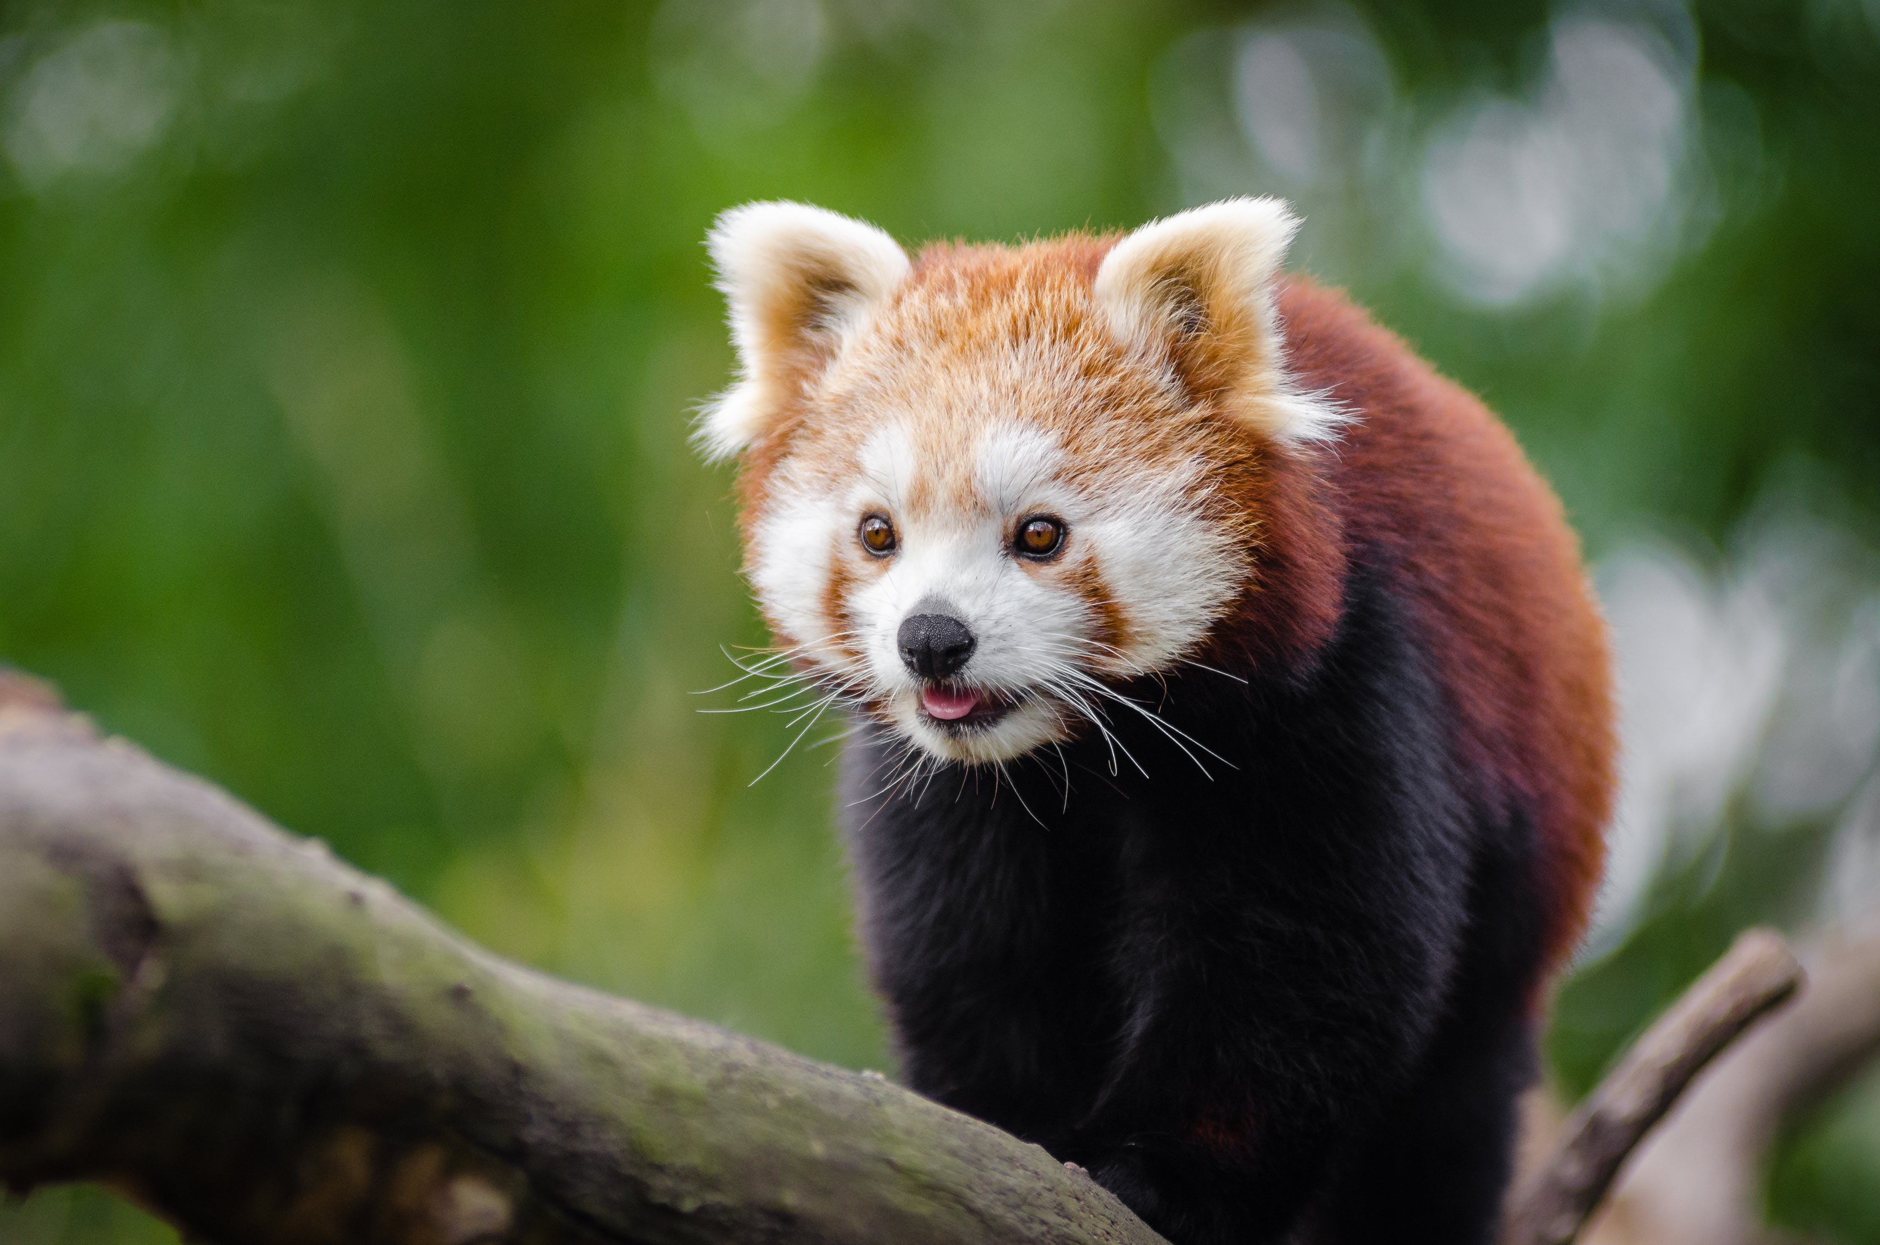
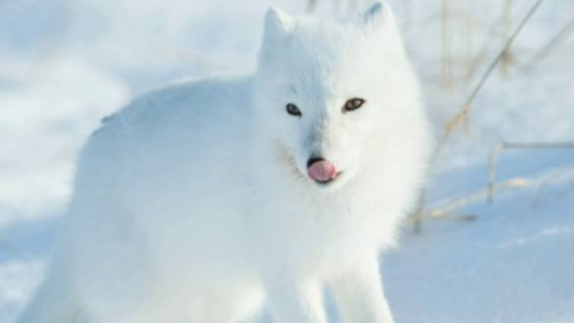
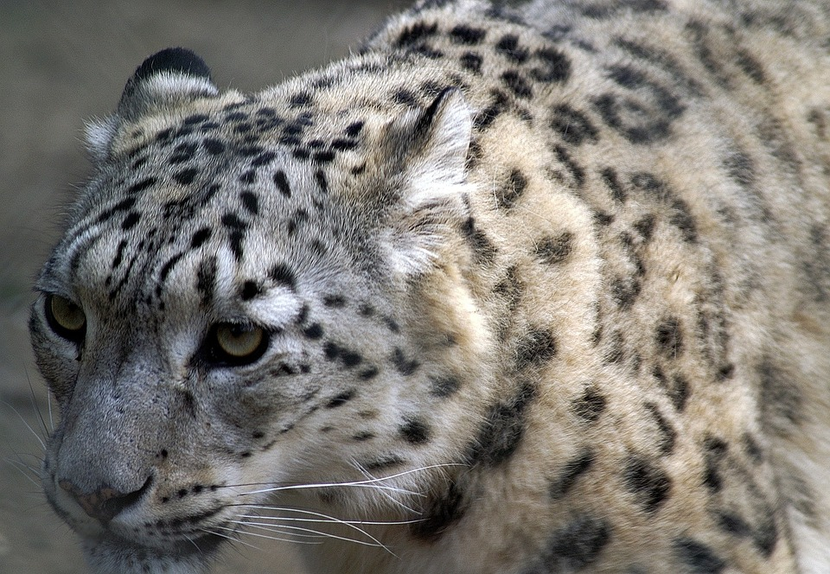
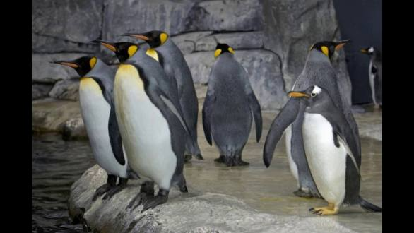
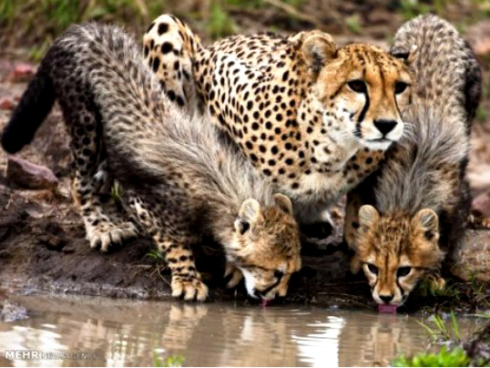
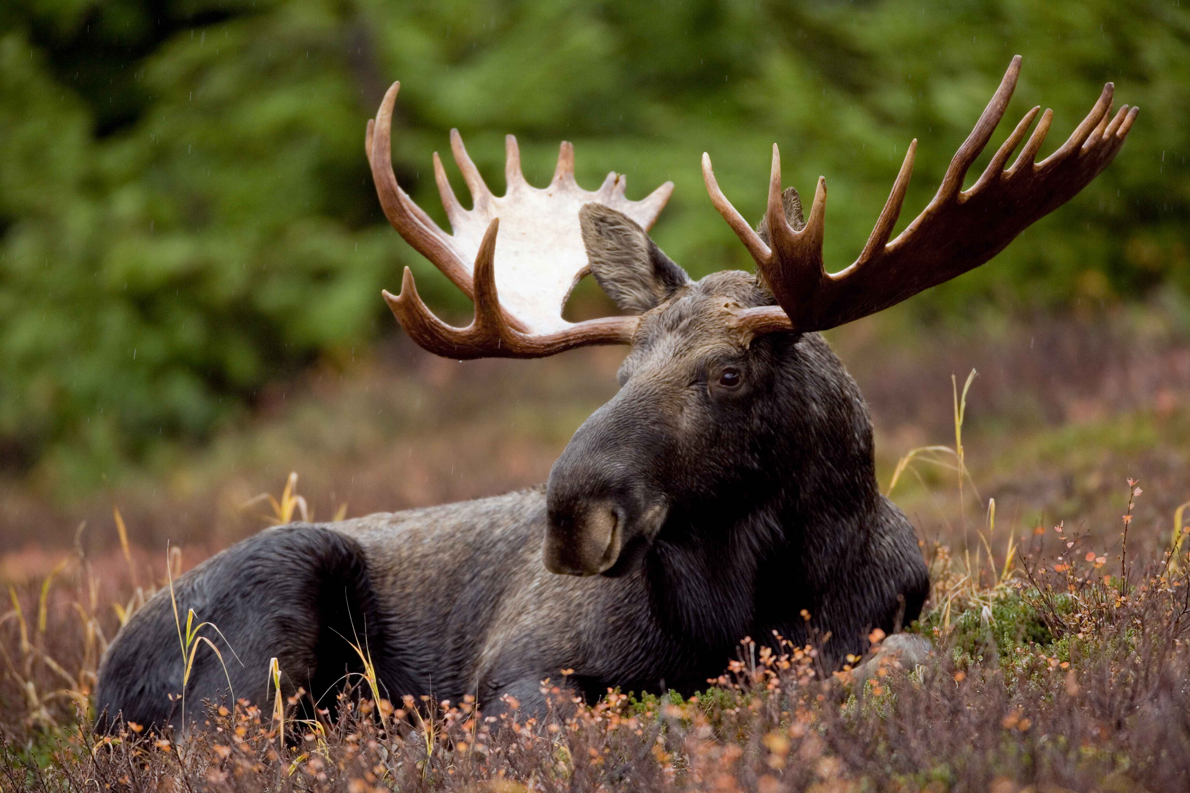
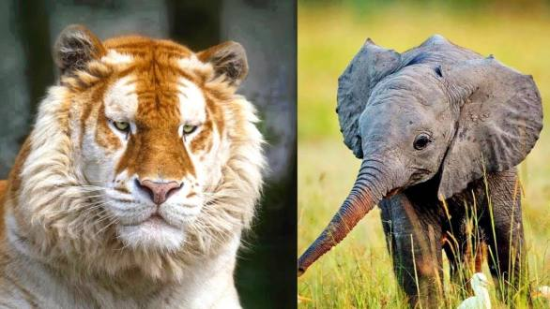
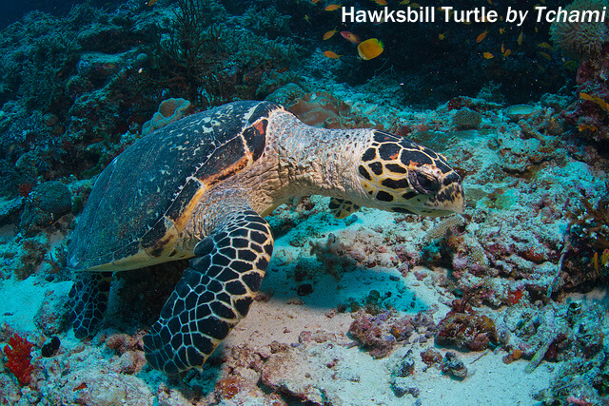
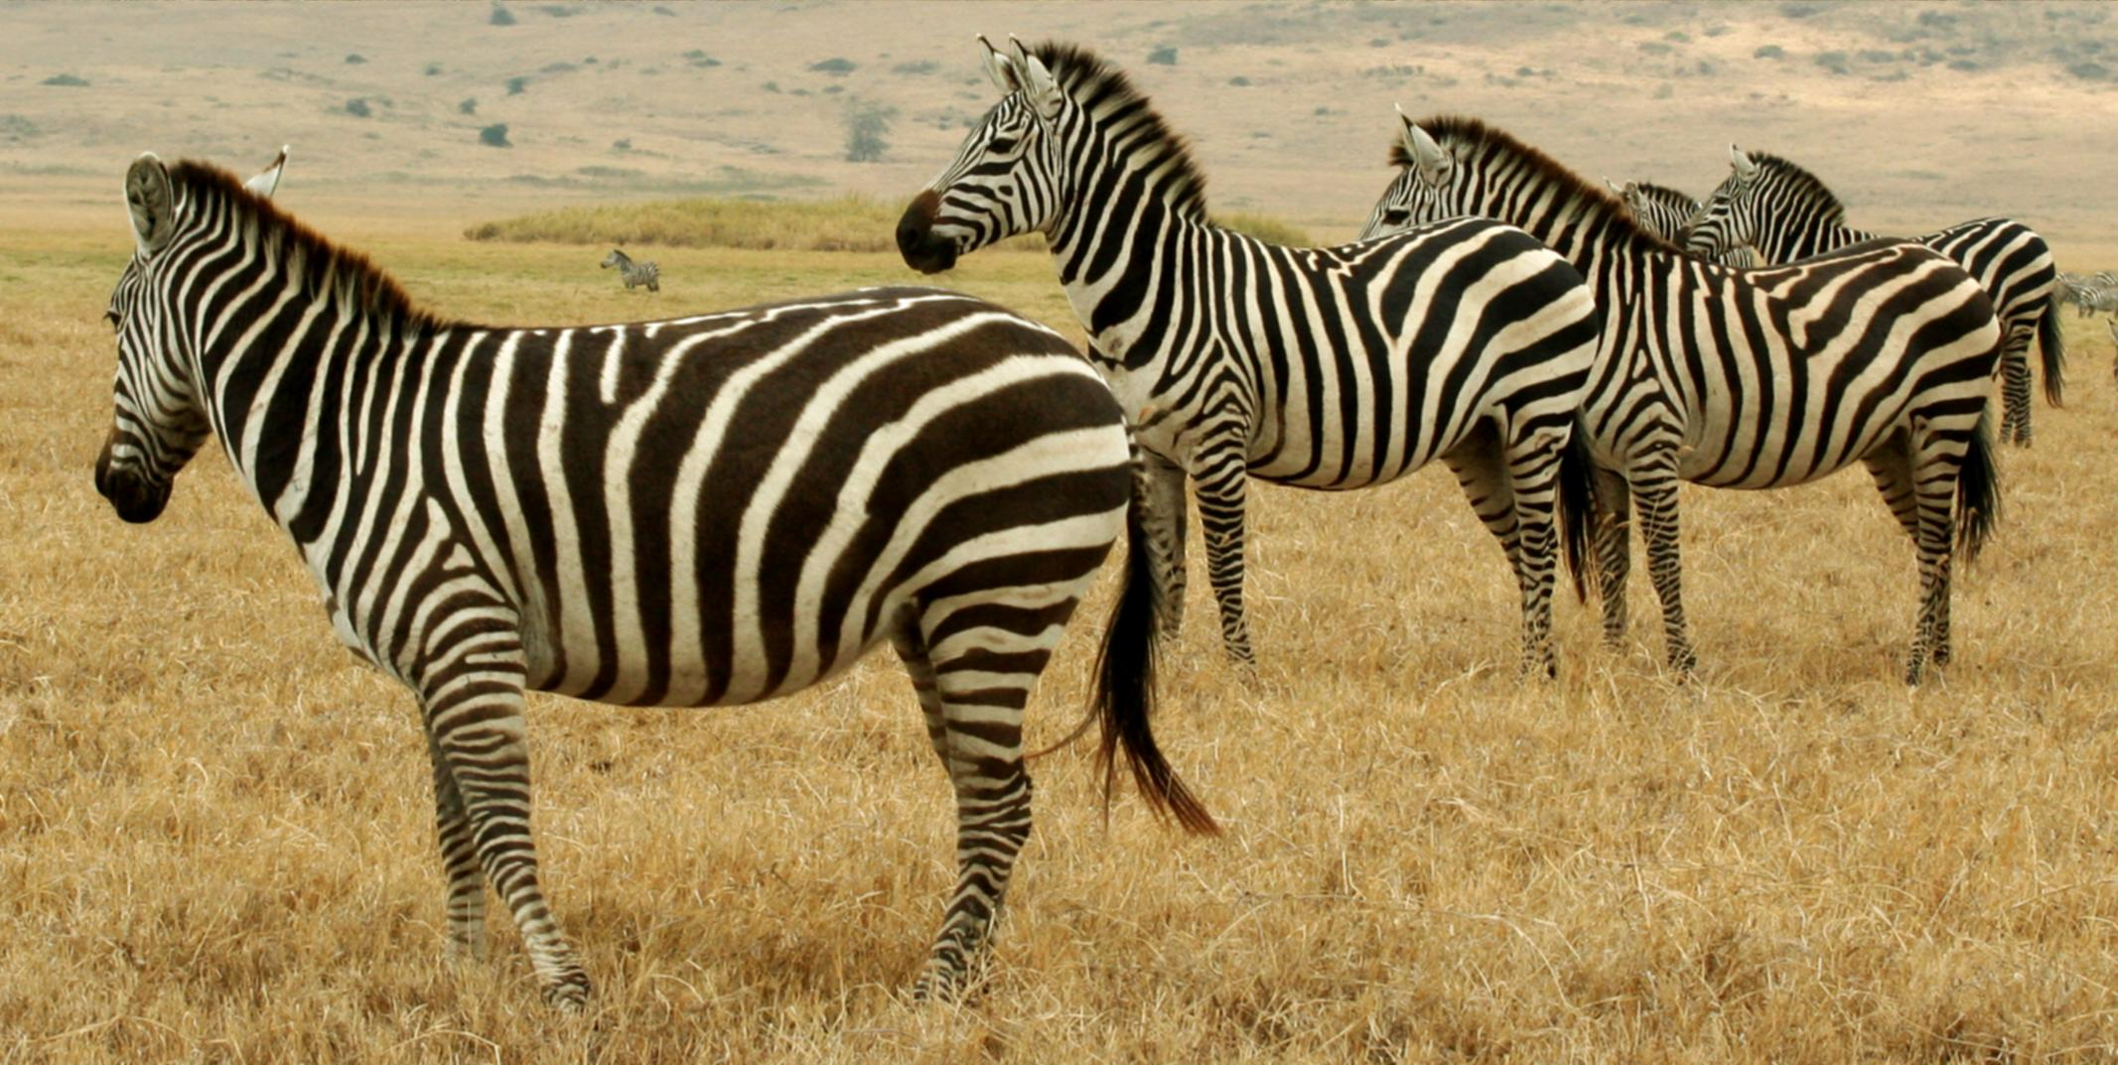
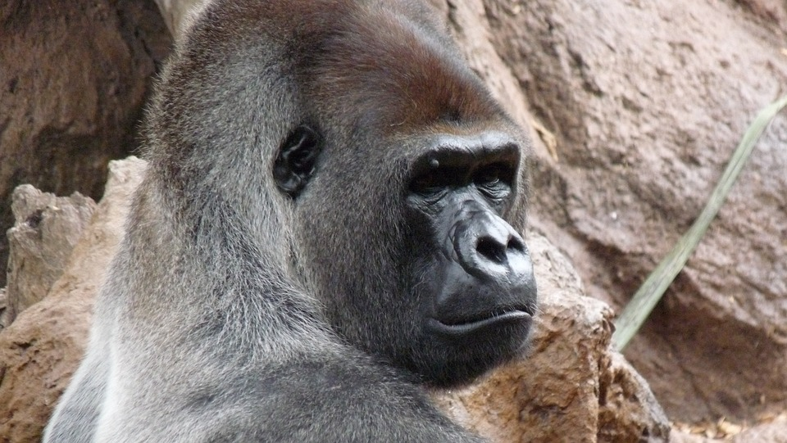
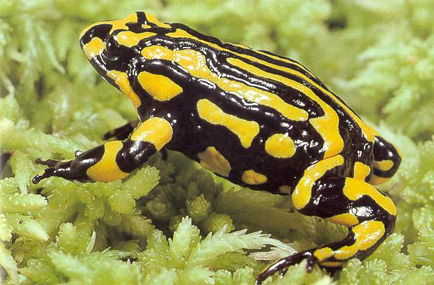
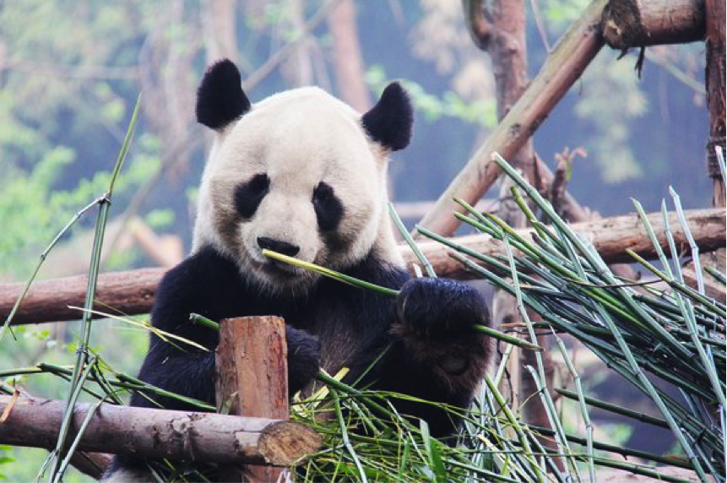
Arctic Fox , gees golden langur, Orangutans, Red Pandas, penguins, leopards, moose's elephants , tigers, turtles, zebras, gorillas pandas and frogs. All of these animals are Endangered, and so many more.
Animal Names that are endangered

Slide 3
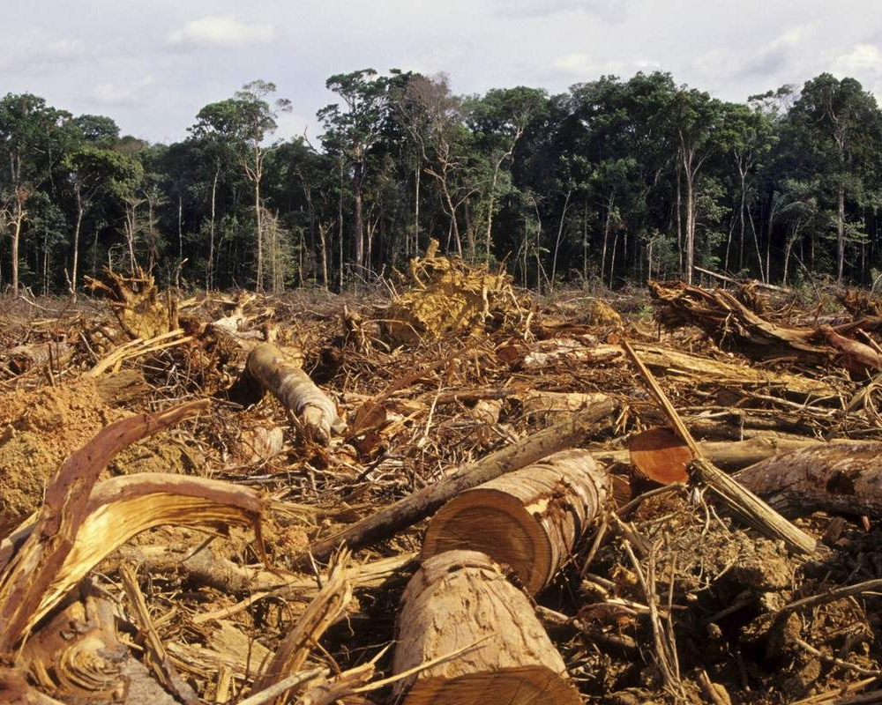
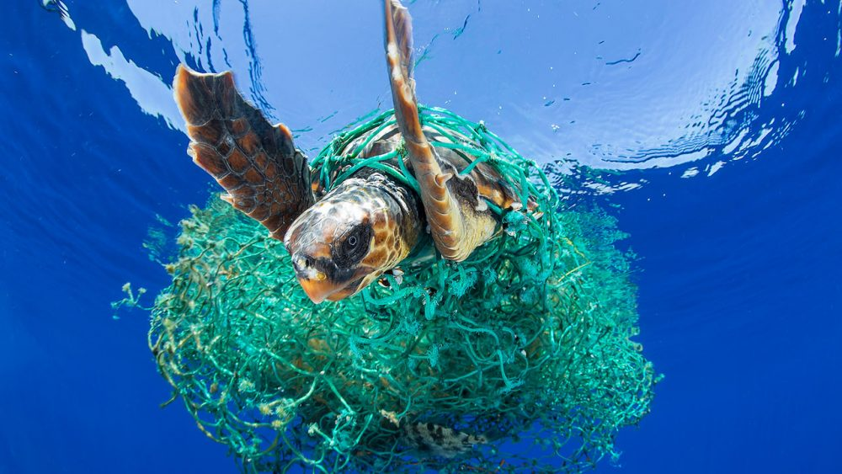
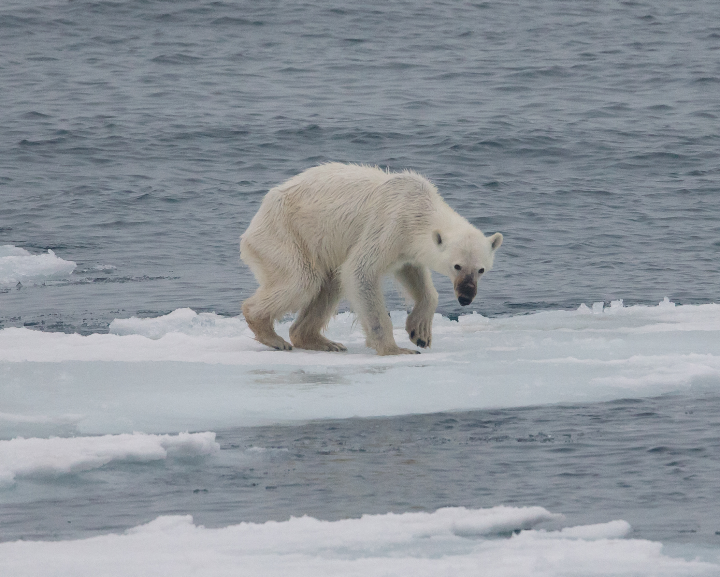
Introduction
Animals and biomes are getting destroyed because of humans. In this PowerPoint you will hear about polar deserts, under the sea and the rainforests.
This Photo by Unknown author is licensed under CC BY-SA.
This Photo by Unknown author is licensed under CC BY-NC.
This Photo by Unknown author is licensed under CC BY-SA.

Slide 4
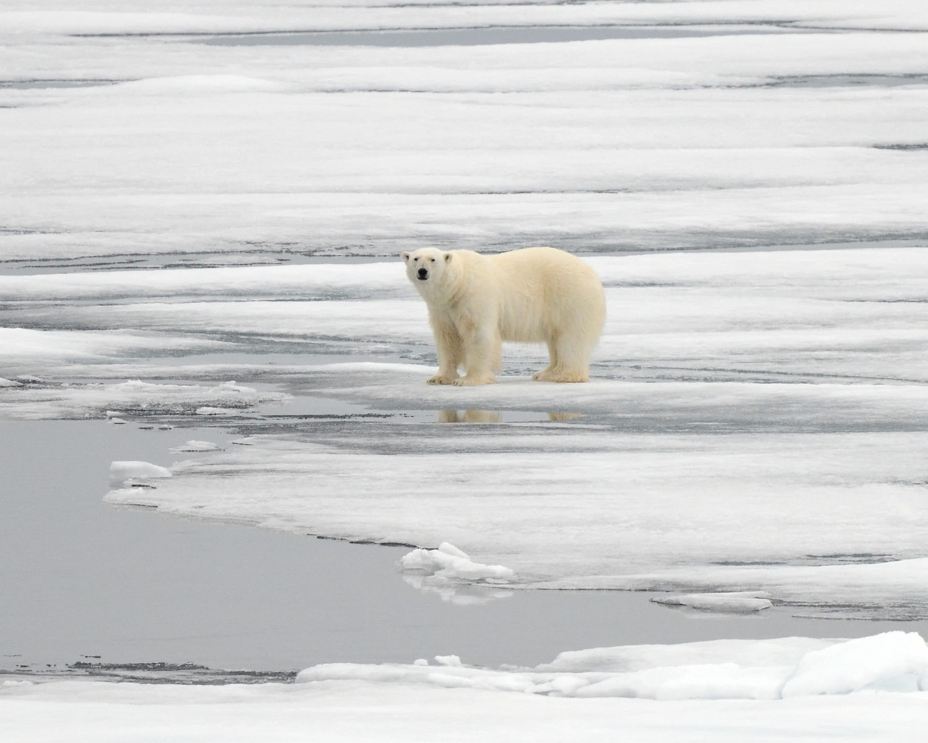
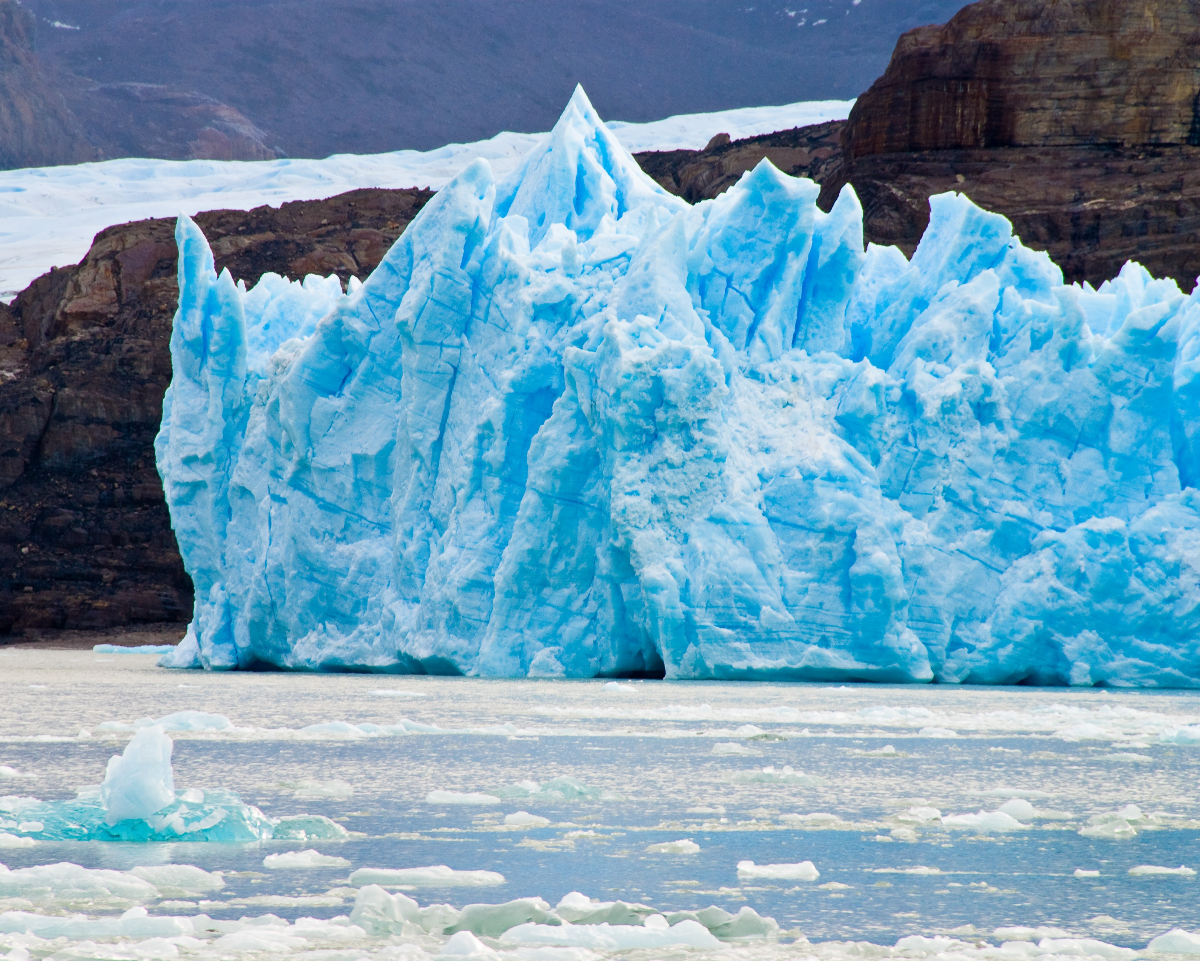
Polar deserts
Polar bears are endangered because of humans. The planet is becoming hotter so icecaps are melting!
Polar bears would say you are melting my home!!!! Please reduce your carbon footprint.
This Photo by Unknown author is licensed under CC BY-SA.
This Photo by Unknown author is licensed under CC BY-SA.

Slide 5
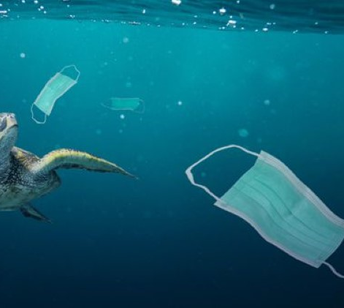
Under The Sea
Under the sea is endangered because of all of us putting rubbish in the ocean which is polluting the seas and endangering the sea life.
The animals will say please stop littering my home!!!!!!! And eating us!!!!!!!!
This Photo by Unknown author is licensed under CC BY-NC.
This Photo by Unknown author is licensed under CC BY-NC-ND.

Slide 6
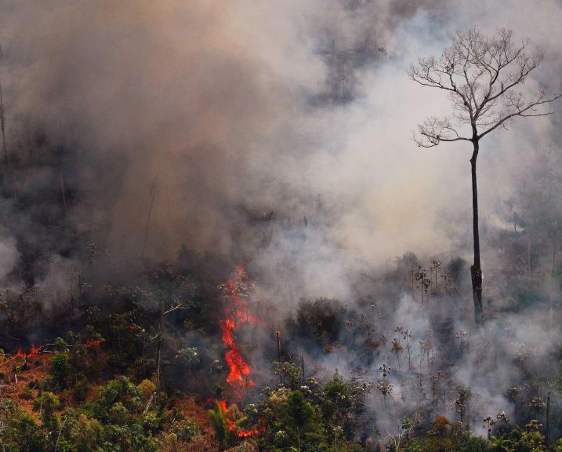
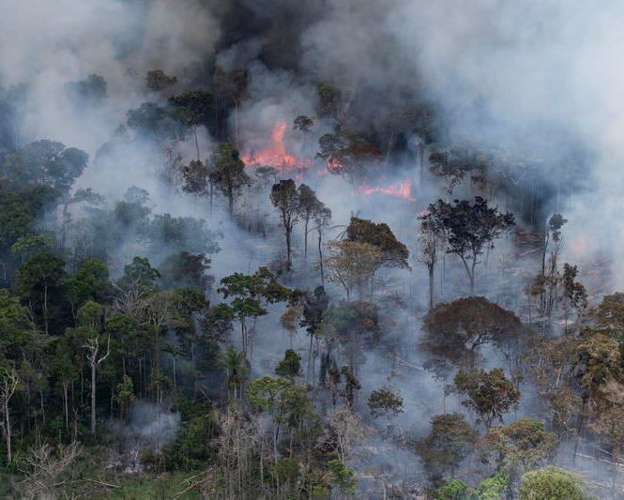
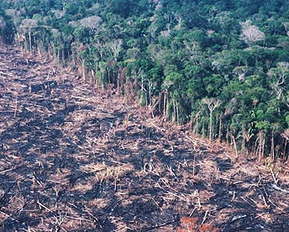
The Rainforest
Rainforests are getting bulldozed. 200, 000 acres of a rainforest is destroyed every day for lots of different things like palm oil, electricity and the cattle industry.
The animals would say is stop cutting down my home and killing my family. So that you can have shampoo, coffee, and makeup.
This Photo by Unknown author is licensed under CC BY-ND.
This Photo by Unknown author is licensed under CC BY.
This Photo by Unknown author is licensed under CC BY-ND.

Slide 7
THE END
I hope you enjoyed my PowerPoint.
BY DOLORES WITTS

