Slide 1
WHAT WOULD A PERFECT WORLD LOOK LIKE
By Deyan P

Slide 2
WAR
A perfect world would have no war and no conflict.
This Photo by Unknown Author is licensed under CC BY-NC-ND

Slide 3
POLITICIANS
A perfect world would let people vote for good things.
This Photo by Unknown Author is licensed under CC BY

Slide 4
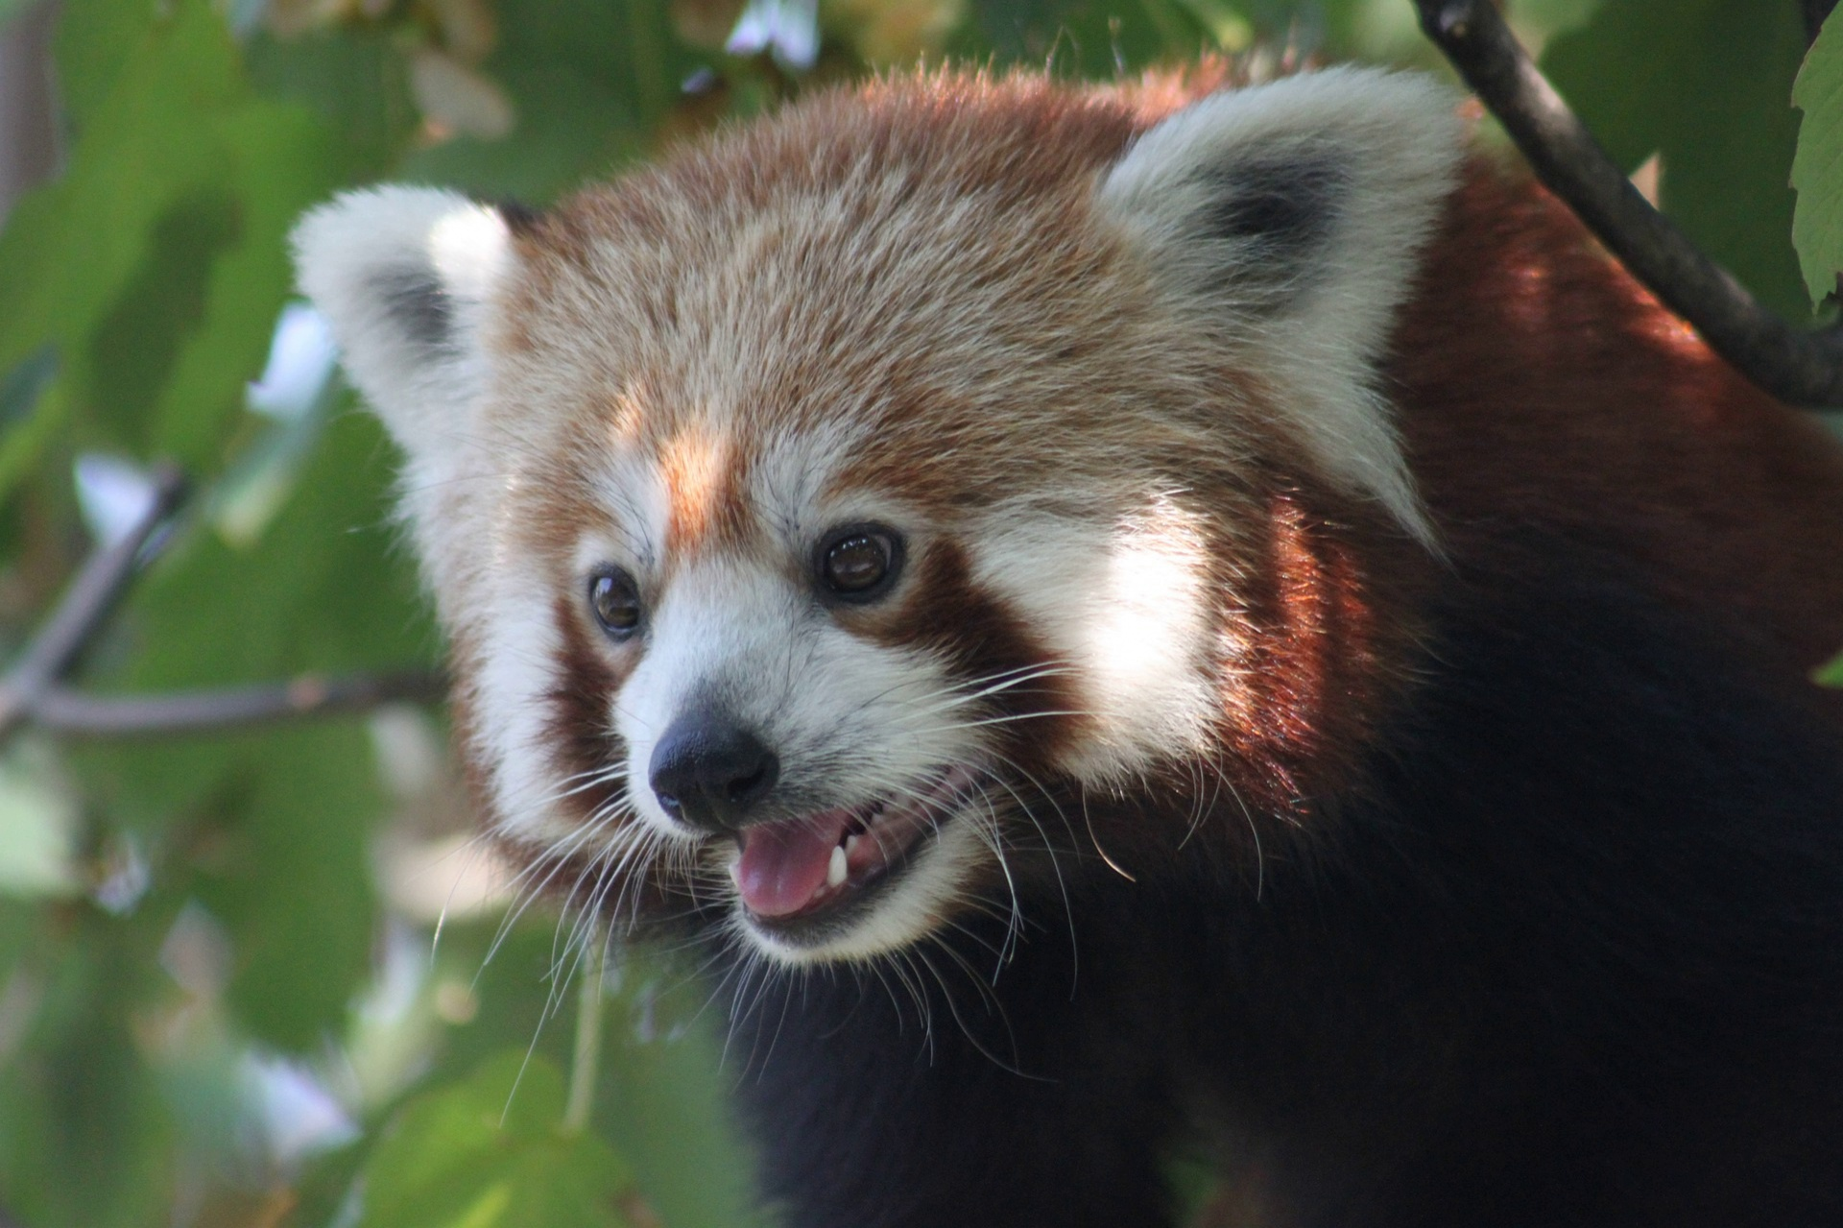
ANIMALS
A perfect world would have no animal cruelty and no poaching.

Slide 5
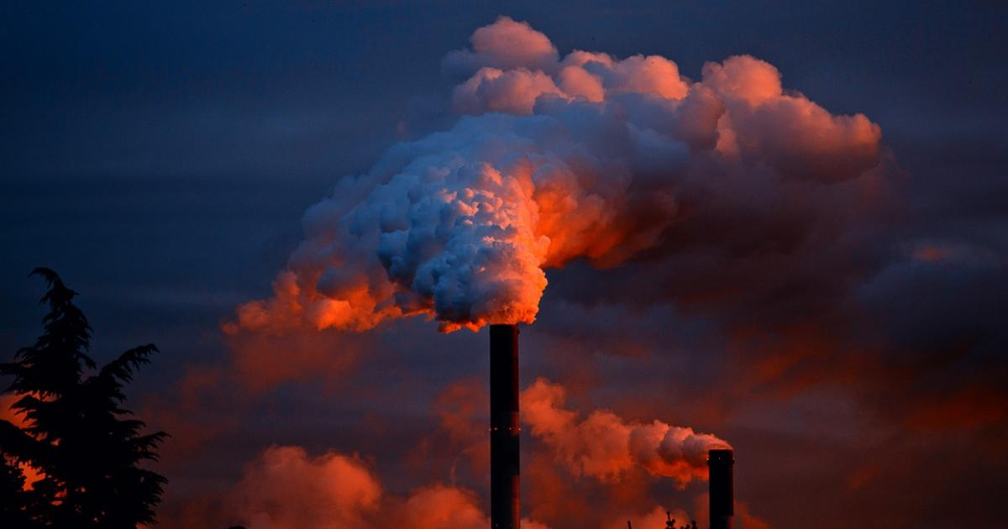
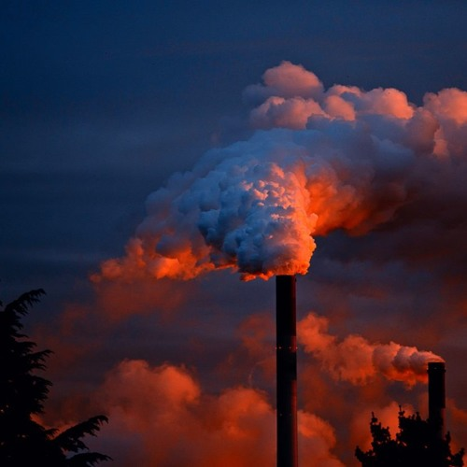
POLLUTION
A perfect world would have no one polluting.
This Photo by Unknown Author is licensed under CC BY-SA

Slide 6
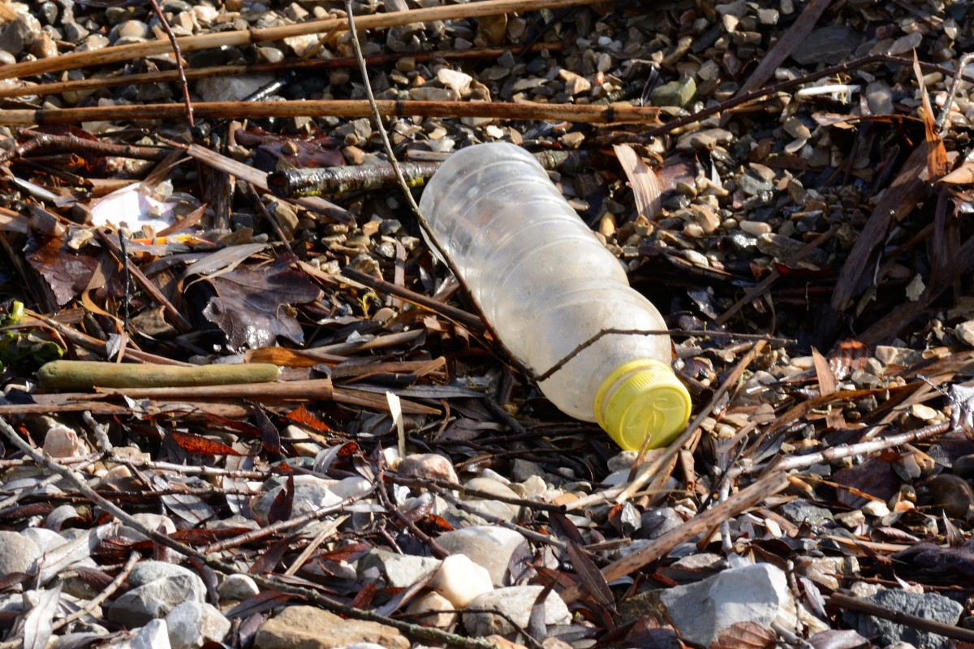
LITTER
A perfect world would have no one littering.

Slide 7
THANK YOU FOR LISTENING TO MY PRESENTATION.
I HOPE YOU ENJOYED IT.

