Slide 1
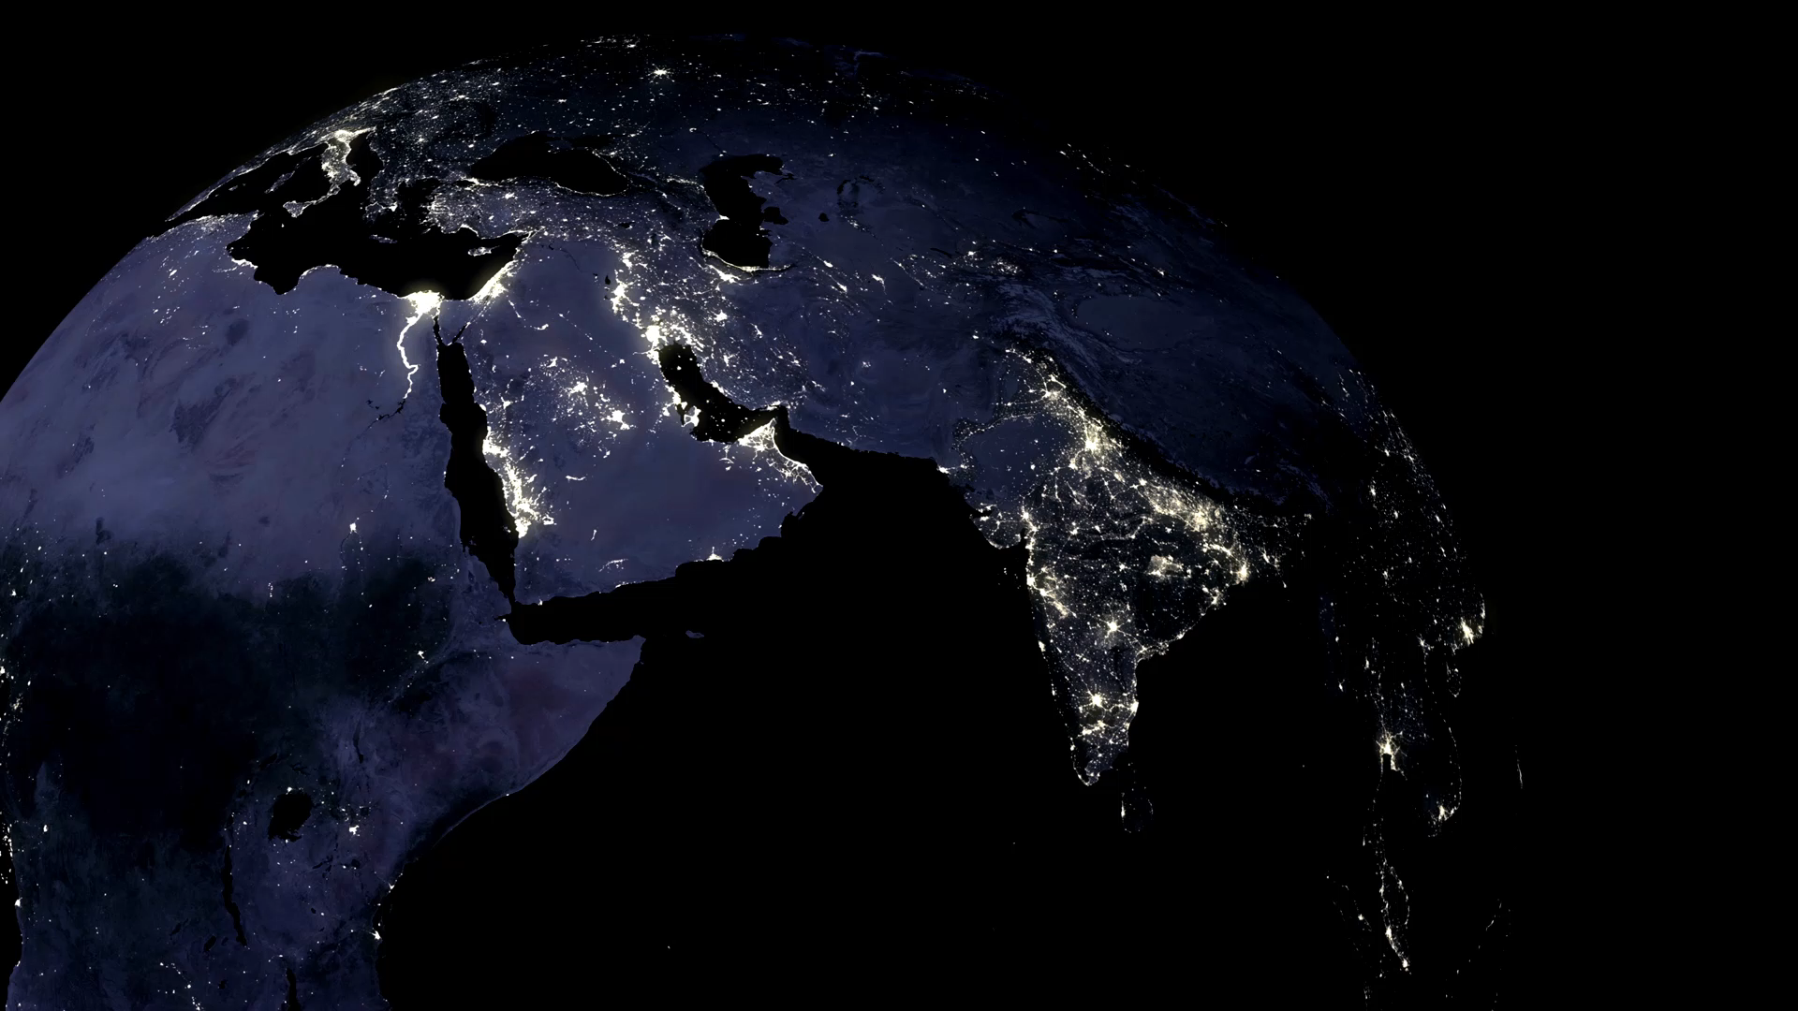
Does our planet belong to us?
By Evie

Slide 2
My Thoughts!
I am going to look at –
Christian beliefs
Science & Geography

Slide 3
Christian Beliefs
Christians believe that in the beginning God created the Universe. He made heaven and earth and according to the book of Genesis in the bible he stated “Let there be light”
This means that God is the creator of all life, the planet, the people and all the things in the Universe.
I think this means that Christians believe that as humans we are made in Gods image and as our planet belongs to God it also belongs to us all. Humans should look after our planet and all that is on it.

Slide 4
Geography & Science
Geography and Science tell us that , humans have only lived on the planet for a short time compared to how long the planet has existed . Scientists and Geographers say that the Sun and the planets formed together 4.6 billion years ago from a cloud of gas and dust called the Solar Nebula.
Science research says that humans evolved between 200,000 and 300,000 years ago.
I think this means that the planet was here long before us so we can’t say that it belongs to us .

Slide 5
My Conclusion
We can see from this that Christians believe a very different thing to people that have researched through Geography and Science. Christians believe that our planet belongs to us but Geographers and Scientists argue that our planet does not belong to us as the planet was here before us.
I think both sides have good reasons but Geographers and Scientists have a stronger arguments even though I am a Christian.

