Slide 1
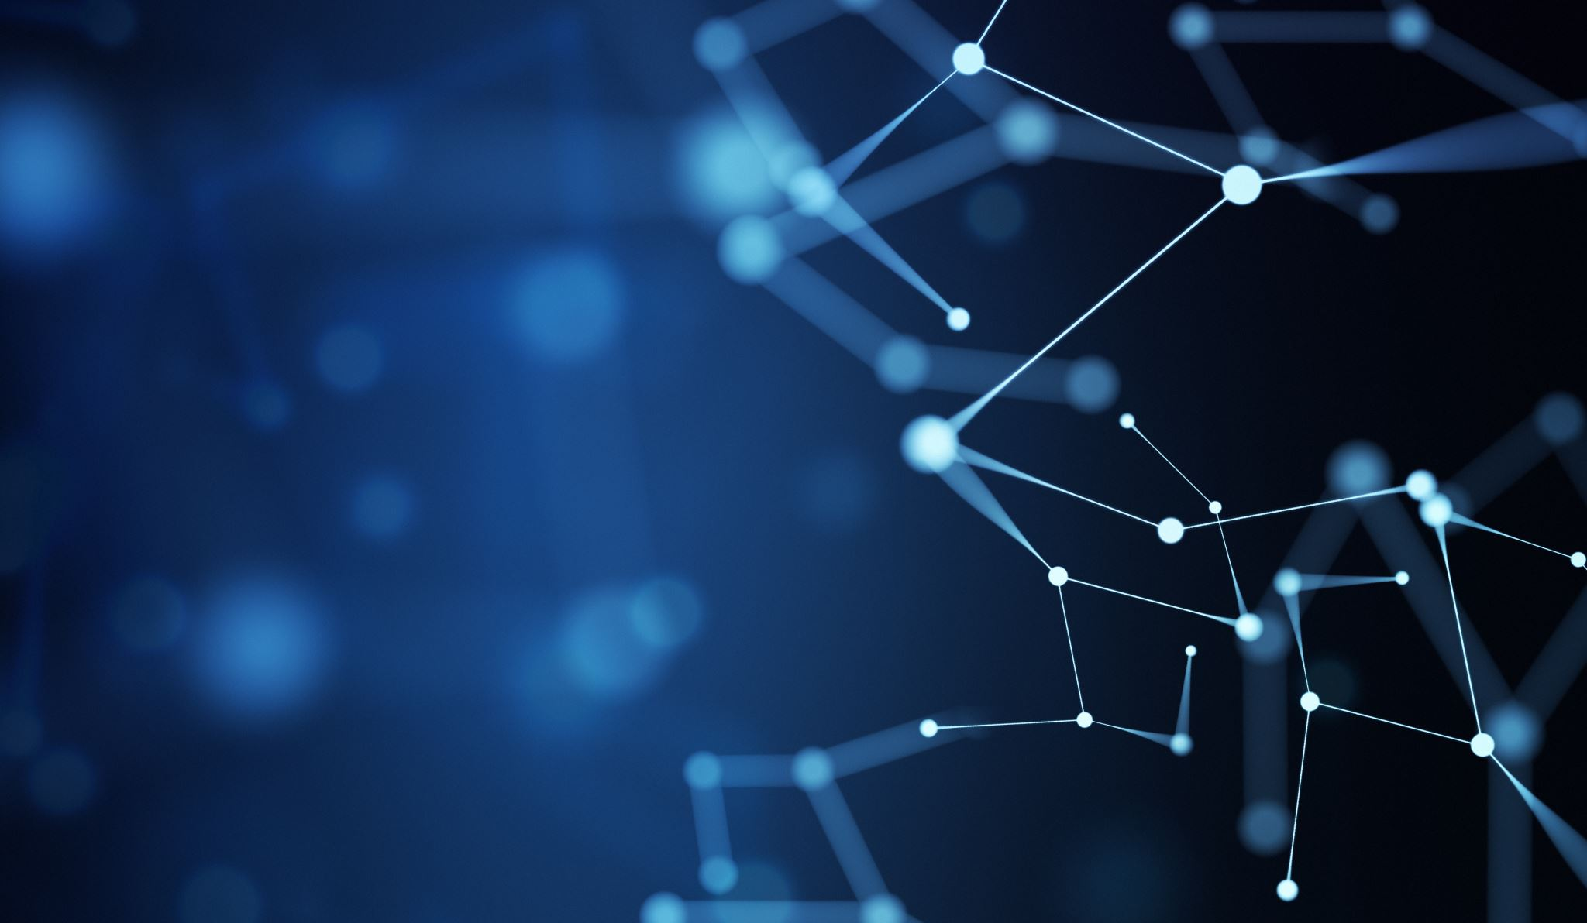
Does the planet belong to us?
By Noah

Slide 2
No

Slide 3
Humans act like everything is ours and animals are getting pushed out and losing their natural habitats.

Slide 4
Bears are losing their habitats and having to go into towns to find food because of humans.

Slide 5
More animals will start to come into human areas because they no longer have a place to live or food.

Slide 6
Some humans hunt animals which makes them extinct which is not good for the planet.

Slide 7
The planet belongs to all of us, but humans are stealing land and animals can’t defend themselves.

Slide 8
Deforestation is bad for primates. They should be able to have more space in the wild.

Slide 9
There should be special police who arrest people who hunt and kill animals.

Slide 10
People who buy things like rhino horns should be arrested and sent to prison.

Slide 11
We shouldn’t drop as much litter. Every village and town should have a team who pick up rubbish.

Slide 12
Humans need to stop polluting.
There should be laws against polluting.

Slide 13
Electric cars are equally as bad as petrol and diesel because they have to dig up rainforests for the batteries.

