Slide 1
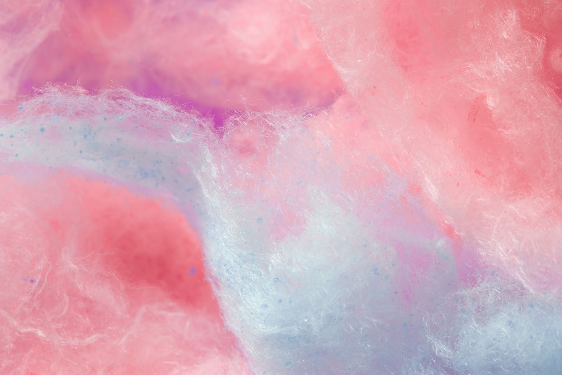
What would a perfect world be like

Slide 2
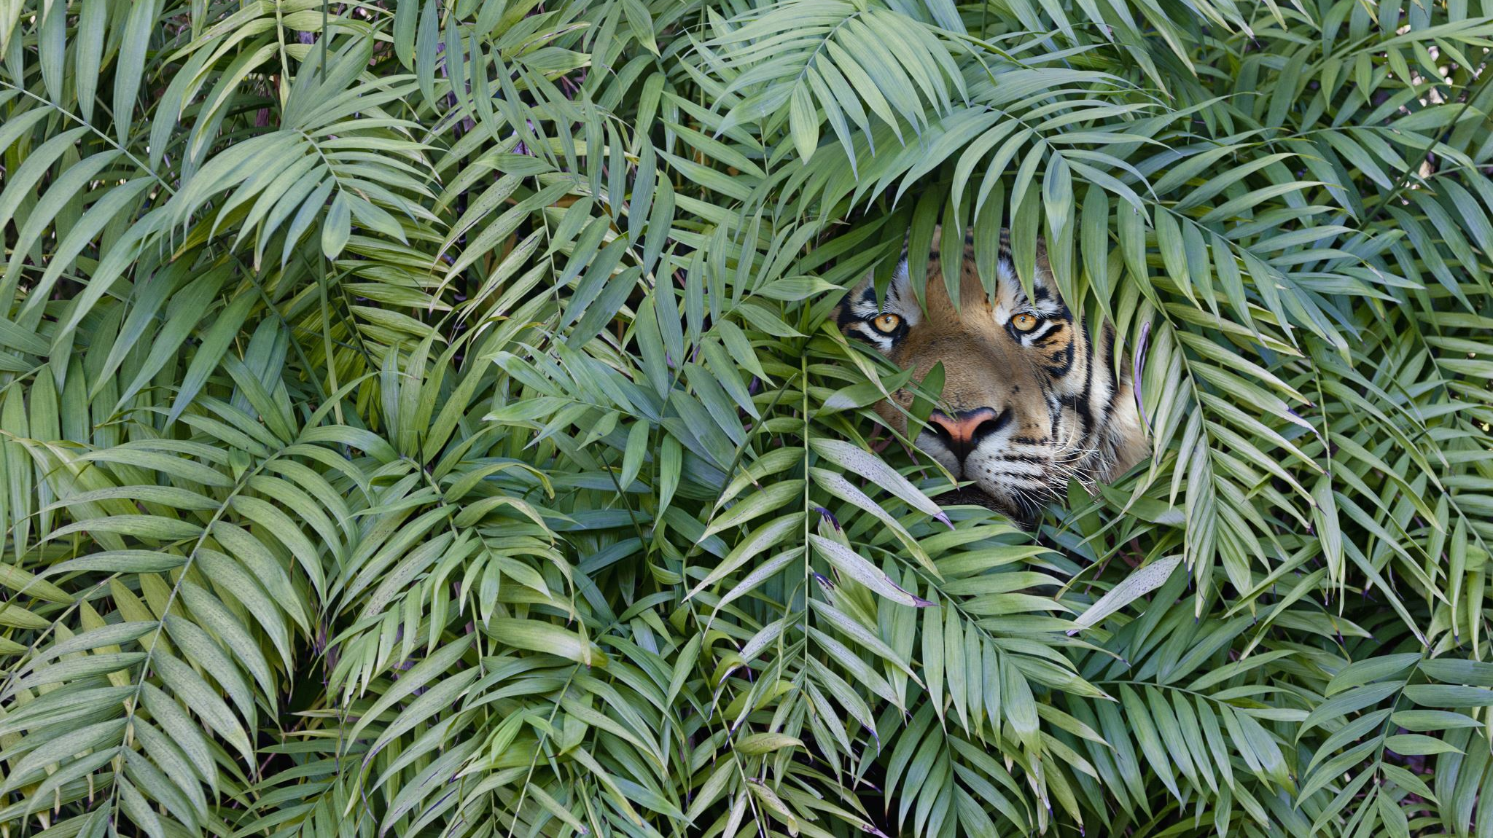
You can help me by

Slide 3
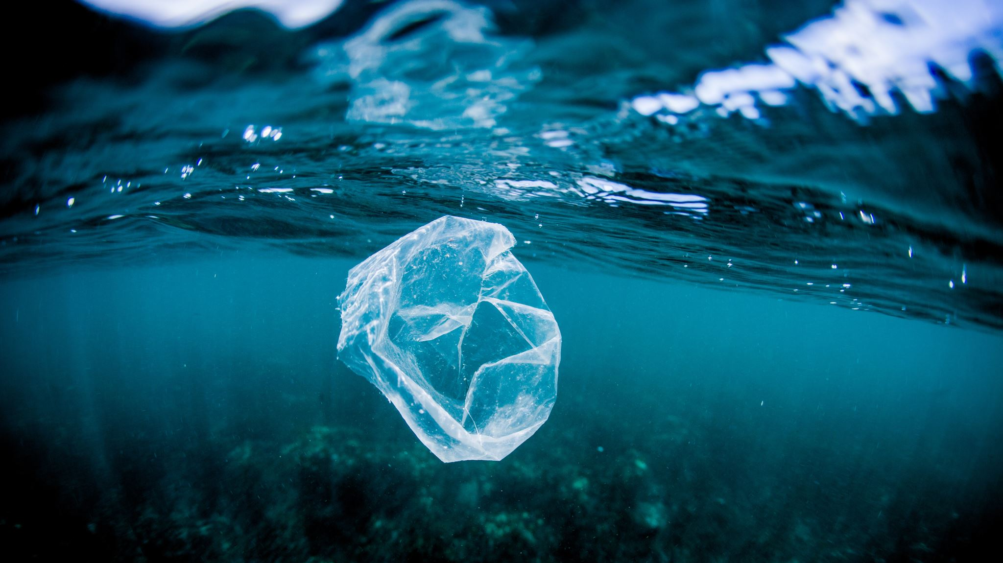
Not putting rubbish in the sea

Slide 4
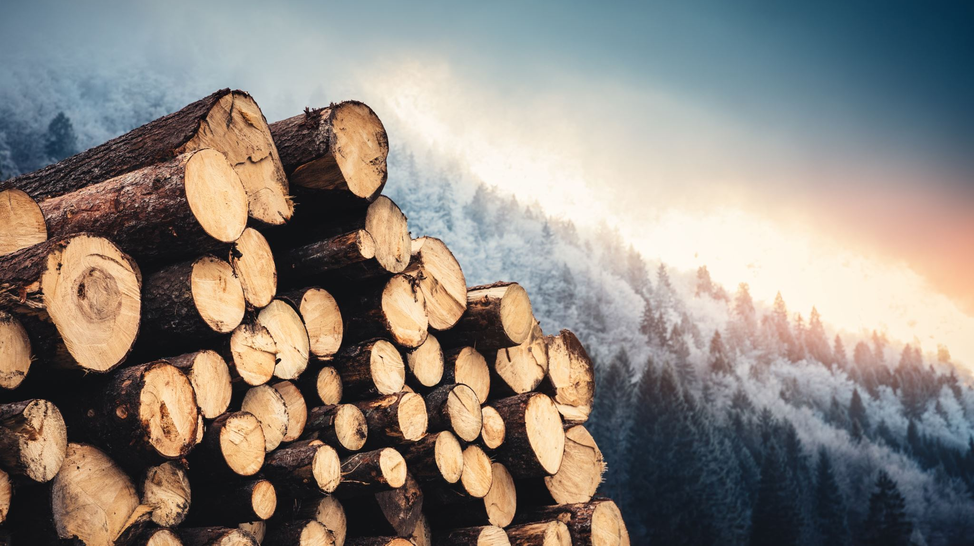
Not cutting down trees

Slide 5
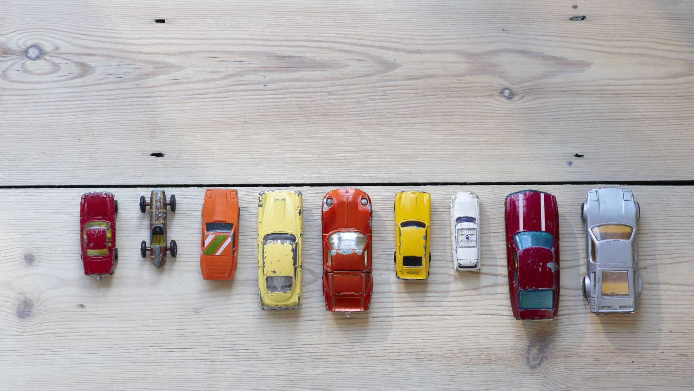
Not using cars so much

Slide 6
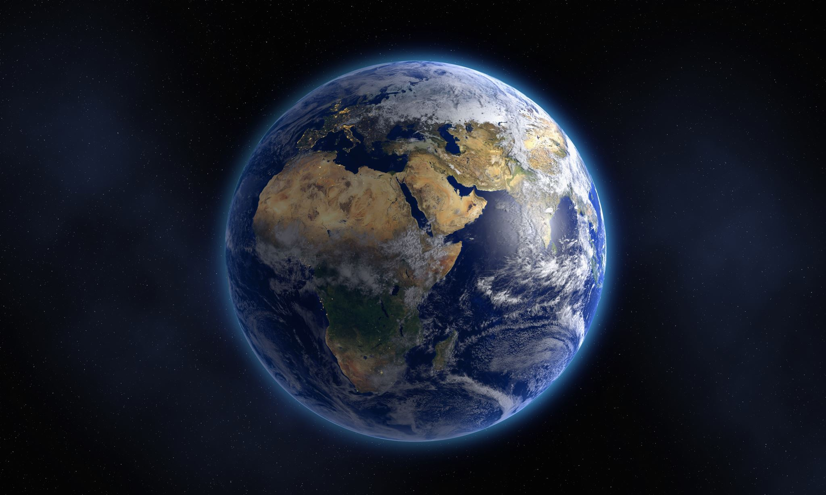
Help save the earth our planet is dying

Slide 7
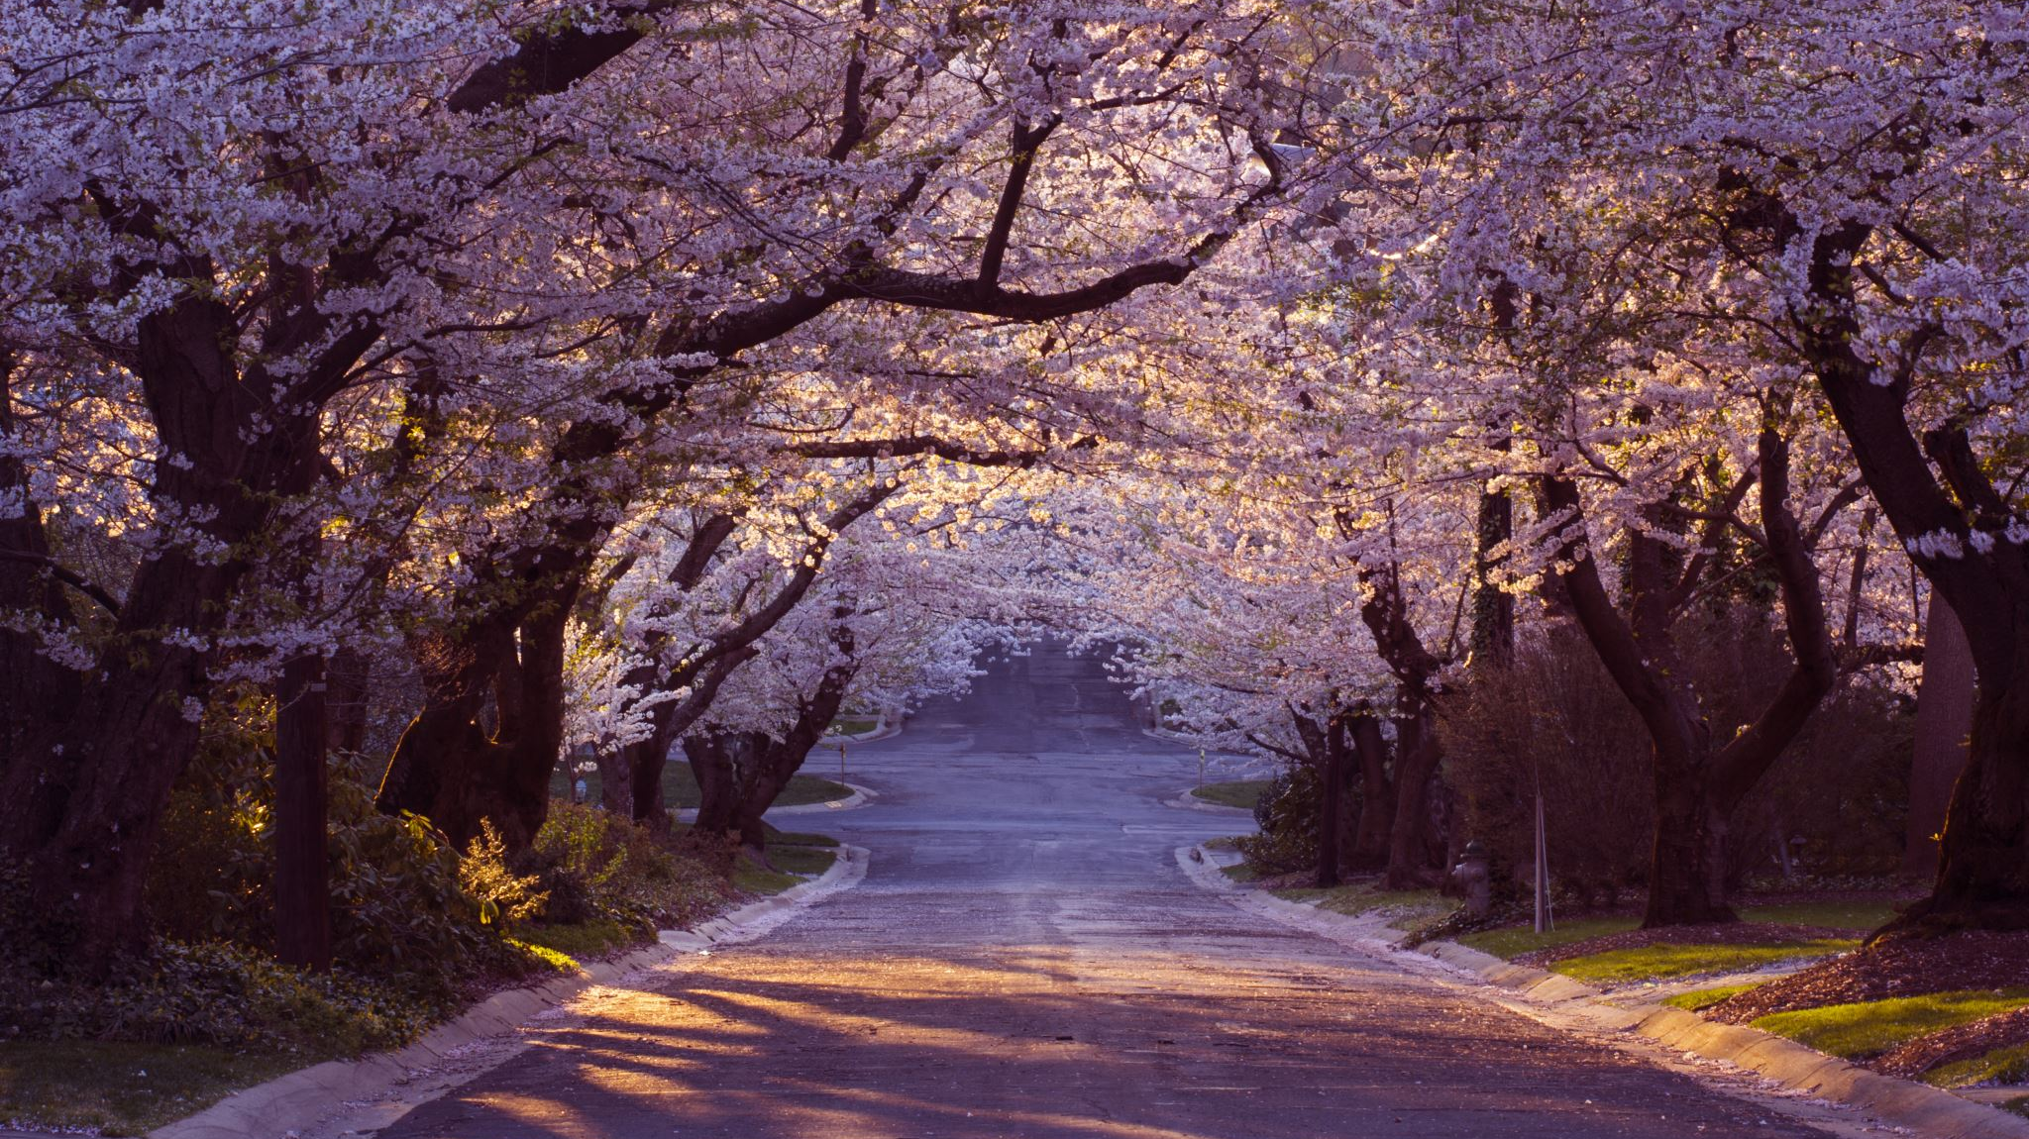
By Megan Lloyd

