Slide 1



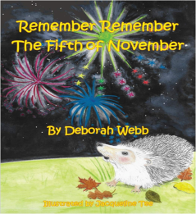
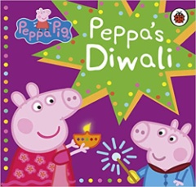
People & Communities
My Family
(Children will begin to make sense of their own life story and Family history)
People who help us – Firefighters
Farmers
Vets
( Children will show interest in different occupations)
Communication, Language & Literacy
Elmer
Mum and Dad make Me Laugh
Dogger
My Friend Bear
Peppa Pig’s Diwali
Remember Remember the 5th of November
10 Red Apples
( Children will listen to stories and understand what is happening with the help of pictures)
RE
(Children will learn about school values and Christian celebrations)
School Values
Harvest
Remembrance
Christmas
Maths
Colours
Matching
Sorting
Number 1 & 2
Patterns
(Children will colour match and sort objects according to properties
Children will talk about and identify patterns around them)
I wonder what is special?
Nursery Autumn 2023
Expressive Arts & Design
Taking on a role in play
( Children will join in with simple pretend play)
Using Shapes in a picture
Junk Modelling
(Children will use a range of materials exploring what they could make and what to use)
Singing Songs
(Children will remember and sing entire songs)
Physical Development
Listening Games
Ring Games
Movement – Squiggle While you Wiggle – Large Gross Motor Movements
Sports Explores
Socatots
(Children will show a preference for a dominant hand
The World
Autumn/Winter Time
Harvest
Bonfire Night
Diwali
( Develop positive attitudes about the differences between people)
PSED
Nursery Rules
(Children will follow rules, understanding why they are important)
Tick Box – Meeting Doodle
Doodle feels good
(Children can talk about their feelings and understand how others might be feeling.

