Slide 1

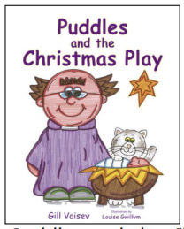

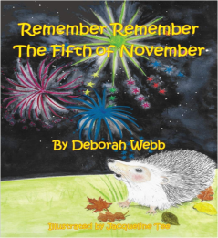

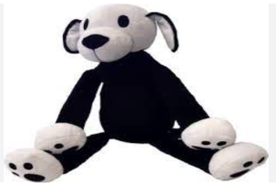
People & Communities
My Family
People who help us – Firefighters
Farmers
Vets
Communication, Language & Literacy
Elmer
Mum and Dad make Me Laugh
Dogger
My Friend Bear
Peppa Pig’s Diwali
Remember Remember the 5th of November
10 Red Apples
RE
School Values
Harvest
Remembrance
Christmas
Maths
Colours
Matching
Sorting
Number 1 & 2
Patterns
I wonder what is special?
Autumn Term
Expressive Arts & Design
Taking on a role in play
Using Shapes in a picture
Junk Modelling
Singing Songs
Physical Development
Listening Games
Ring Games
Movement – Squiggle While you Wiggle – Large Gross Motor Movements
Sports Explores
Socatots
The World
Autumn/Winter Time
Harvest
Bonfire Night
Diwal
PSED
Nursery Rules
Tick Box – Meeting Doodle
Doodle feels good
.

