Slide 1
Dueling

Slide 2
What is dueling
Duelling is a fight between two people – using weapons – usually because one person has insulted the other.

Slide 3
Who did dueling?
Duelling was made in the middle ages because it solved there arguments. Not just men did it women did it to.
Villagers did it, politicians did it, knights did it , Lords did it and ladies did it!
Everyone did it

Slide 4
What did they duel with?
Swords,
Pistols,
Axes,
Knives
clubs

Slide 5
Famous Duellers
Alexander Hamilton and Aaron Burr
Aaron Burr was the vice president of America
But Alexander and Aaron didn’t get along. They fought and Alexander got shot in the stomach and died, so the fight stopped. Aaron won.

Slide 6
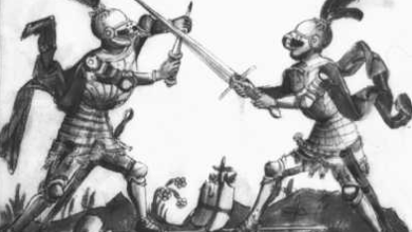
Why is it weird
I think deuling is weird because you don’t need to hurt or kill people to figure out your problems.

