Slide 1
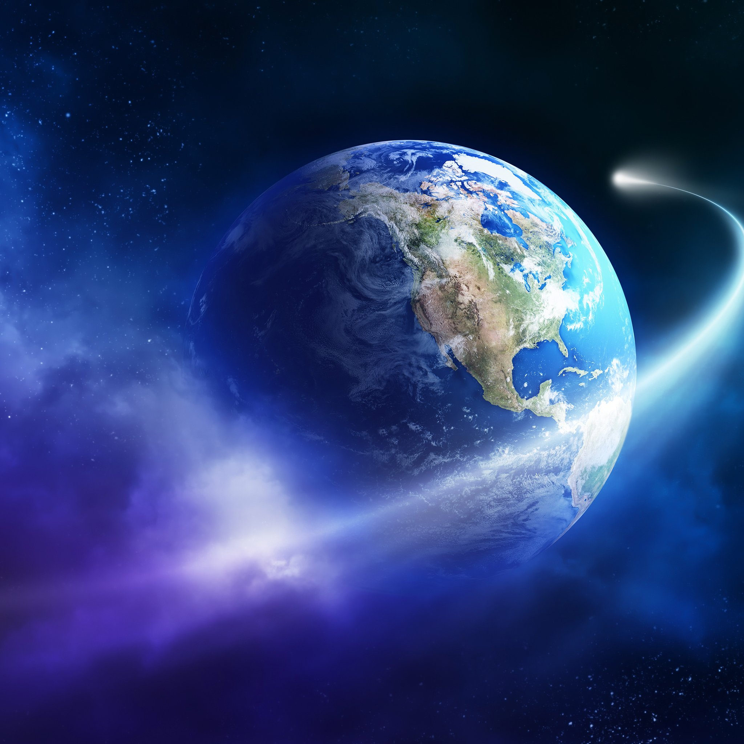
  THE PERFECT WORLD
By Freddie Wright

Slide 2
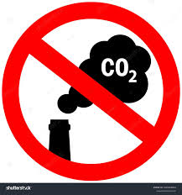
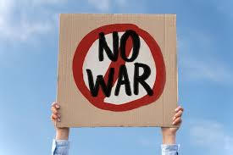

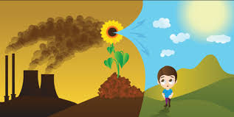
The perfect world
What would I change to make the perfect world?
No war
No harmful gasses
No pollution
No Deforestation

Slide 3
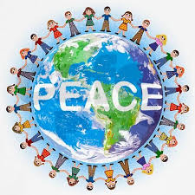
No WAr
What would happen if there was no war ?
Children and families would feel safe.
No innocent people would get hurt.
There would be world peace.

Slide 4
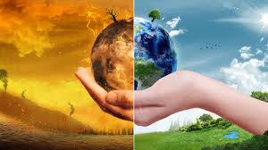
No harmful gases
What would happen if there was no harmful gases ?
There would be no climate change.
Animals wouldn’t lose their habitats.
Extreme weather is less likely to happen.

Slide 5
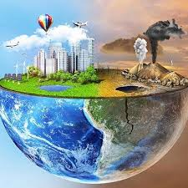
No pollution
What would happen if there was no pollution ?
The ocean would be cleaner and safer for the sea animals.
The environment would be a cleaner safer place.
Clean air

Slide 6
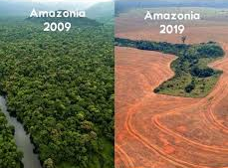
No deforestation
What would happen if there was no deforestation?
Animals wouldn’t lose their homes.
Animals are less likely to become extinct.

Slide 7
Why It would be perfect for me?
The world would be a safer, cleaner environment for me and the animals. So that makes it a perfect world to me!!!

