Slide 1
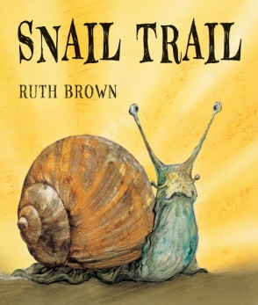
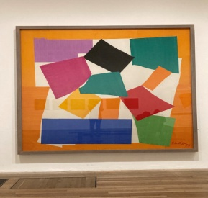
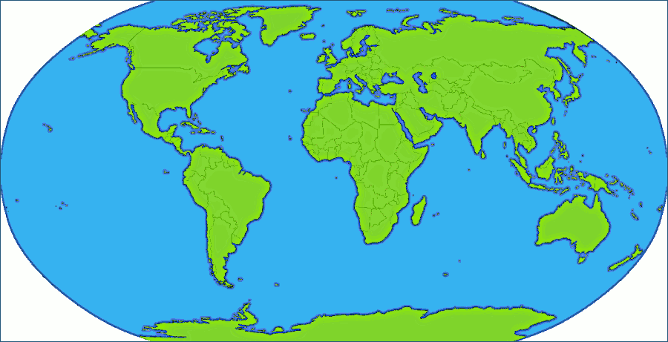
Text
Snail Trail
Incy Wincy Spider
What the Ladybird Heard
Expressive Arts & Design
Communication,
Language & Literacy
Activities
Communication,
Language & Literacy
Model Making
Painting different mini beasts
Labelling
Story Board/Paths
Retelling familiar stories
Making a list
Maths
Number Composition
1-5 Revision
Night and Day
Ordering Events
Positional Language
I Wonder What Moves?
Nursery Summer 2 2025
People & Communities
Henri Matisse
The World
RE
Exploring how things work
Exploring different countries
Investigate different forces
The clothes We Wear

