Slide 1
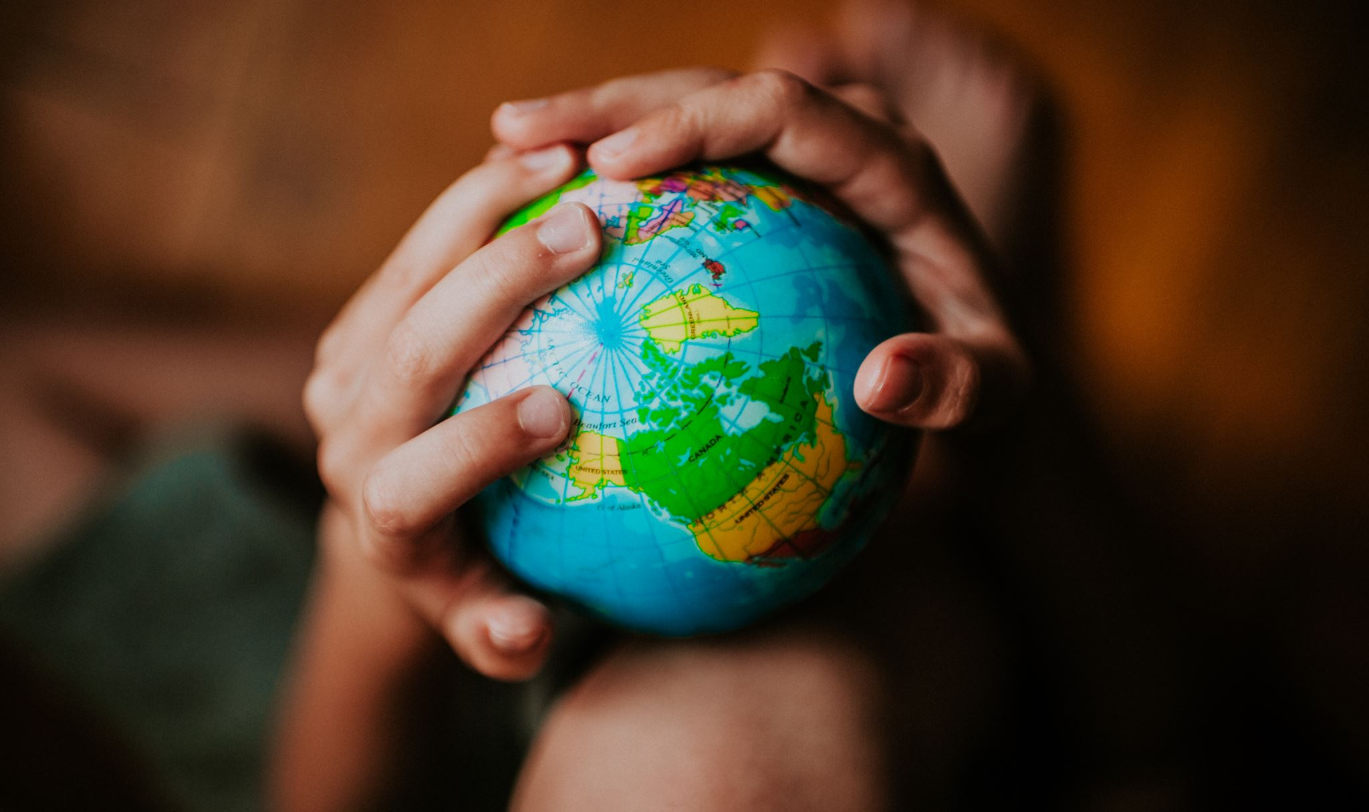
What would a perfect world be like? 🌍
By Leo Charles

Slide 2
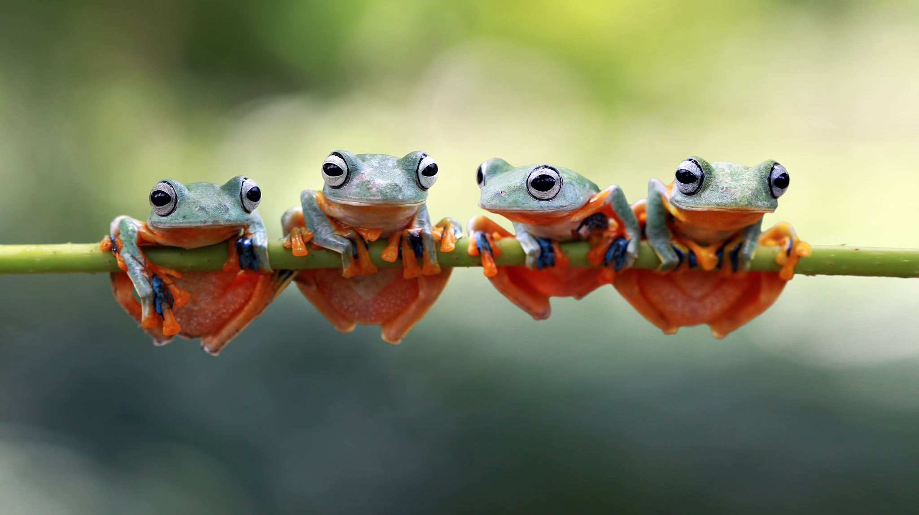
Frogs
Frogs are my favorite animal so I will want them in my world.🐸

Slide 3
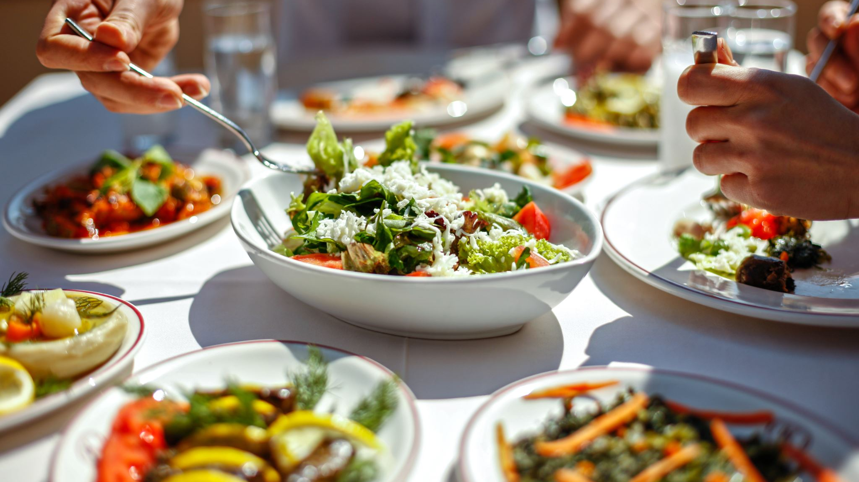
food
I would want all my Favorite food in my world.🍕🍔🌭

Slide 4
Everything is free
I want everything to be free because who wants to save up money for 2 years and spend it on one thing? NOT ME!

Slide 5
World peace
I want world peace because no more frogs will get hurt and who wants to wake up to world war 3 outside there window again NOT ME!
This Photo by Unknown Author is licensed under CC BY

Slide 6
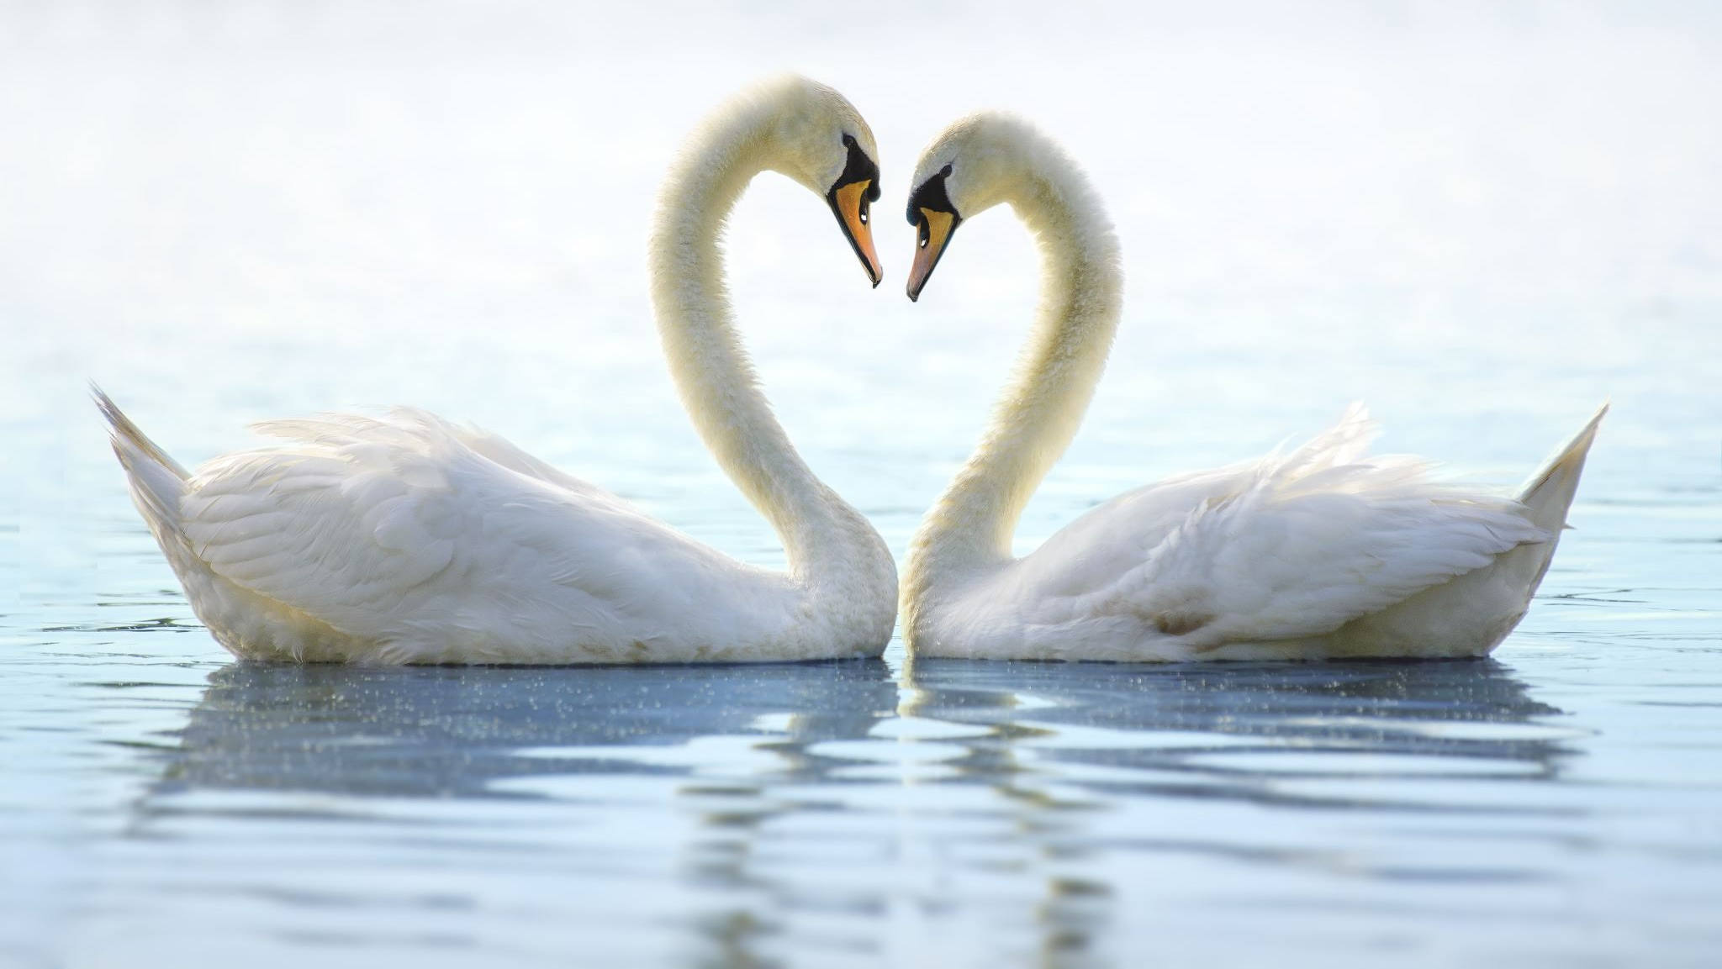
New animals
I want more animals of my own like different frogs and animals that I would like

Slide 7
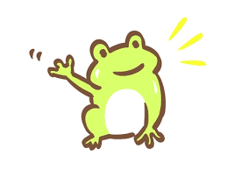
The end
Thank you for watching my PowerPoint (●’◡’●)

