Slide 1
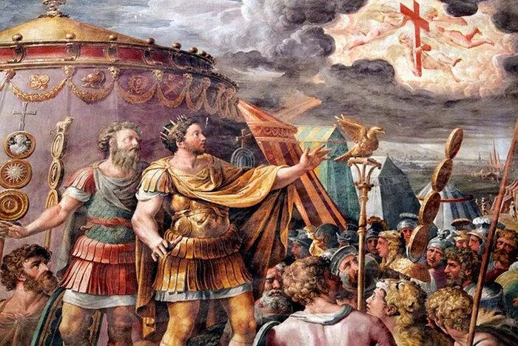
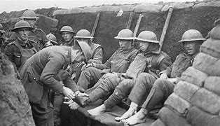
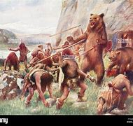
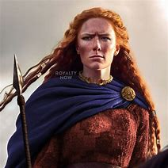
What is the strangest thing from the past?
Boudicca Walker

Slide 2
Strange Things!
Rotten Romans
Frightful First World War
Savage Stone age
Brave Boudicca

Slide 3
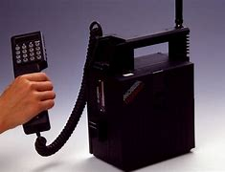
Introduction
I found so many strange things, I couldn’t decide on the strangest!

Slide 4
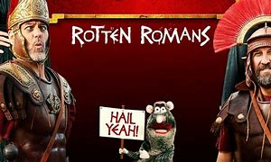
It was good to be a gladiator.
Gladiators would fight each other or even animals like bears and tigers until one of them died.
The crowd would cheer and whoop as this was happening.
Sometimes, gladiators would fight bears without armour or any weapons.
Who would like to do that?

Slide 5
Soldiers used poisonous gases to hurt each other.
Soldiers used to wee on their handkerchiefs and then put them on their nose, mouth and face!
ERRRRRR! DISGUSTING!!!
They thought this would stop them breathing in the poisonous gases.

Slide 6
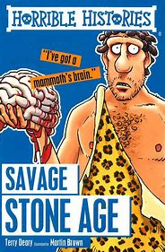
Imagine having a piece of raw steak in your lunch box.
Well, that’s what you would have if you were a Stone Age child.
They didn’t know how to make fire for a long time so ate all of their food raw.
How did they not get sick?

Slide 7
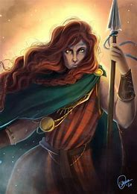
Save the best till last!
Boudicca was a strong leader, brave warrior and the woman I got my name from.
Boudicca made soldiers paint themselves blue to look scarier.
She defeated the Romans three times and had a deadly death stare.
Luckily for you, I’m a little bit nicer than that Boudicca.

