Slide 1
What if animals could talk?
Alfred Clausen

Slide 2
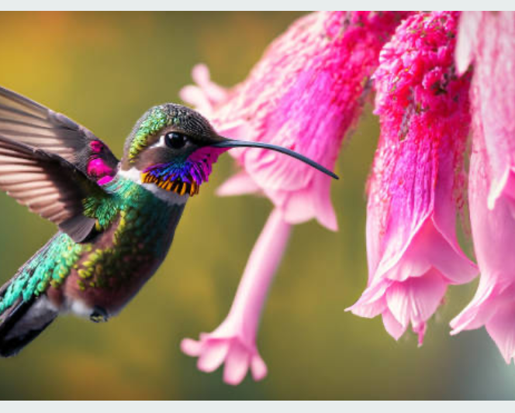
Animal’s voices
If animals could speak, they would inform you that their habitat is getting destroyed or helping their health

Slide 3
Cats speaking

Slide 4
Dogs speaking

Slide 5
If a rabbit could talk what will it say it will say give me food please and set me free.

Slide 6
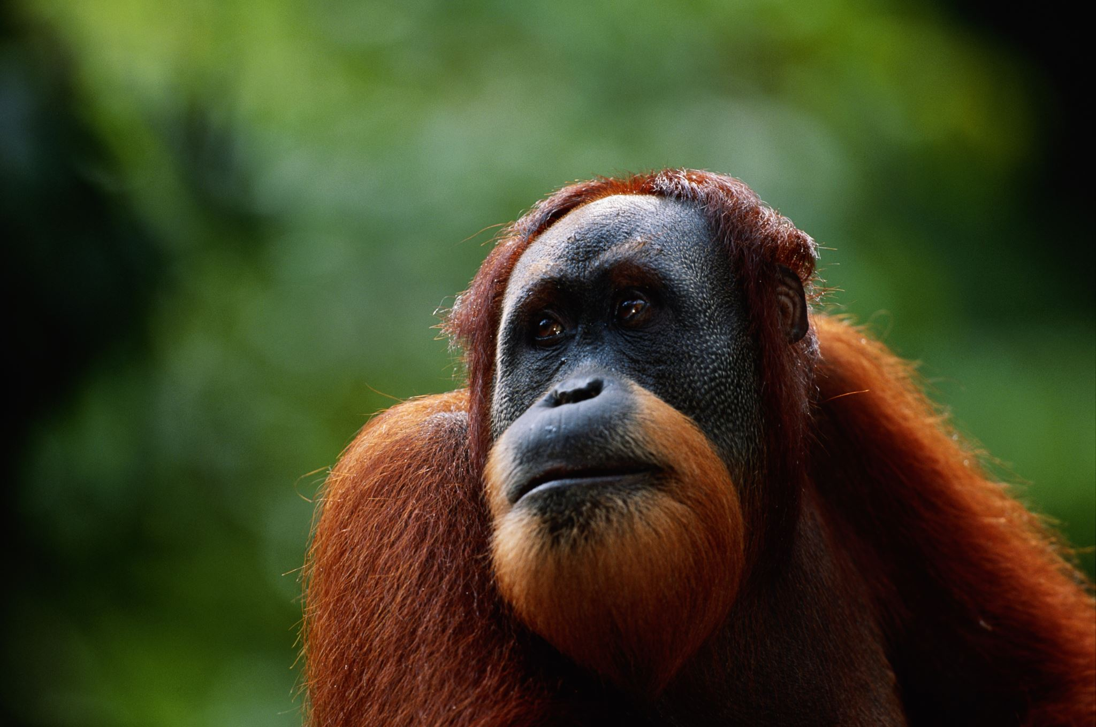
Orangutans
Don’t eat my palm oil
Help me don’t destroy my habitat
Don’t hurt me
Take care of me

Slide 7
The End

