Slide 1
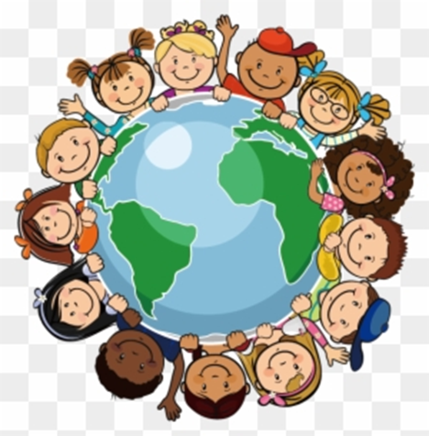
DOES OUR PLANET BELONG TO US ???
BY KIRSTEN LITTLE

Slide 2
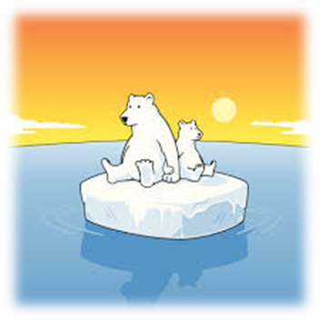
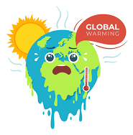
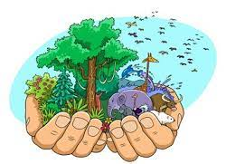
DISAGREE?
I don’t think our planet belongs us to us because we weren’t the first humans/living things on the planet.
No because God created the world and he just left us to be his trusted keepers, but he is the owner.
Over the years we have made a difference/changes to our planet, for example climate change and this proves we cannot be trusted to be the owners.
If more than one person believes they own the planet it can cause conflict as it will be unclear who has the last or final say.

Slide 3
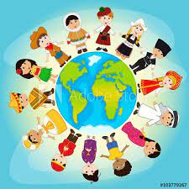
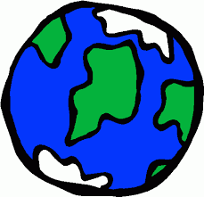
AGREE?
I think we own the planet because we were left to create places for humanity to live in the past, present and future.
We were left trusted to take care of the planet by our ancestors, we are all owners and can make a positive contribution to the planet. It is too big for one person to be the owner.

Slide 4
