Slide 1
What is the strangest thing about how people lived in the past?

Slide 2
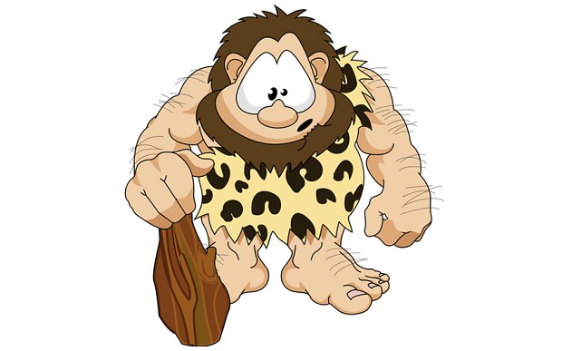
The stone Age

Slide 3
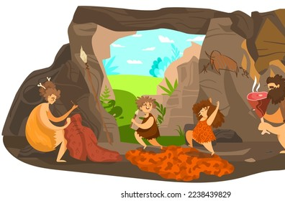
The stone Age was 5000 years ago and it was made up of the Paleolithic period, Mesolithic period and the neolithic period.

Slide 4
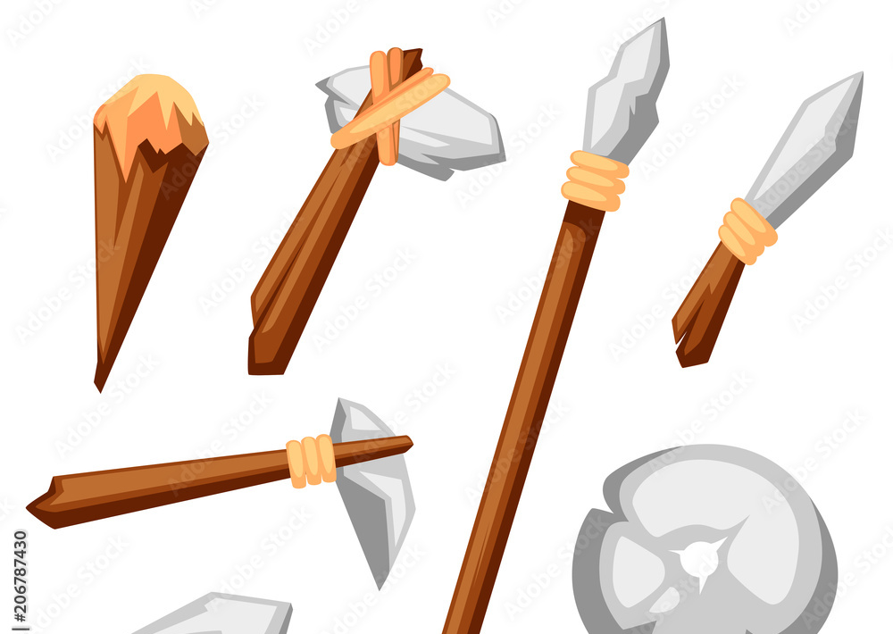
Paleolithic Period
Tools made of stone and wood.
The people used the tools to hunt and build.

Slide 5
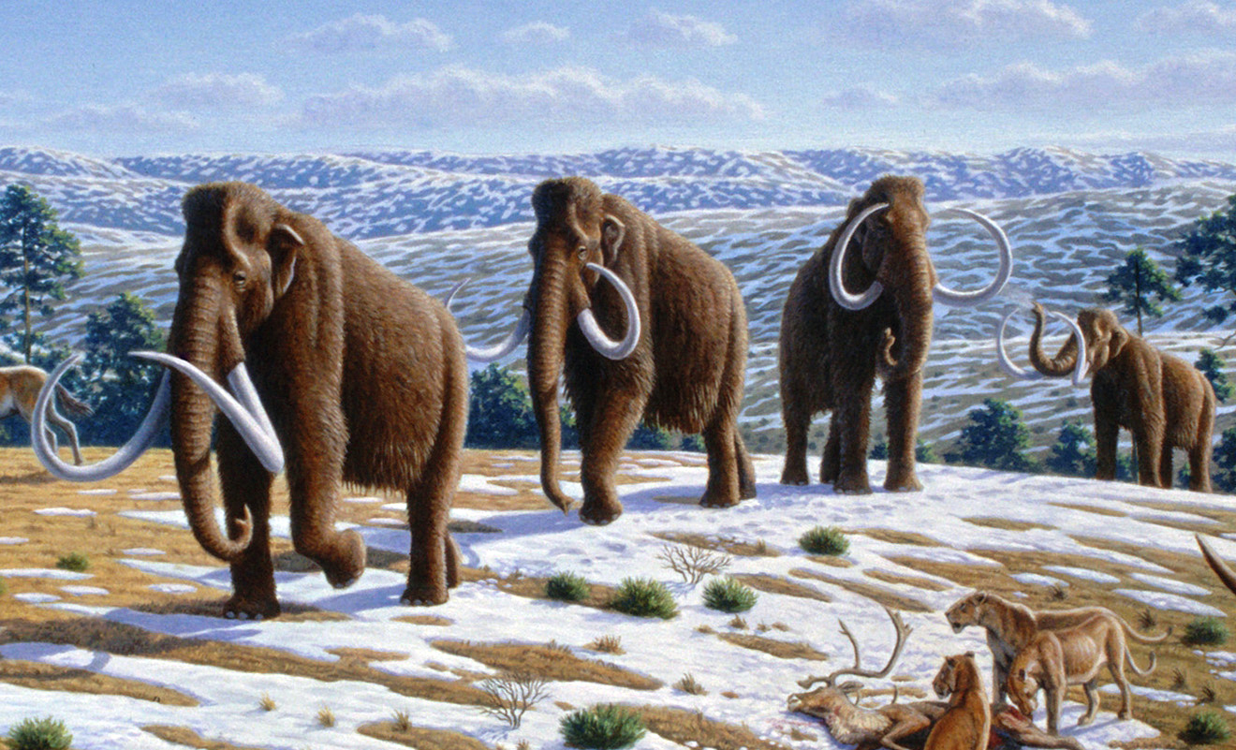
They hunted fish and animals like mammoths, bison and deer.

Slide 6
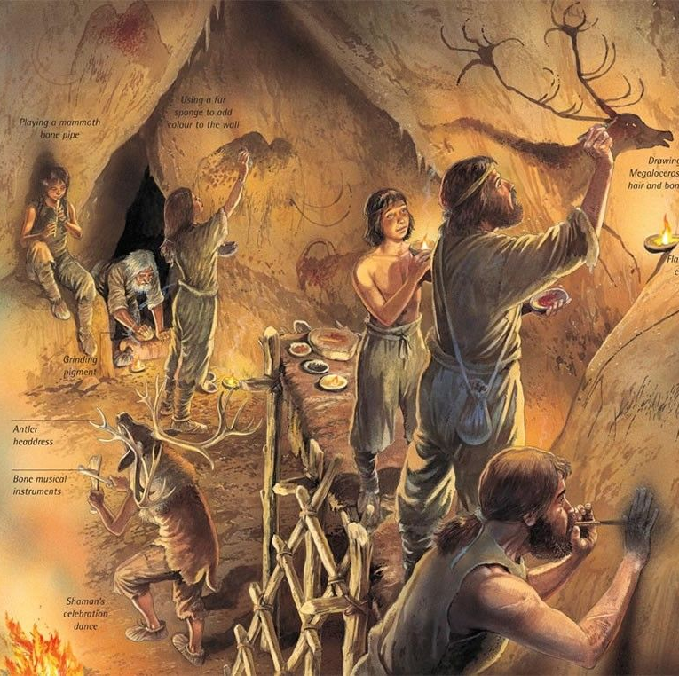
They lived in huts and caves.

Slide 7
They ate animals, fish, plants and fruit.

Slide 8
Picking fruit

Slide 9
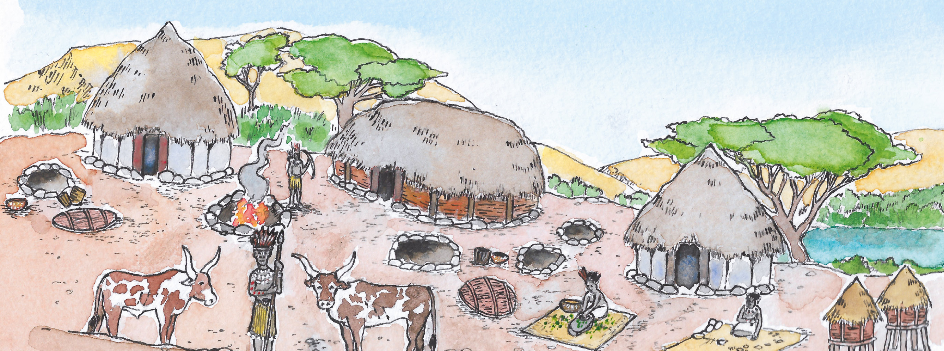
Mesolithic Period
They started to live in villages.
They grew crops.

Slide 10
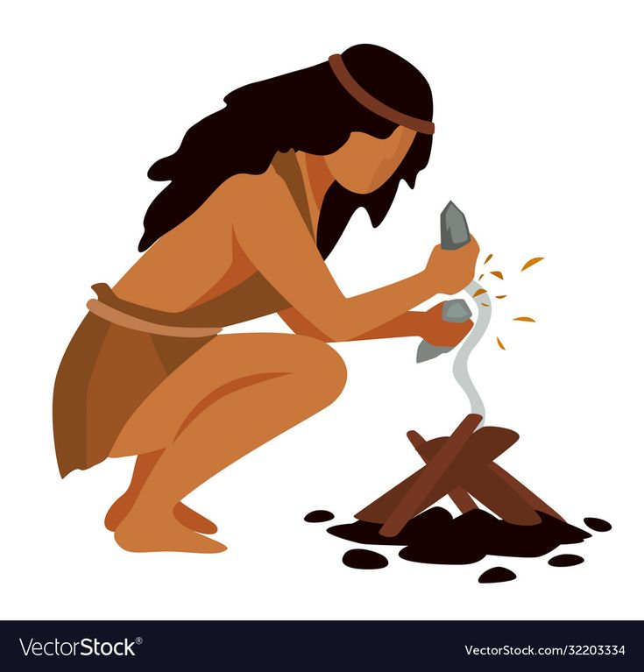
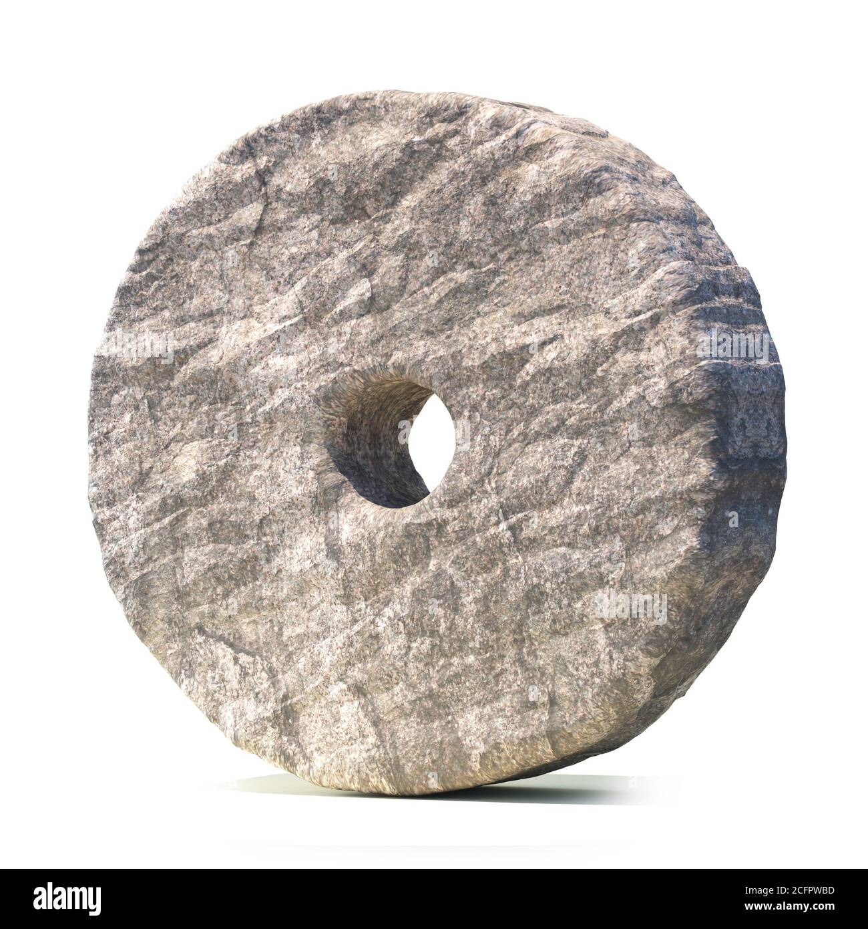
Neolithic Period
Grew more crops.
Had more animals.
Had better tools.
Discovered fire.
Invented the wheel.

Slide 11
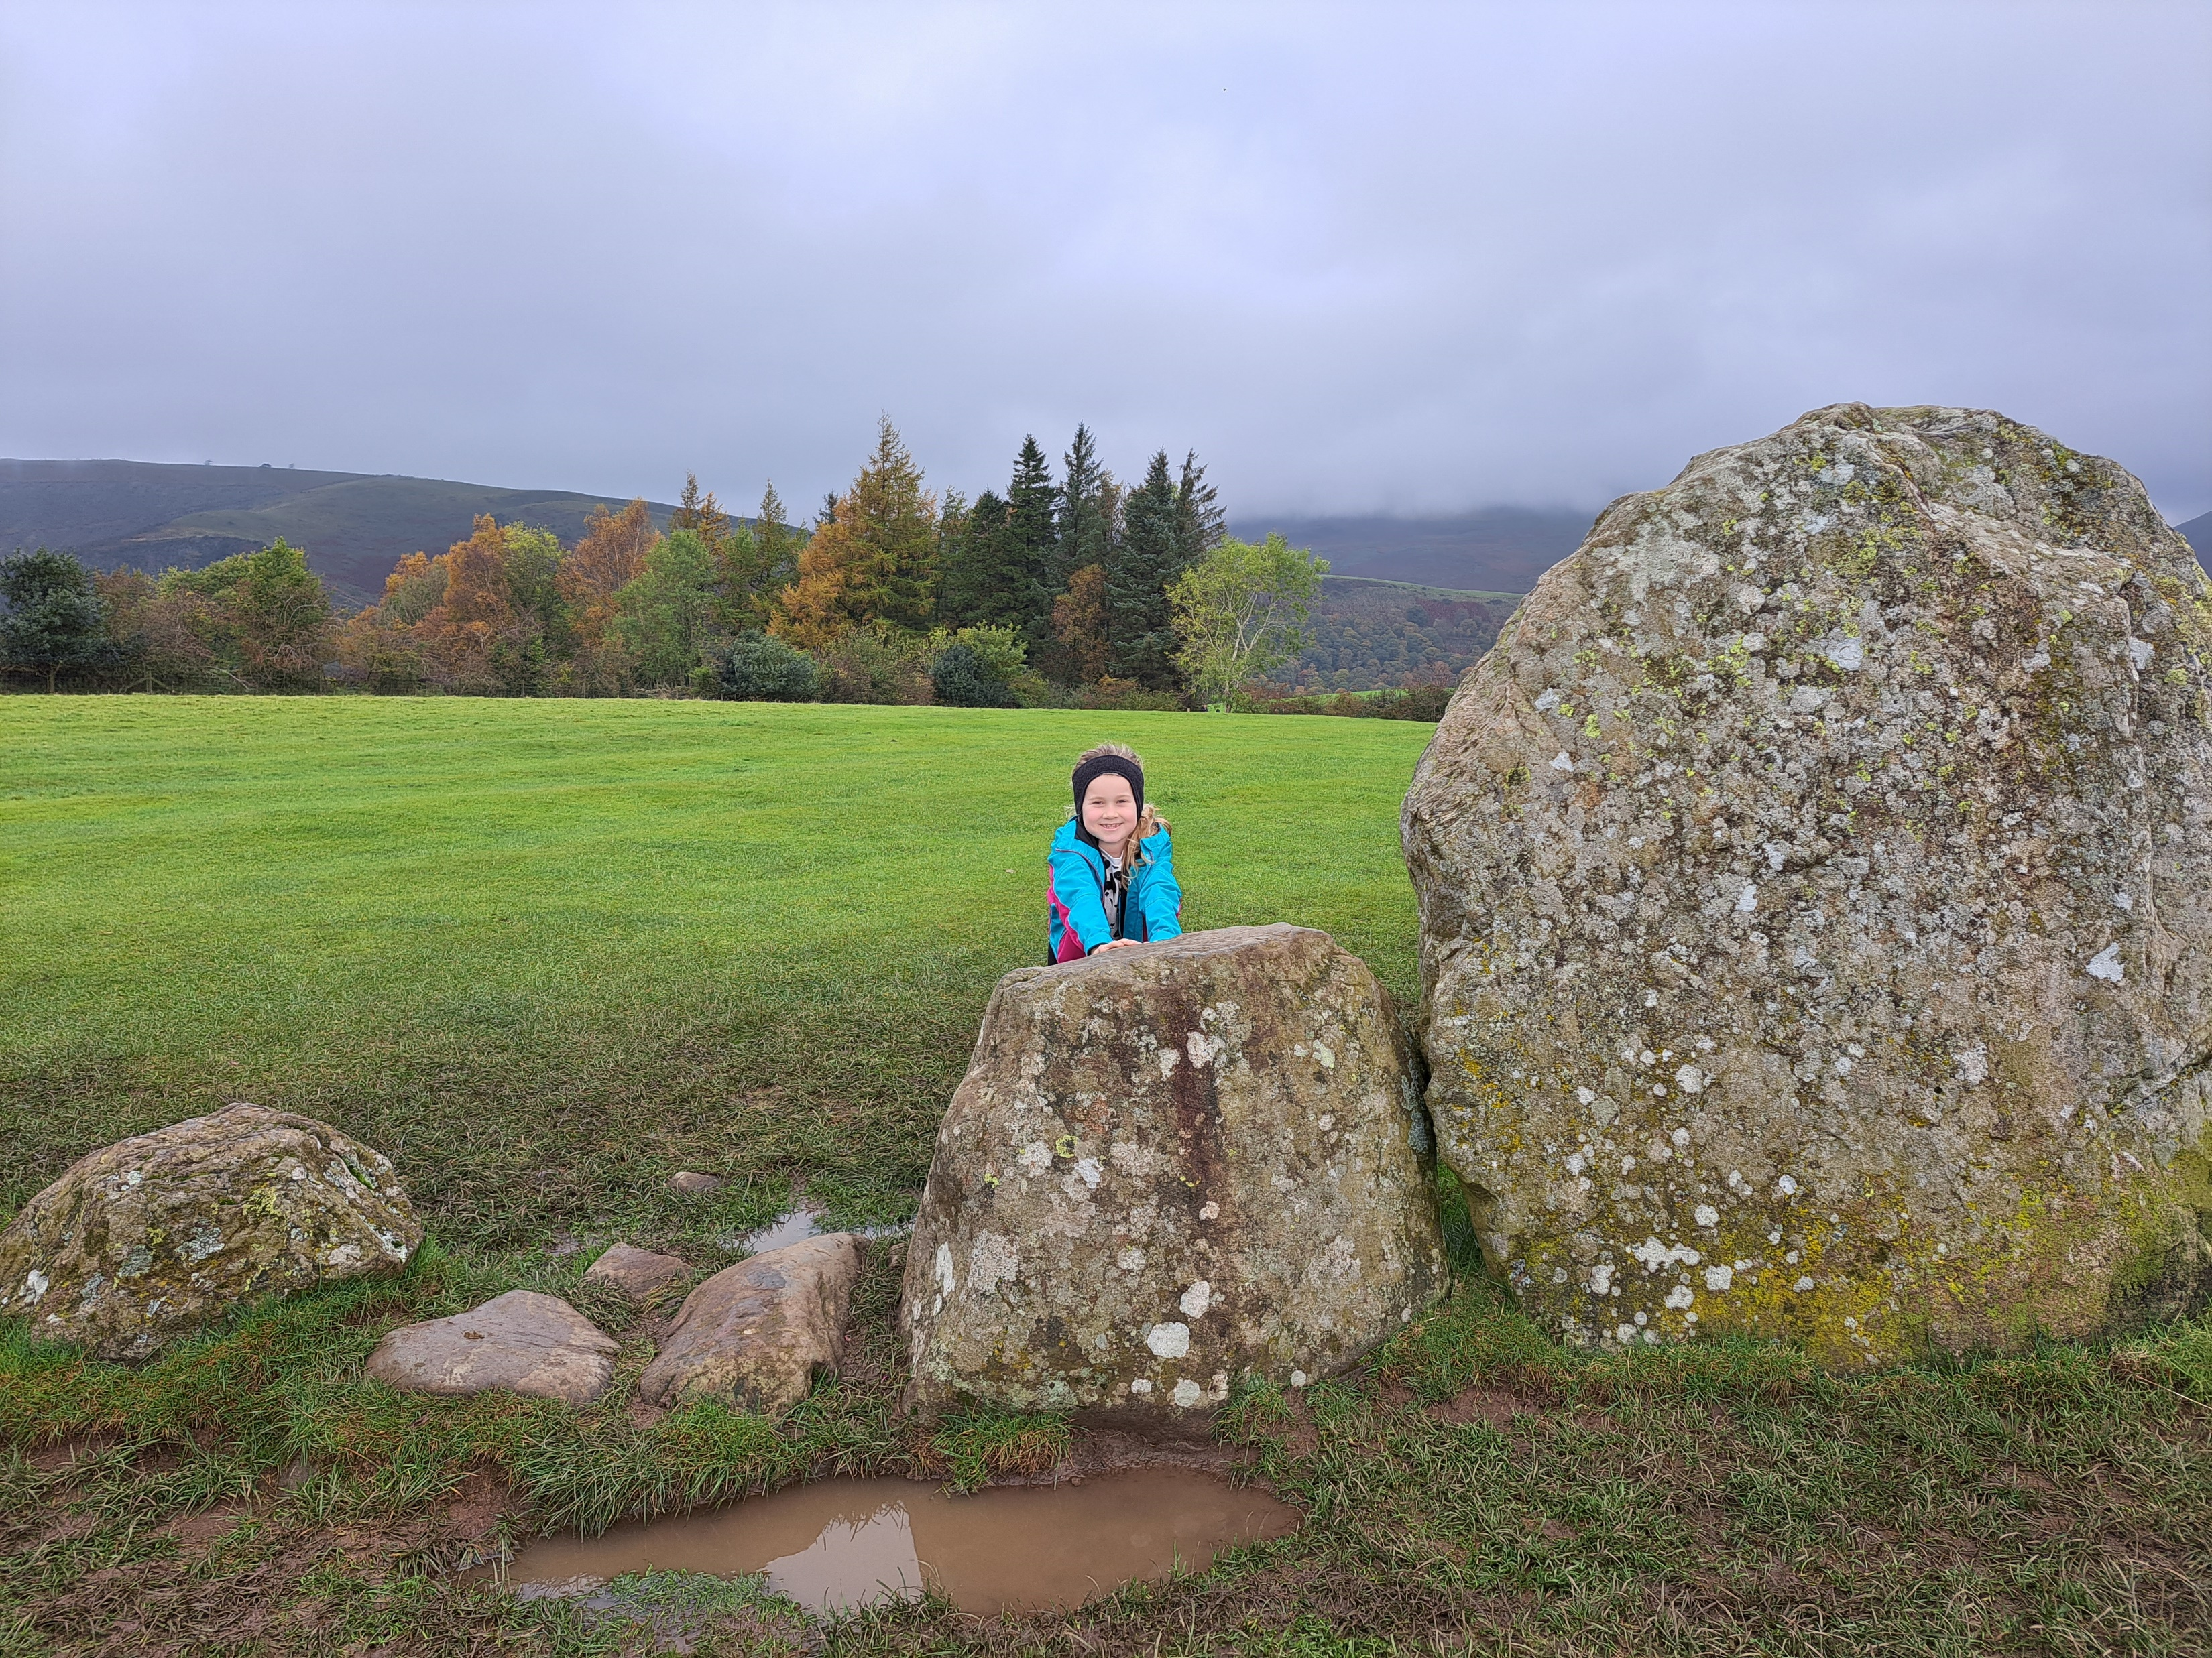
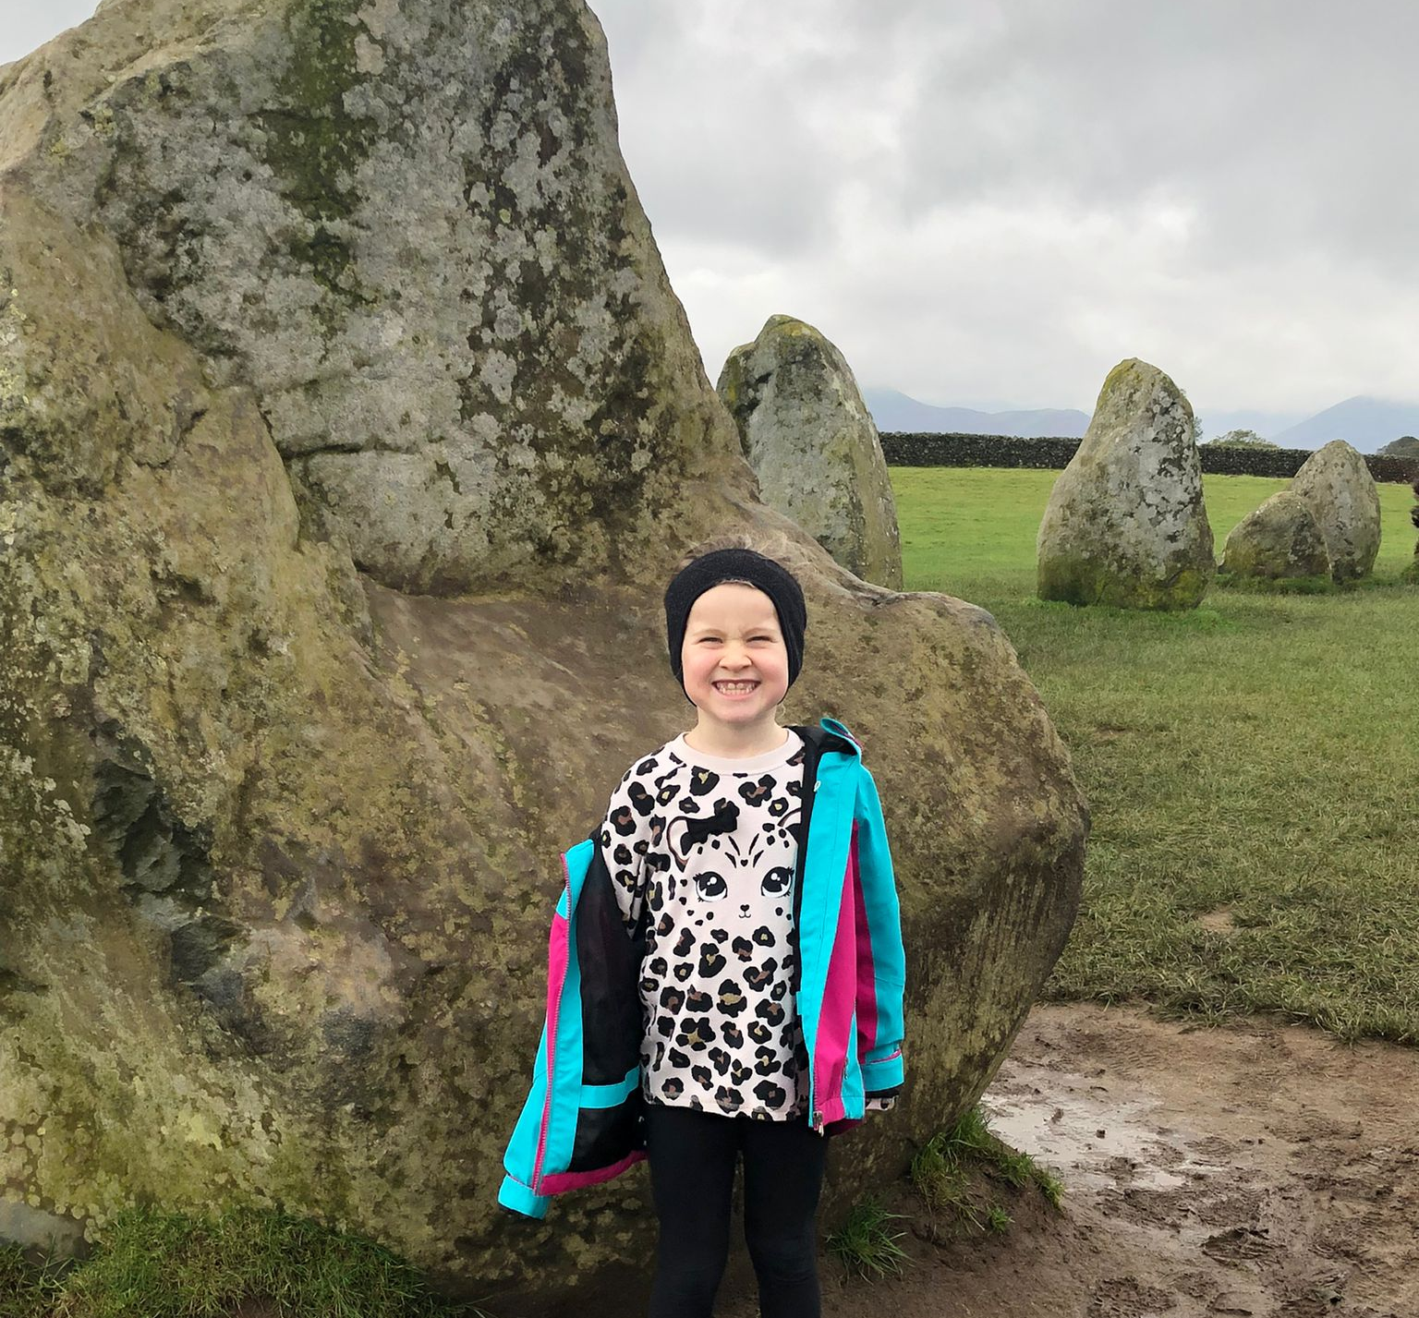
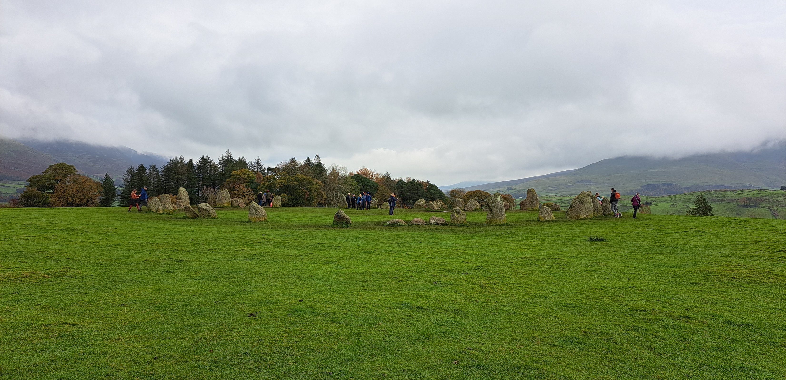
Neolithic stone Circle
This is me on holiday at the Castlerigg Stone Circle in Keswick. This is in the Lake District. These stones are from the Neolithic Period.

