Slide 1
Is it better to be an adult or a child?

Slide 2
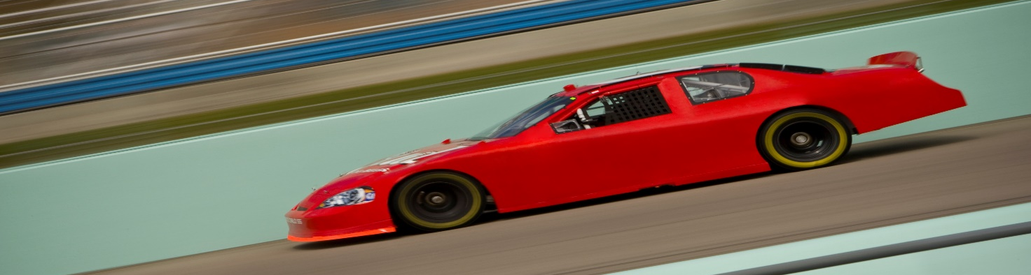
I THINK ITS BETTER to be… An adult!
You get to do lots of jobs – like being a racecar driver or a DJ!
You can be a BOSS!!
You can go to DJ dance parties
You can earn lots of money!
You can go on holidays whenever you like

