Slide 1
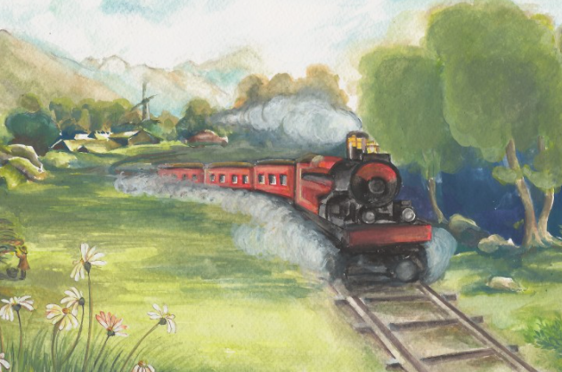
Year 3 Whole Class Reading
Classic Poetry

Slide 2
clambers
lumping
glimpse
plain

Slide 3
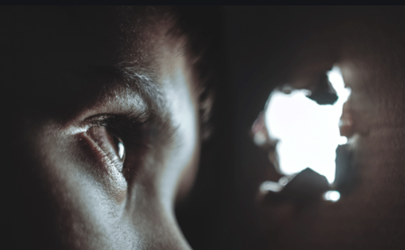
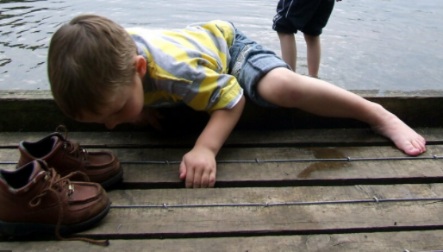
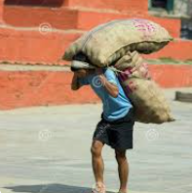
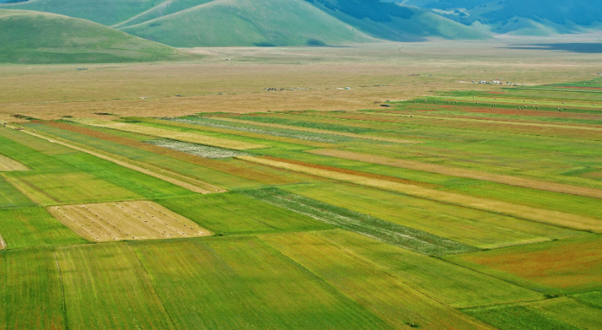
Week 1
glimpse
(a partial view)
clambers
(climb in an awkward way)
lumping
(carrying something with difficulty)
plain
(a large area of flat land)

Slide 4
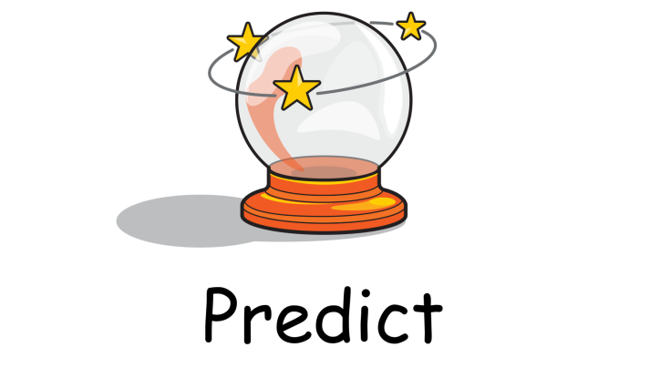
Reading Skills

Slide 5
From a Railway Carriage
Faster than fairies, faster than witches, Bridges and houses, hedges and ditches; And charging along like troops in a battle, All through the meadows the horses and cattle: All of the sights of the hill and the plain Fly as thick as driving rain; And ever again, in the wink of an eye, Painted stations whistle by.

Slide 6
From a Railway Carriage
Faster than fairies, faster than witches, Bridges and houses, hedges and ditches; And charging along like troops in a battle, All through the meadows the horses and cattle: All of the sights of the hill and the plain Fly as thick as driving rain; And ever again, in the wink of an eye, Painted stations whistle by.
Here is a child who clambers and scrambles, All by himself and gathering brambles; Here is a tramp who stands and gazes; And there is the green for stringing the daisies! Here is a cart run away in the road Lumping along with man and load; And here is a mill and there is a river: Each a glimpse and gone for ever!
Robert Louis Stevenson

Slide 7
From a Railway Carriage
Faster than fairies, faster than witches, Bridges and houses, hedges and ditches; And charging along like troops in a battle, All through the meadows the horses and cattle: All of the sights of the hill and the plain Fly as thick as driving rain; And ever again, in the wink of an eye, Painted stations whistle by.
Here is a child who clambers and scrambles, All by himself and gathering brambles; Here is a tramp who stands and gazes; And there is the green for stringing the daisies! Here is a cart run away in the road Lumping along with man and load; And here is a mill and there is a river: Each a glimpse and gone for ever!
Robert Louis Stevenson

