Slide 1
What Would a Perfect World Look Like?
BY CHARLIE AND OLIVER!

Slide 2
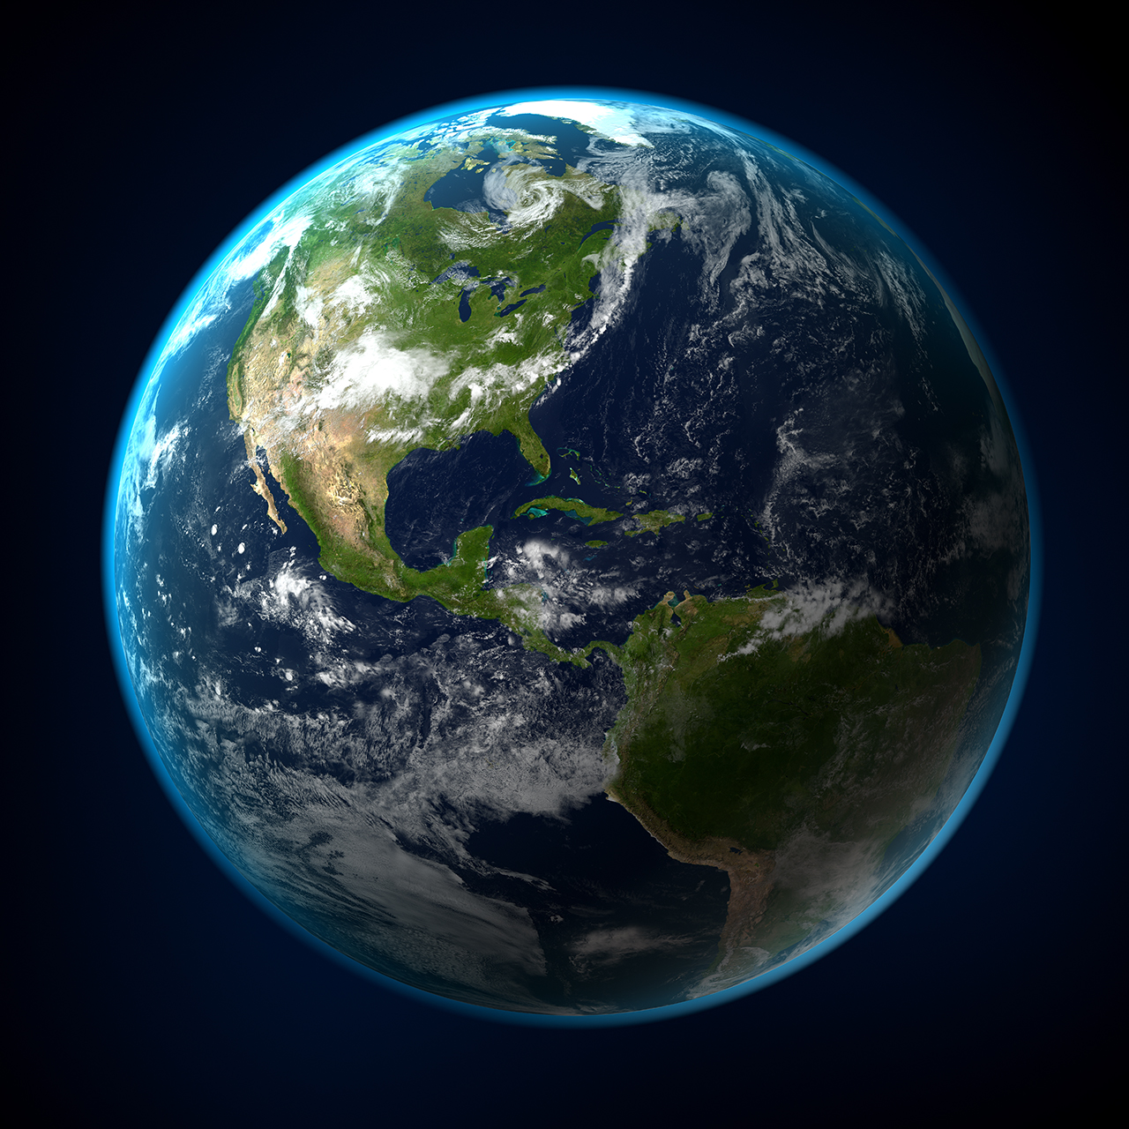
No war , just peace
There should be no war because people can die and should not be violent. Instead you should try to talk through problems to come to an agreement . Rather than fighting over something , arguing or disagreeing.

Slide 3
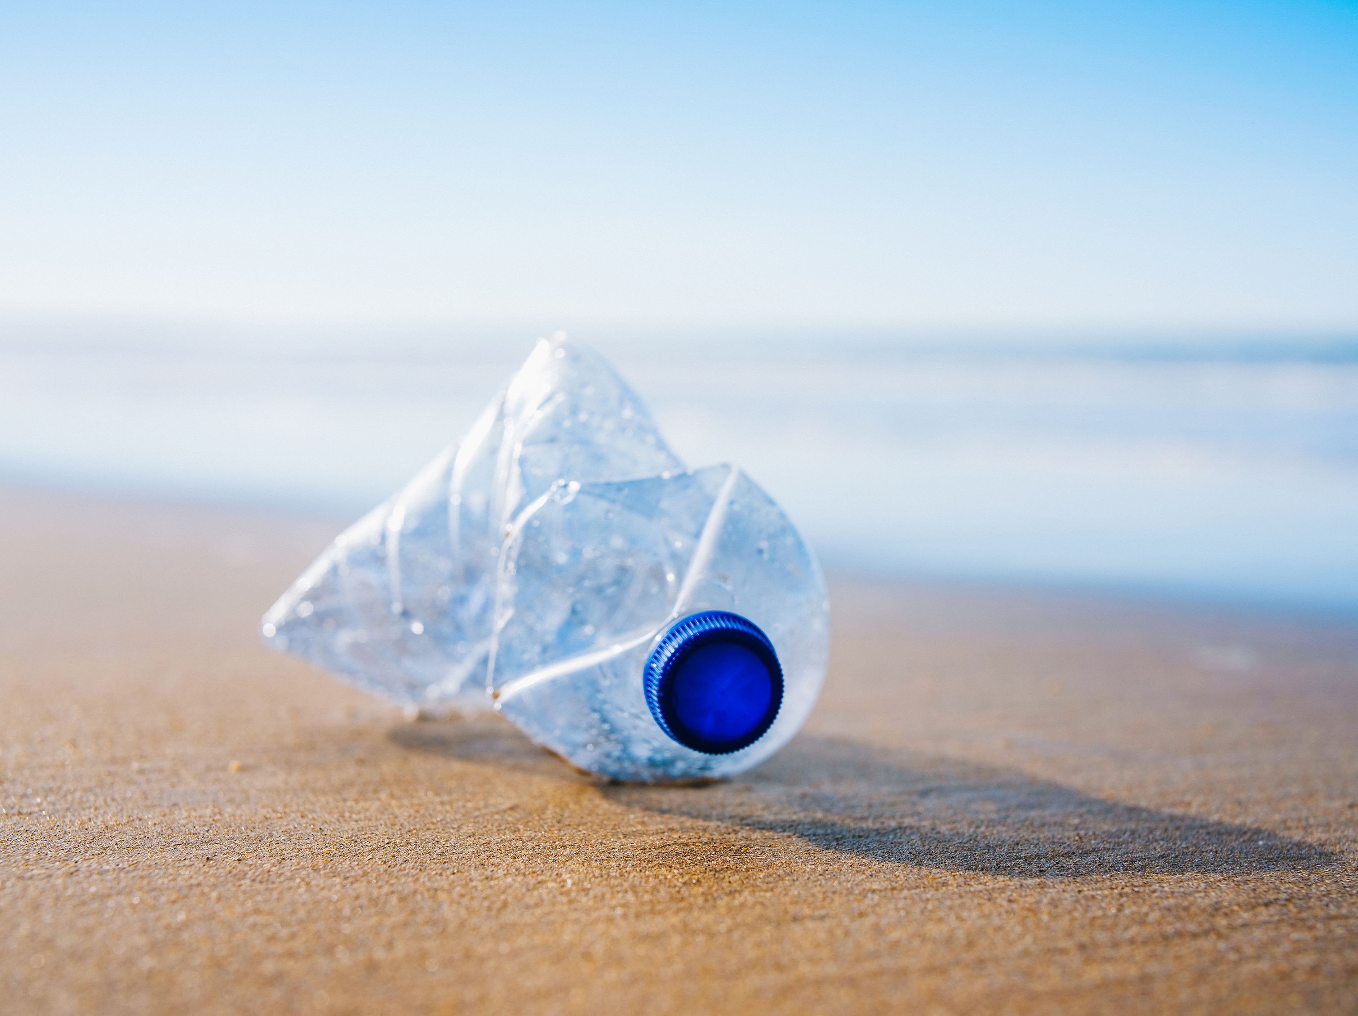
No pollution / harmful things to human body
You should not burn fossil fuels like coal and oil .No littering , instead you should recycle and produce something new. You shouldn’t pollute the ocean but instead put your rubbish in a nearby bin. Protecting the mangroves to insure that all marine life remains safe.
You should avoid harmful things to your body and organs. Avoid things like drugs, smoking and vaping because this can damage organs like your heart which could kill you. Lungs that could stop breathing and it can make your muscles weak. Also , you have to think about your balanced diet or five a day because it could make your skin go red , make you weak or generally fat or big.

Slide 4


Friends, Family & homelife
Have at least one friend or else you will be lonely.
Family are always there to help you through things and lead and guide you wherever you go.
A home where you can rest and take all the stress out of you and where you can have family time.
Friends are always there to play with you and make you feel happy. With no outsiders.
When you argue you forgive each other. Friends are also there to play with you and have fun,

Slide 5
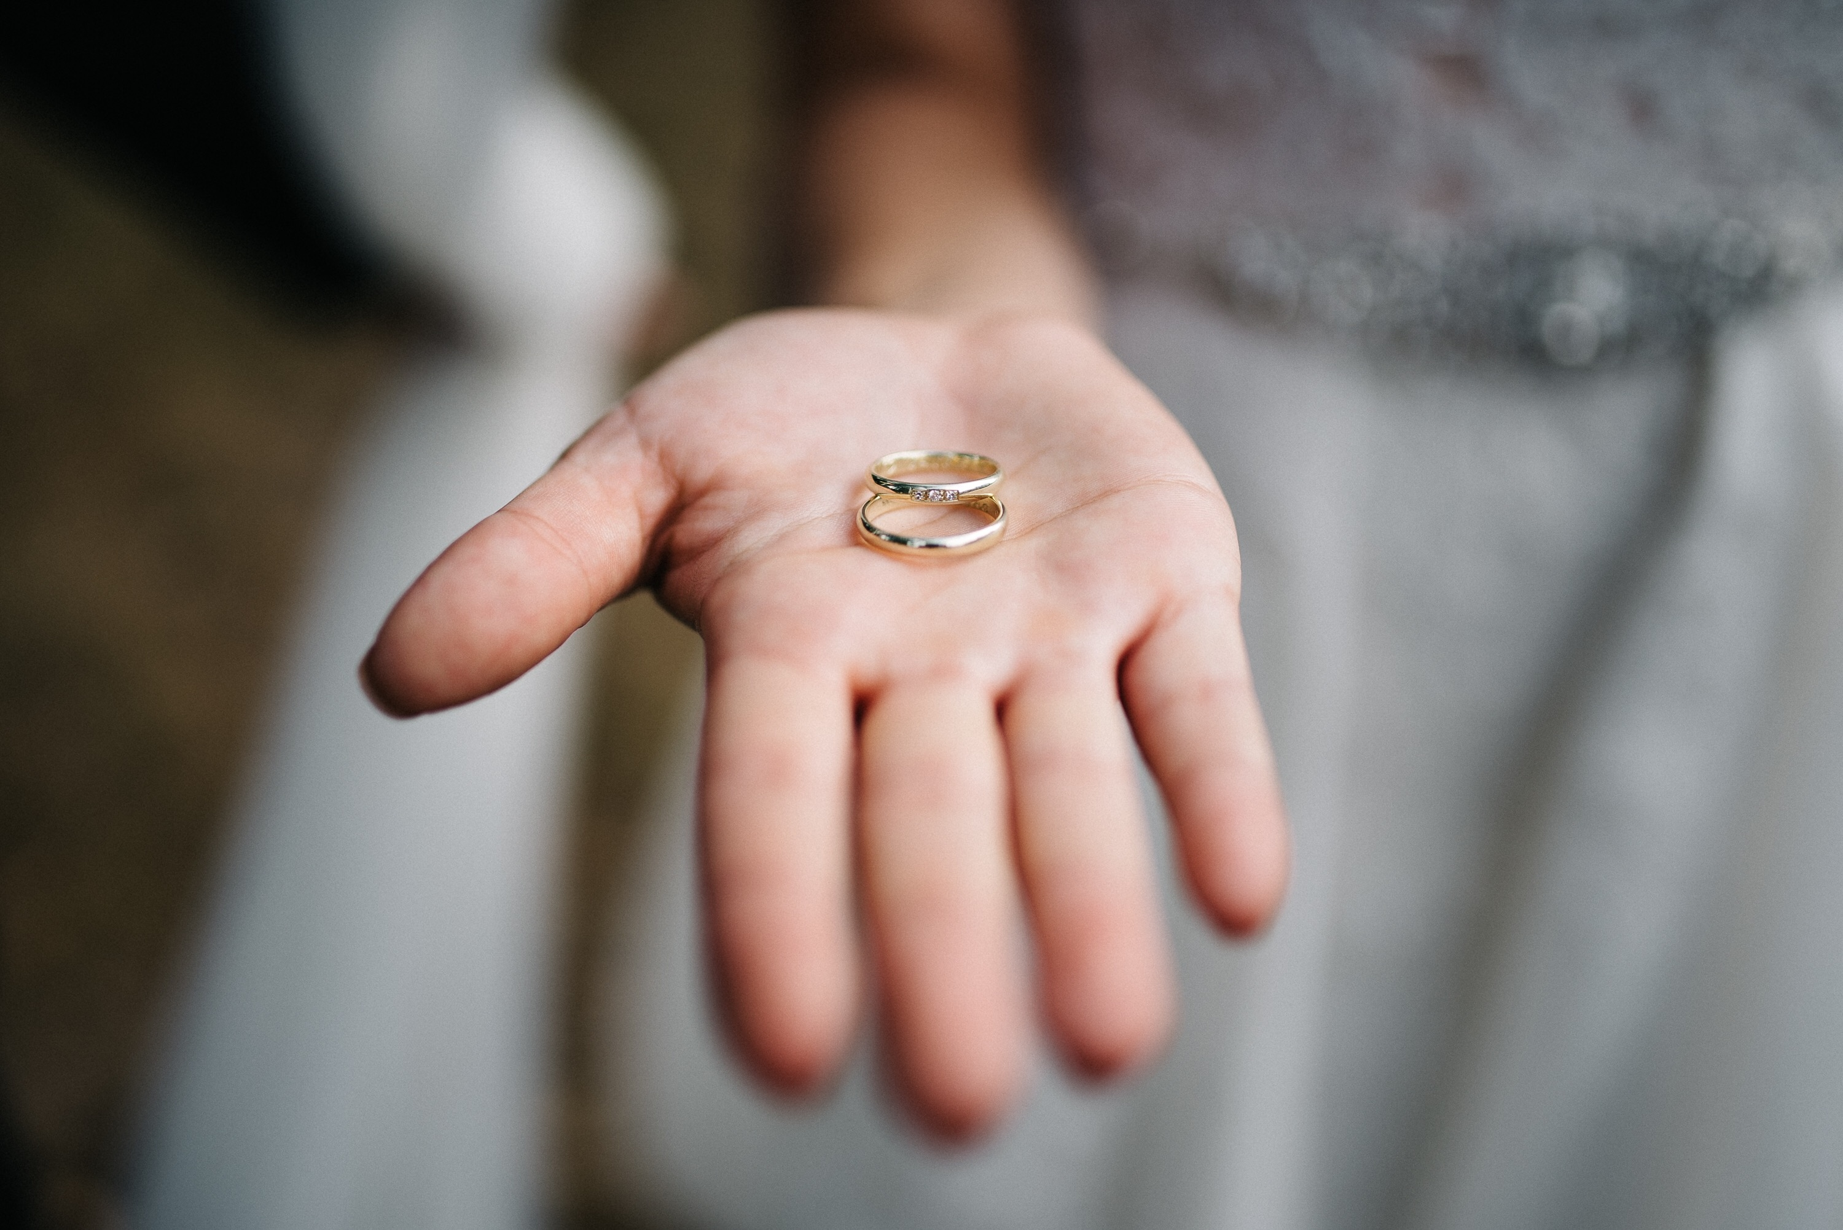
Helping and respecting others
Donate to charity for those less fortunate than us
Support others in dark times and in times they need your help
Respecting differences in views & opinions and appreciating everyone is different
Be unselfish and share with everyone. ‘Sharing is caring’.

Slide 6

Thanks for reading!
Hope you enjoyed!
From Oliver and Charlie

