Slide 1
What if the Animals around the world had a voice what would they say?
By Jacoby Landsborough

Slide 2
Orangutang
Oooooo Ahh Ahhhhh
Stop destroying my home!

Slide 3
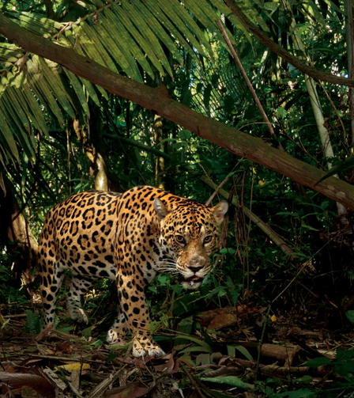
jaguar
Come on dudes why are ya’ll doing this??

Slide 4
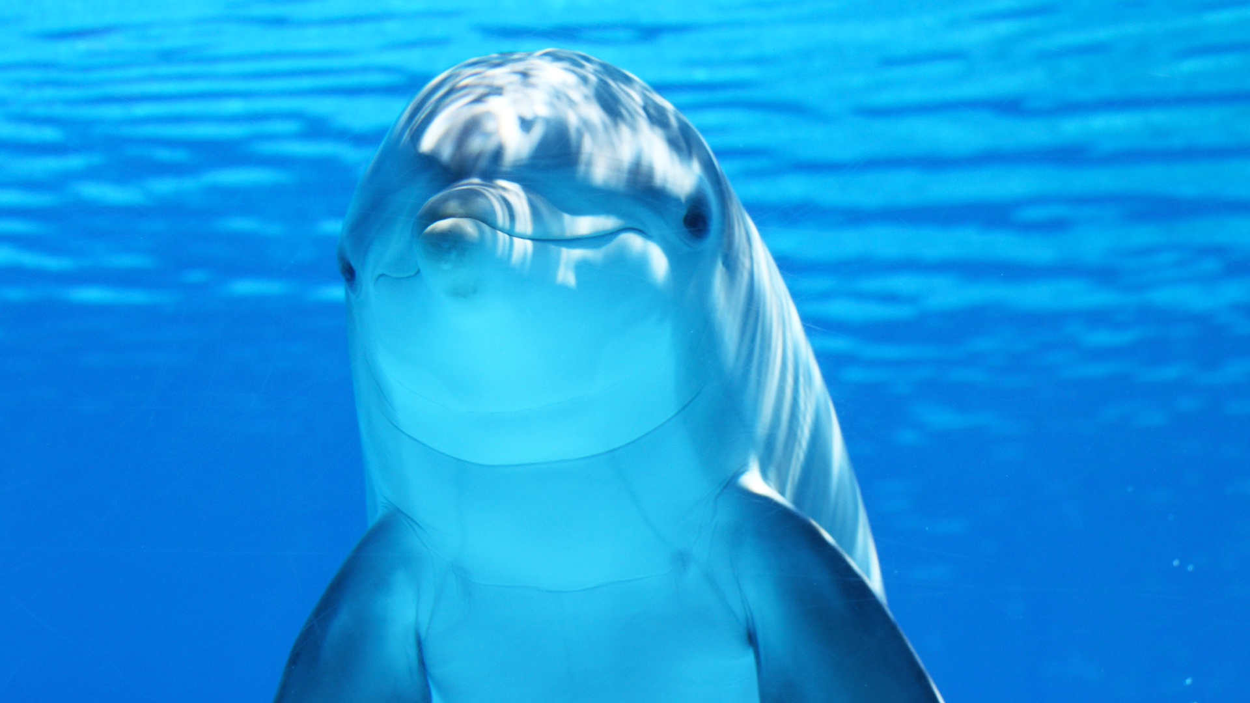
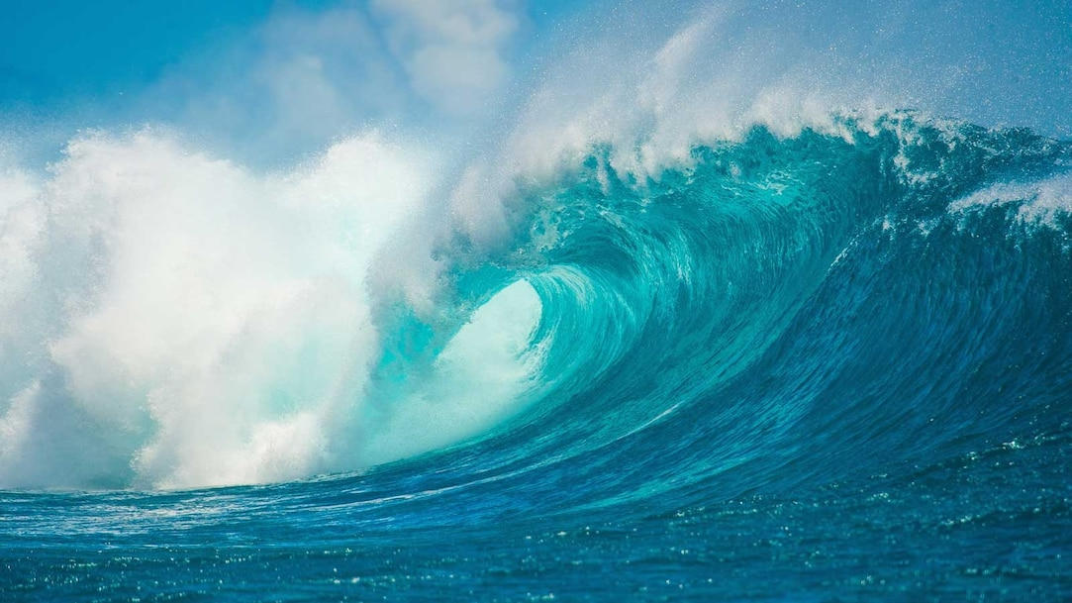
dolphin
Eek click click your plastic waste is killing my fishy friends stoooooooooop

Slide 5
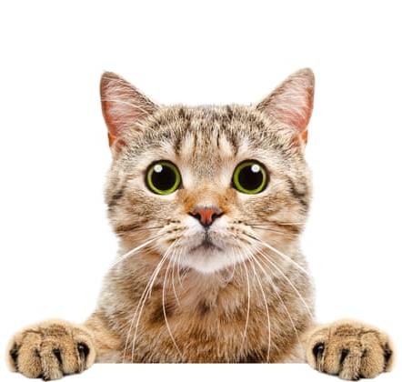
Cat
I'm loving life

Slide 6
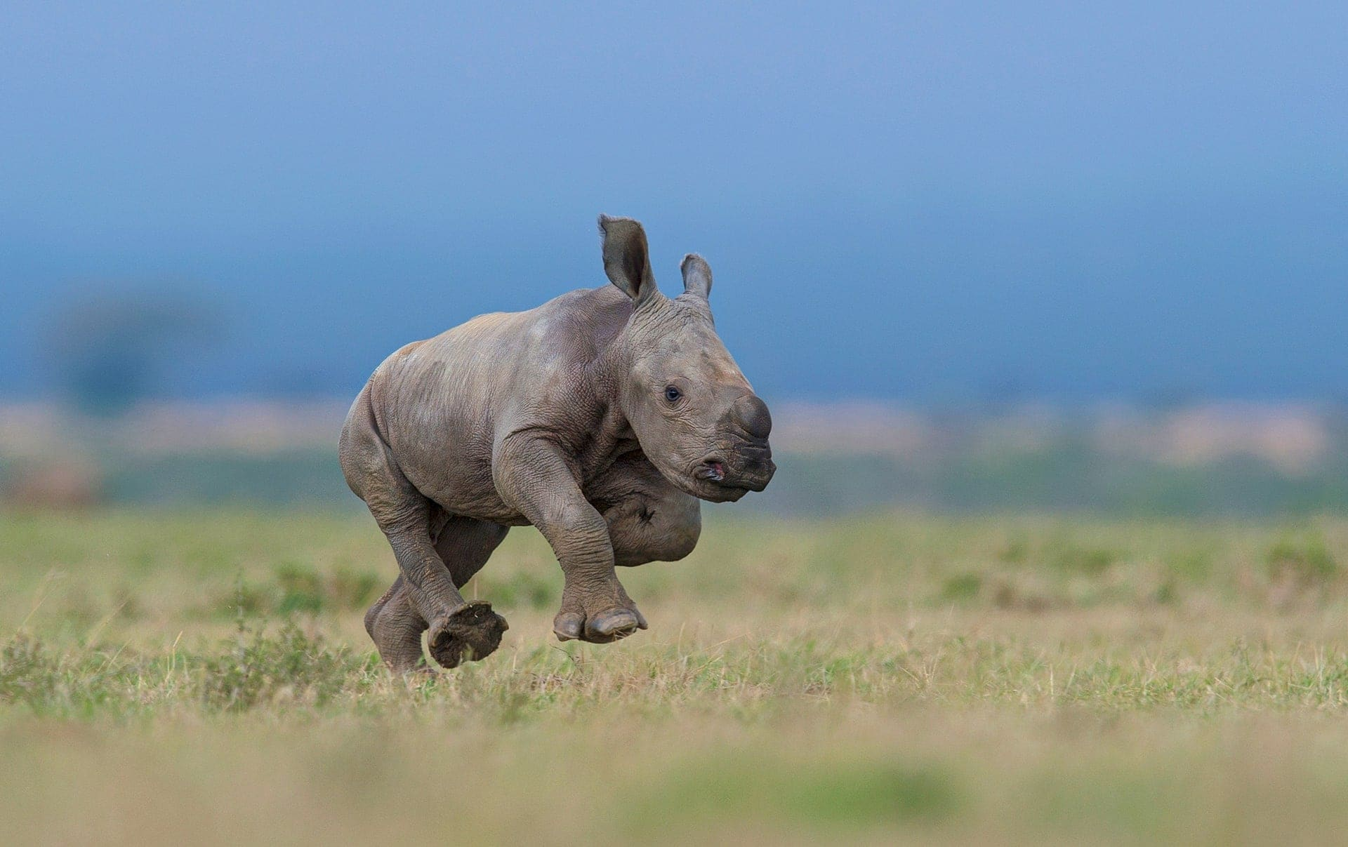
rhino
Help I lost my mama because of a hunter guy.

