Slide 1
Is it better to be an
adult or a child?

Slide 2
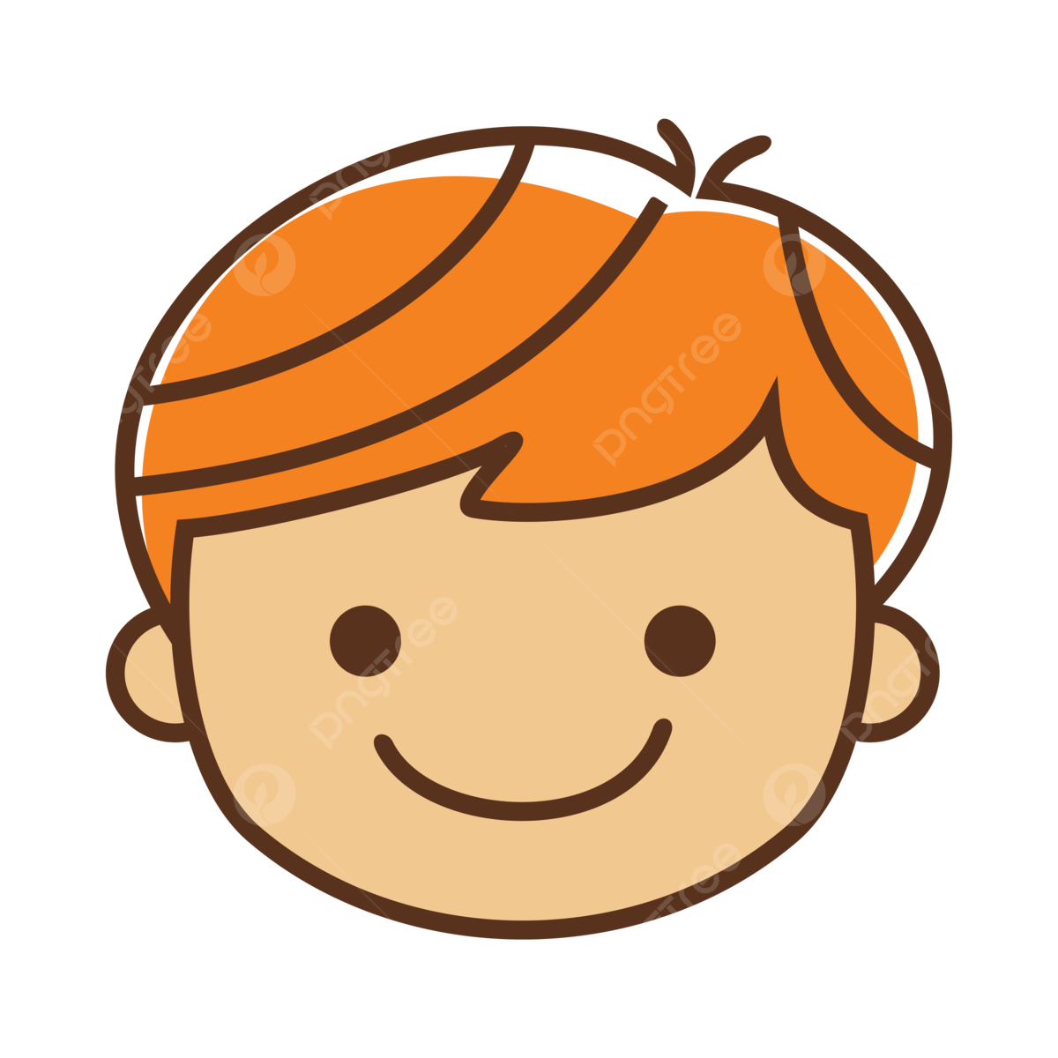
Being a Child
Good things | Bad things
You get more presents on your birthday | Don’t like to get told off when you have been naughty at school
Have a weekend and holidays to enjoy | You have to go to school
You can play all day | Sometimes I want a toy and Mommy and Daddy won’t buy it
You can go on the playstation
I am grateful that I do not have to make my own food
I am happy that people who are not from my family will buy me presents for my birthday
I get to ride my bike all day
I get to go to good places
You get lots of love

Slide 3
Being aN ADULT
Good things | Bad things
You get to go out with your friends at night | You don’t get many presents for your birthday
You get to love your family all day long until you die | You have to work all day
Do a job that you love like wrestling or football with your friends | You have to pay all the bills
You get to boss people about and shout at naughty children | You babies get bigger

Slide 4
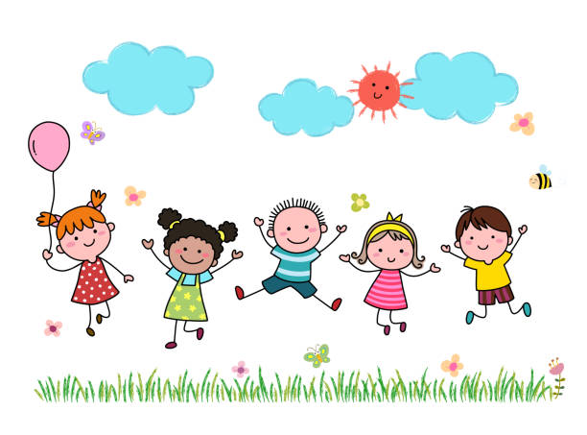
I think it is better to be a child because there are so many good things but being an adult there are as many bad as good.

