Slide 1
WHAT ANIMALS WOULD SAY…
BY FREDDIE WRIGHT

Slide 2
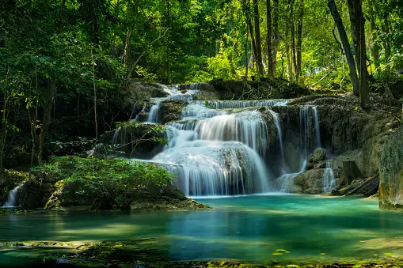
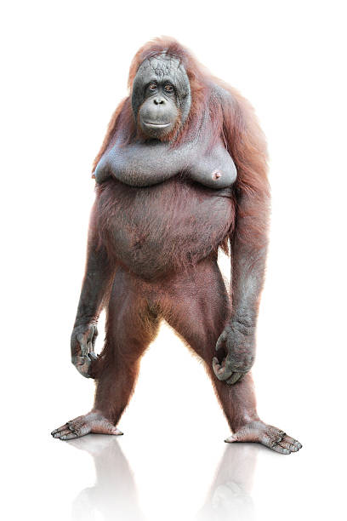
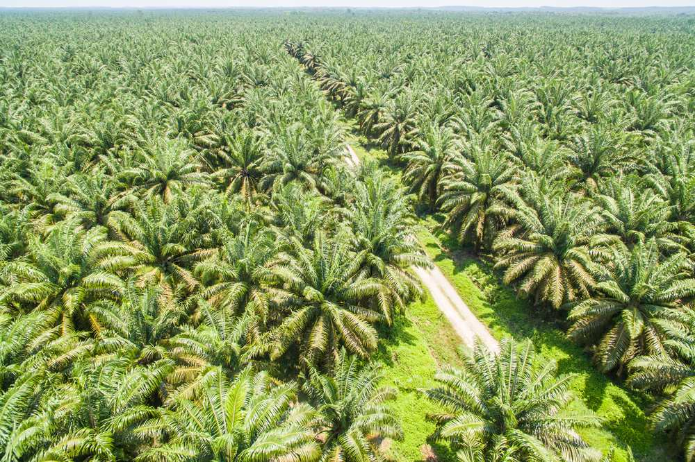
RAIN FOREST
PLANTATION
Orangutans: people are bulldozing my rainforest and Im losing my home and all my family. just So humans can have chocolate! How could they!

Slide 3
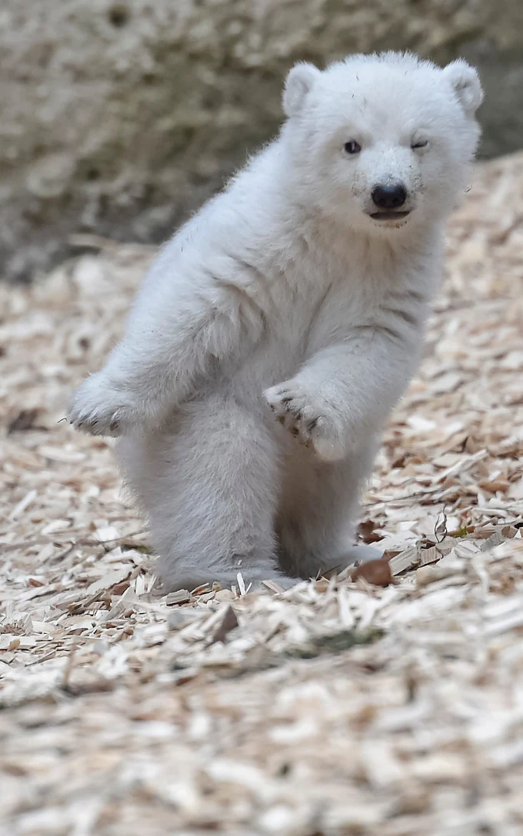
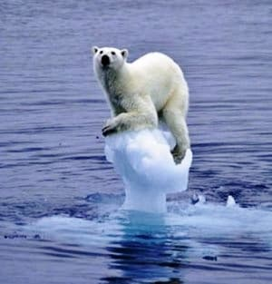
TUDRA
Polar bears: My ice caps are melting and the planet is getting hotter and I have nowhere to live.

Slide 4
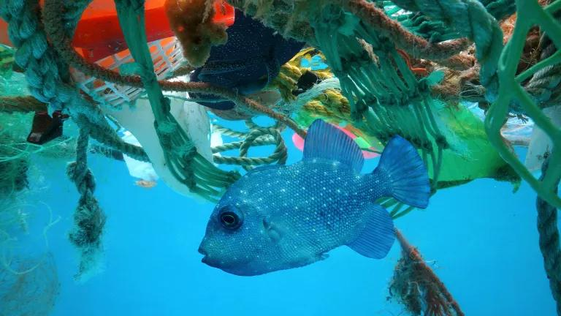
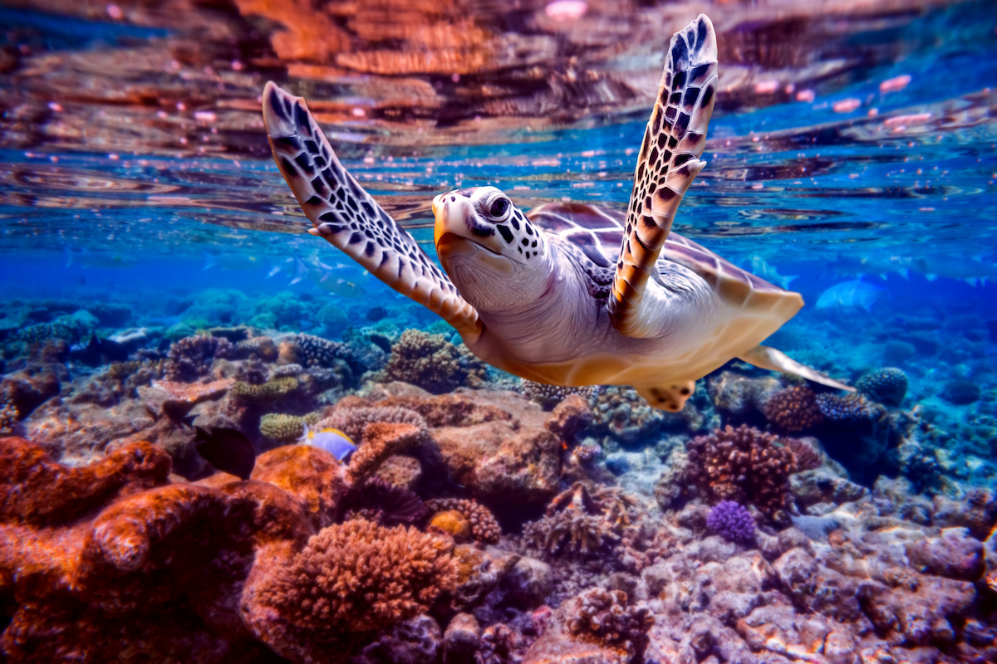
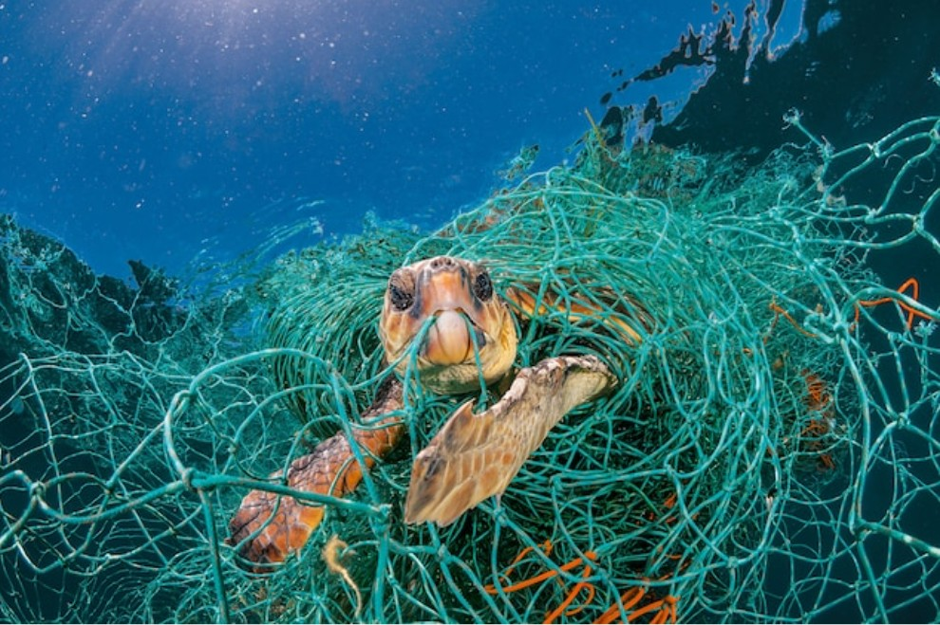
UNDER THE SEA
POLLUTION
Fish: every day I have to deal with pollution. Rope, wire and rubbish. Apparently in 10 years there will be more pieces of rubbish than fish in the entire ocean, how crazy!

