Slide 1
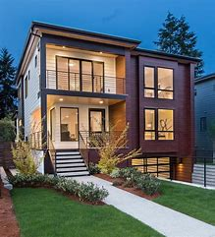
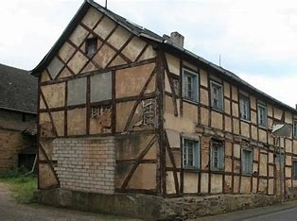
Old fashioned home vs modern home
By Autumn Byrne

Slide 2
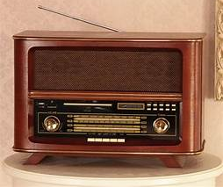
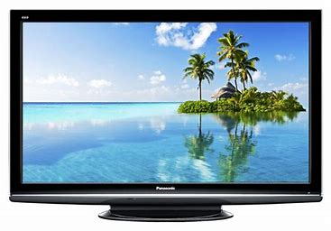
Entertainment Before the television was invented people would use radios for entertainment! Nowadays people use tv’s and there are much more channels than there were !

Slide 3
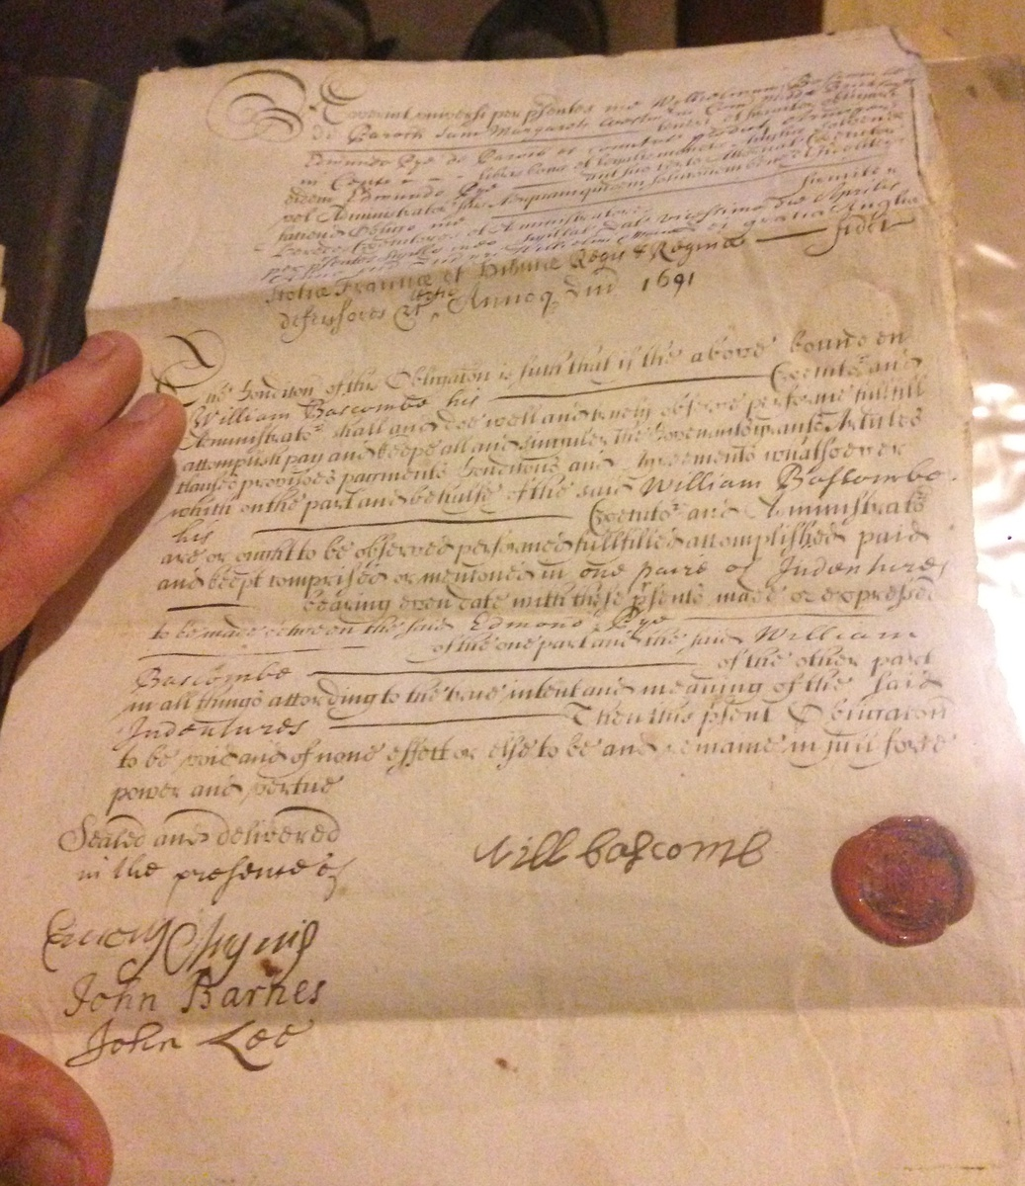
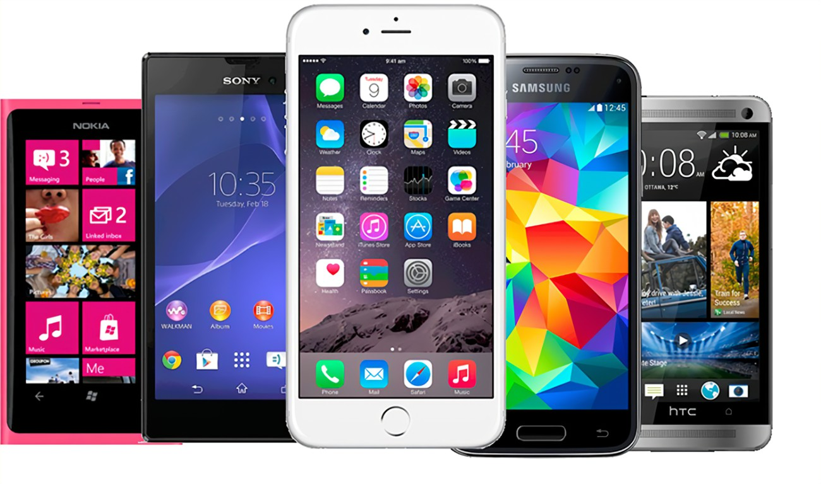
Communication Before mobile phones, people would write and deliver letters because phones and telephones weren’t invented!

Slide 4
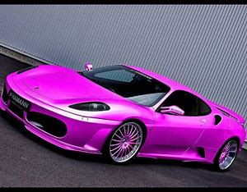
Transport Years ago, people would use horse and carts because modern cars weren’t invented! I know which one I prefer

Slide 5
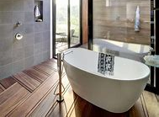
Bath time Centuries ago people would use tins as baths how strange! But now we use bathtubs with rubber ducks' soap and foam shaper you might not use all of them

Slide 6
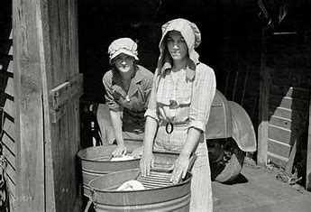
Cleaning A long, long, long, time ago people used wooden boards and tin buckets to wash their clothes in.

Slide 7
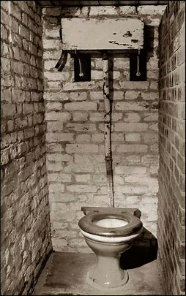
Toilet outside in the gardens there would be toilets! Look at this one it looks like it's been used how strange.

