Slide 1
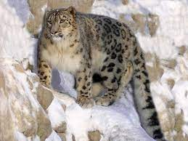
If animals could talk what would they say?
Snow Leopards
I like to live in solitary which means I prefer living alone as I am less likely to be hunted.
I am usually found in Russia, Mongolia and China living between 3000-5500m above the sea.
My home would be high up living in caves amongst rocky cliffs.
I like to eat goat, deer, wild boar and other small mammals.
I have beautiful thick fur but this makes me a target for hunters.
I am worried how long it will be until we are extinct, I don’t know exact numbers but there are only between 3900-6400 of us left.

Slide 2
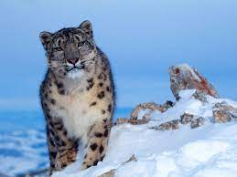
If animals could talk what would they say?
Snow Leopards
Approx 450 of my friends are killed every year.
I am concerned that poaching is also reducing the resources I have to live and survive for much longer.
Humans are also mining now in my natural habitat which means we have fewer places to hide.
Climate change is also making my chances of survival harder. My ideal condition is between -4 and 22 degrees Celsius. I am frightened as temperatures are always rising meaning my cosy cold climates are disappearing.

Slide 3
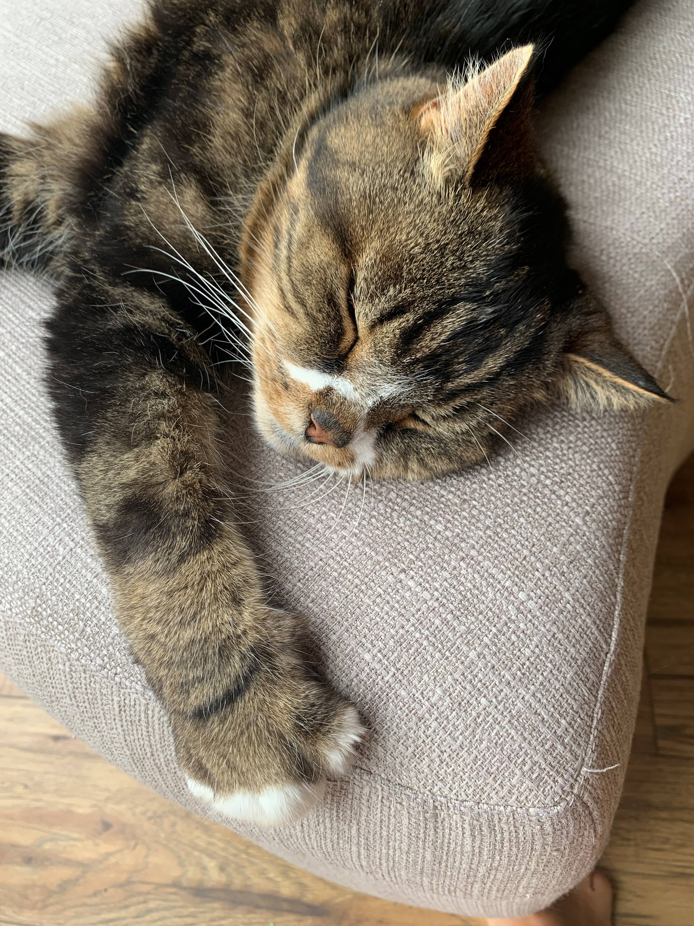
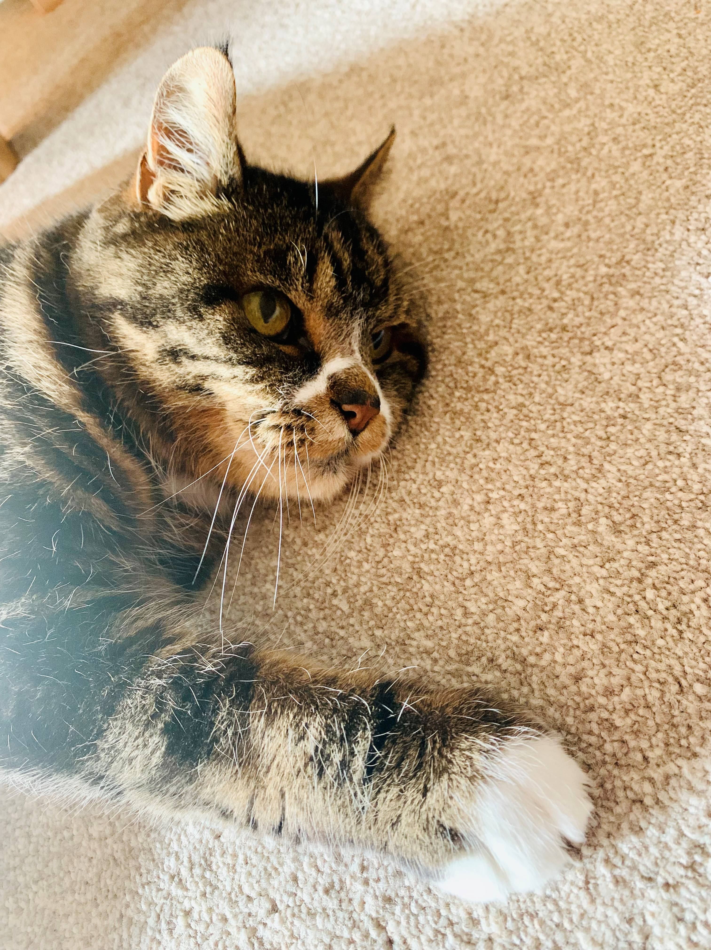
If animals could talk what would they say?
Domestic Cats
This was Louis if he could have talked he would have said:
I like warm, cozy beds or sofas to sleep on after a day of sleeping outside, playing and eating.
My favourite food was fresh chicken or tuna, although I was partial to some pate for my birthday and Xmas.
To show my love for you I brought you mice, some dead or alive!!
My biggest threat are the pesky, big dogs that live in our village and silly drivers that may not see me in the road. Although I was known to have a few cat scraps that meant I had to go to the vets.
I am grateful for my owners as I do not have to worry about finding a safe place to live, being hunted or catching my own food like members of my larger cat family. You always looked after me and kept me safe.

