Slide 1
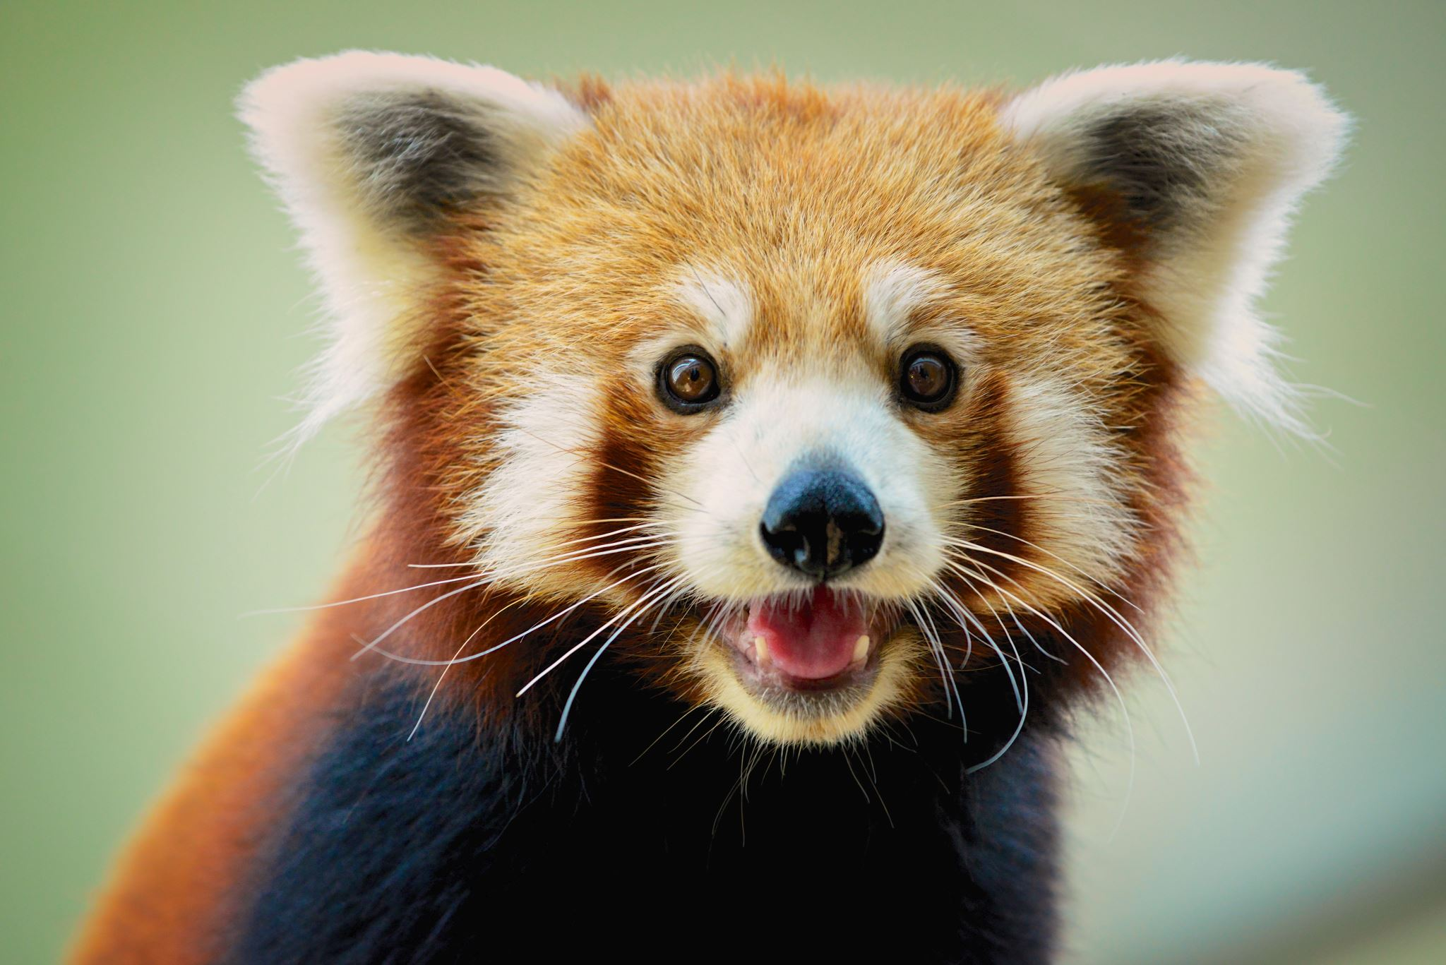
What if animals around the world had a voice? What would they say?
By LEO Charles

Slide 2
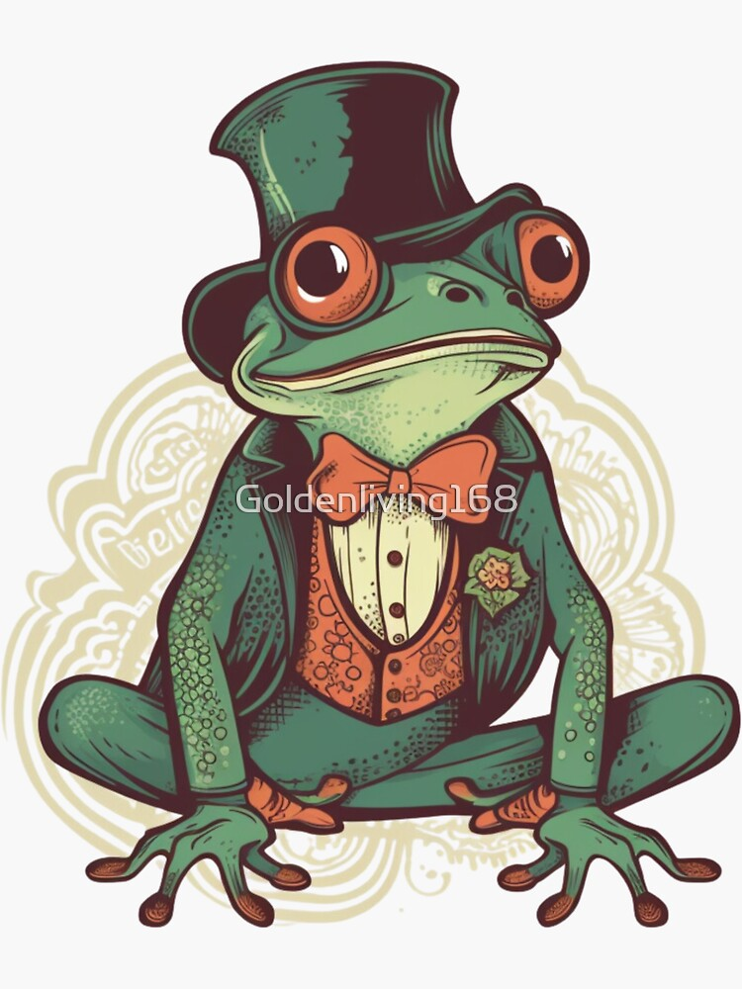
hi I am going to be your host my Names George and I will direct you

Slide 3
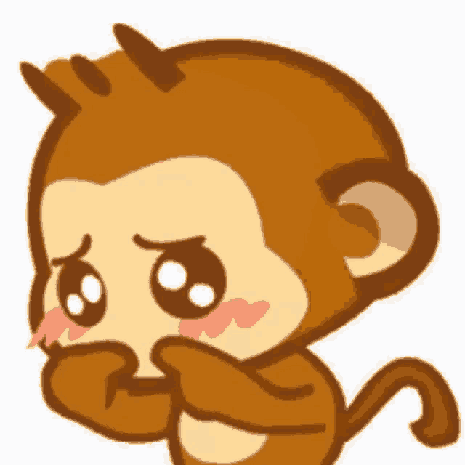
Ok first, lets start with the monkey or orangutans
They would be shouting “help what are you doing to my forest stop it we don’t like it!”.
“Stop breaking the trees what do you want!”.

Slide 4
Now the red panda
They would be saying “why are you hunting me down (I’m not a chicken but my fur does look like one)”.
“I’m not a sheep get wool from them I am cuter don’t you think?”.

Slide 5
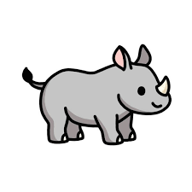
Now the rhino
They would say “Stop! Can’t you get a diamond or gold instead of my tusk”.
“It’s part of my nose imagine if someone just came up and ripped part of your nose off it hurts!”

Slide 6
It’s our world too we deserve to be treated like it.
The end😊

