Slide 1
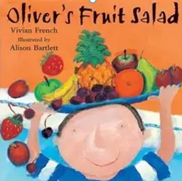

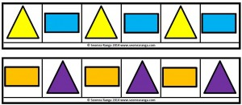
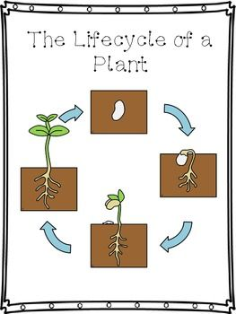
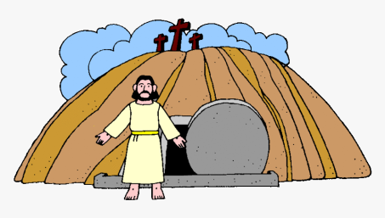

Communication, Language & Literacy
Nian The Chinese Dragon
Supertato
Why I Love My Mummy
Oliver’s Fruit Salad
We're going on an Egg Hunt
People & Communities
Chinese New Year
Mothering Sunday
World Book Day
Maths
Numbers 1-5
Linking numerals to amounts
Weight
Repeating Patterns
Expressive Arts & Design
Painting fruit
Spring Flowers painting and making
Painting Characters from stories
Making Chinese Dragon
I wonder what is new?
Nursery Spring 2 2026
PSED
Tick Box – Doodle Makes Choices - Communication
The World
Spring Time Changes
The Life Cycle of a Plant
Physical Development
Sports Xplorers
Balancing Bella
RE
Easter
New Life

