Slide 1
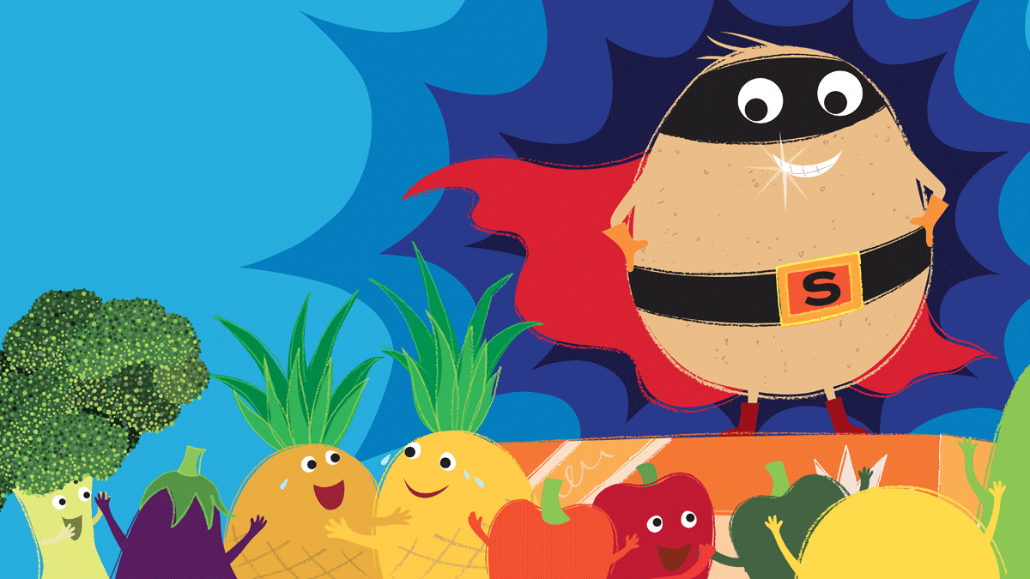
Supertato
Creative
Make a Supertato
Construction
Using bricks can you make a trap to catch the Evil Pea.
Small World
Using vegetables can you make the characters from the story and then retell the story.
Dance
Be a Superhero
Creative
Make a superhero mask. What would be your super powers

