Slide 1
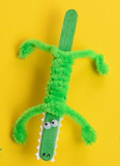
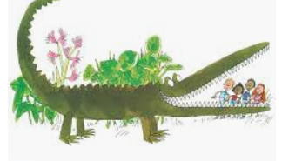
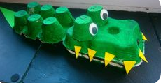
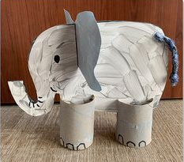
World Book Week The Enormous Crocodile by Roald Dahl
Maths
Find out how long a crocodile is. How long might the Enormous Crocodile have been? Could you measure this distance?
Make a cardboard cut out of the enormous crocodile. Using your hands/feet/pencils can you measure how long he is?? Watch the video about measuring length with the children, can they remember the rules of measuring length with non standard measurement – objects need to be the same e.g all shoes or all pencils and must be the same size– mustn’t leave a gap between objects being used
Literacy
See work added to Seesaw
UW
Do some research to find out more about crocodiles and where they live. Find out about other animals in the story and make a fact file.
PSED
Talk about good and bad characters in the story. Why was the Enormous Crocodile so mean? How did the animals help the children in the story? How could you help a friend in need?
The Enormous Crocodile likes to eat children. Could you think of a healthy meal the crocodile might like
instead? Draw or collage a healthy meal for the crocodile on a paper plate.
EAD
Choose an animal out of the story and create a 3D model of it.
Make a lollypop stick/pipe cleaner craft crocodile.
Paint a picture of your favourite character

Slide 2
Monday
Watch Part 1 of the
The Enormous Crocodile
Tuesday
Watch Part 2 of the
The Enormous Crocodile
Thursday
Watch Part 3of the
The Enormous Crocodile

