Slide 1
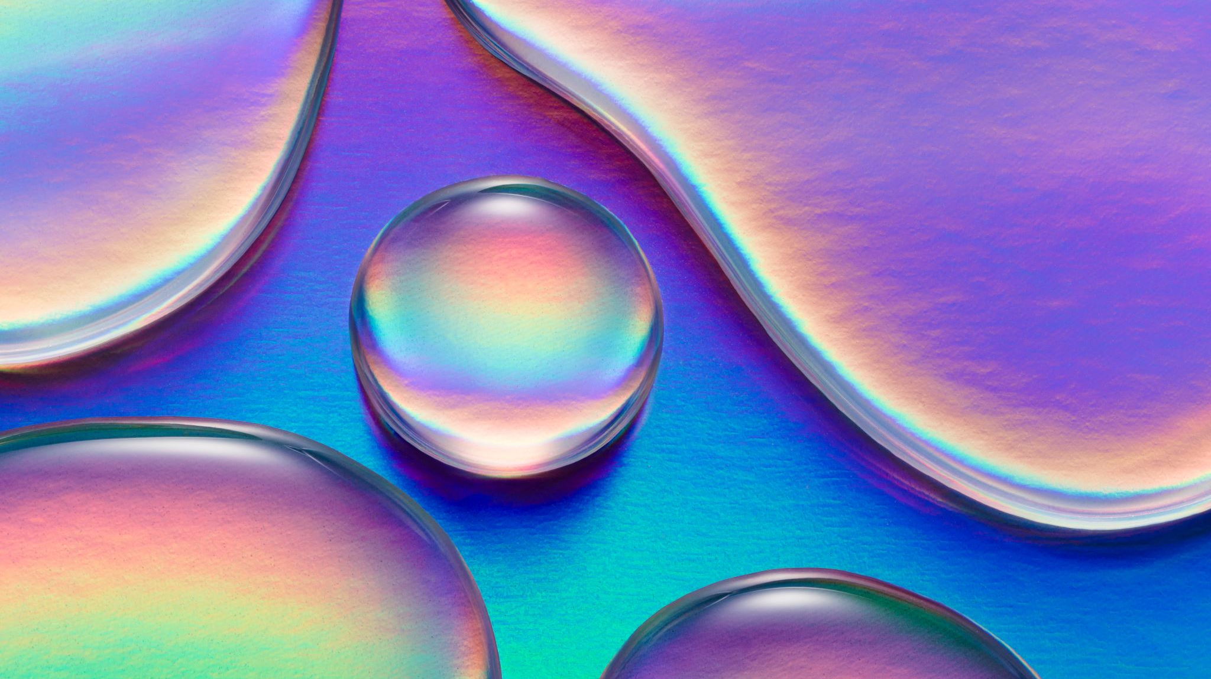
What if the animals around the world had a voice ? What would they say?
By Penny

Slide 2
The earth has lots of different animals but the animals in the rain forest are dying because there are humans cutting down the trees and spoiling nature.

Slide 3
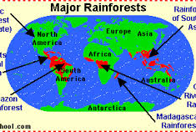
Some rain forests are 70 million years old. They have lots of animals and plant species which are being slowly destroyed.

Slide 4
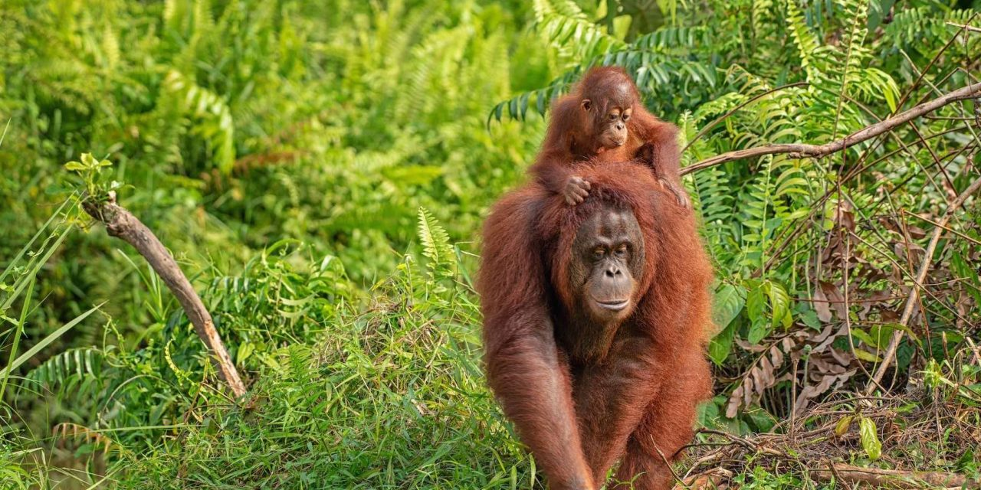
Orangutans In some rainforests there are orangutans, but they are almost extinct because the humans are cutting down the trees for more palm oil.
Please help us and stop buying palm oil
PLEASE.

Slide 5
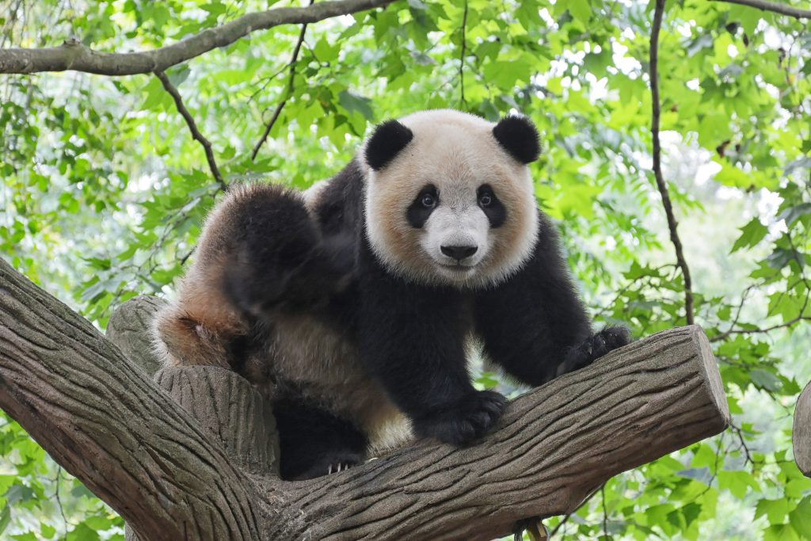
Pandas Did you know that Pandas need to eat 24-84 pounds of bamboo every day. In the rain forest there is not much bamboo left because humans are cutting down the trees. The pandas will die because they are starving.
Please save me or I will be extinct for ever. I don’t want you to make me extinct . PLEASE help me!

Slide 6
Pygmy Sloths There are only 100 Pygmy sloths left and they live on a very small island. They are dying because of the trees being cut down and because people take them to be their pets.
Help me please because I don’t want to be a pet. I am a wild animal.

Slide 7
African elephants About 90% of African elephants have been killed. About 100 are killed every day. This is because people are killing them for their tusks. They are also dying because where they live is being destroyed.
Please stop killing us and please stop cutting down our habitat.

Slide 8
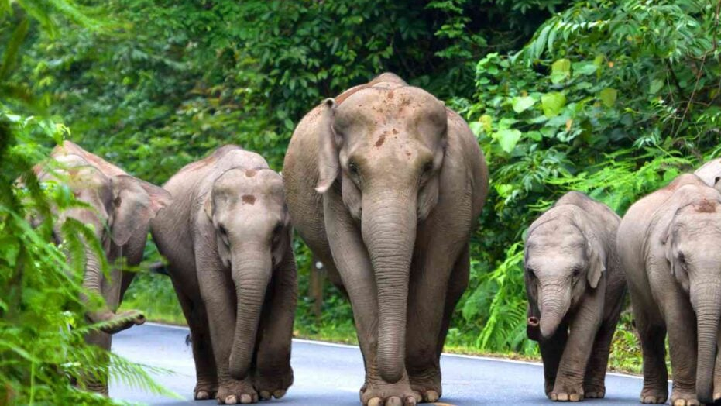
Elephants are the world's largest mammal. They need to eat lots to survive. They eat grass, leaves, fruit, twigs and branches but these are all being destroyed by people.

Slide 9
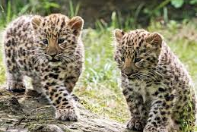
Amur Leopards These live in Russia and China and they are building roads and houses where they live. Amur Leopards are the rarest big cats in the world.
Please stop building by us. We don’t want roads, we want our habitat back.

Slide 10
So, what can we do to help?
Don’t buy products without the logo RSPO on them because this is good palm oil.
If you use products without this logo, it is bad because animals are becoming extinct.

