Slide 1
What is the strangest thing about people who lived in the past?
By Dolores Witts

Slide 2
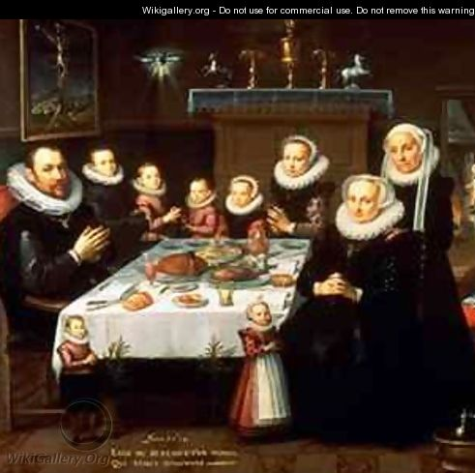
Tudors at Dinner Time
The Tudors didn't have forks – they ate with their fingers and knives
This Photo by Unknown author is licensed under CC BY-NC-ND.

Slide 3
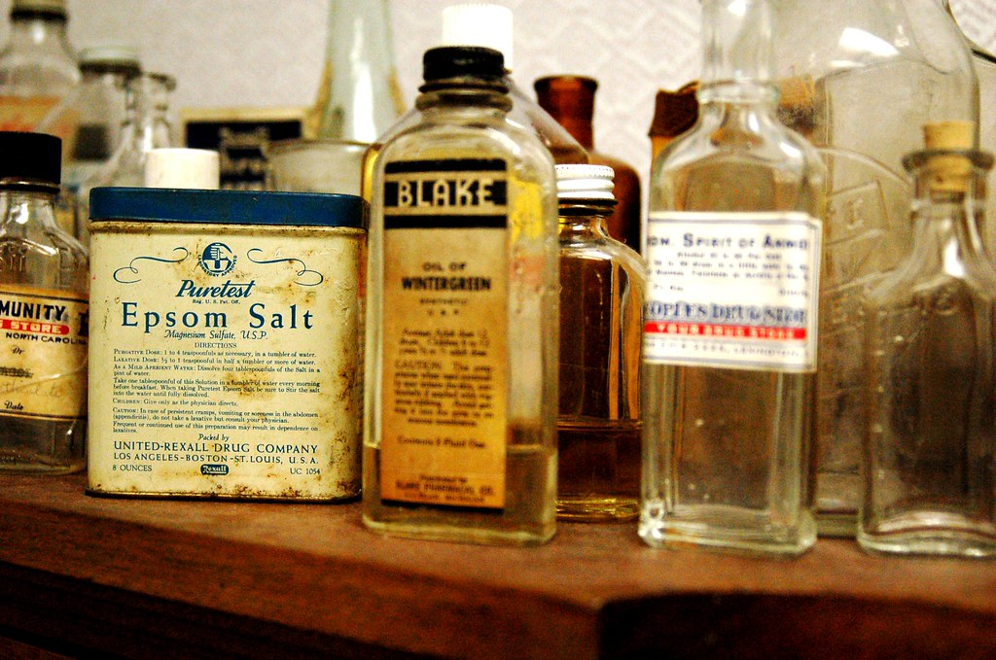
Tudors and Doctors
Only rich people could afford doctors so Tudors tried to cure themselves with things like butter and spiders – they had no other way to survive
This Photo by Unknown author is licensed under CC BY-ND.

Slide 4
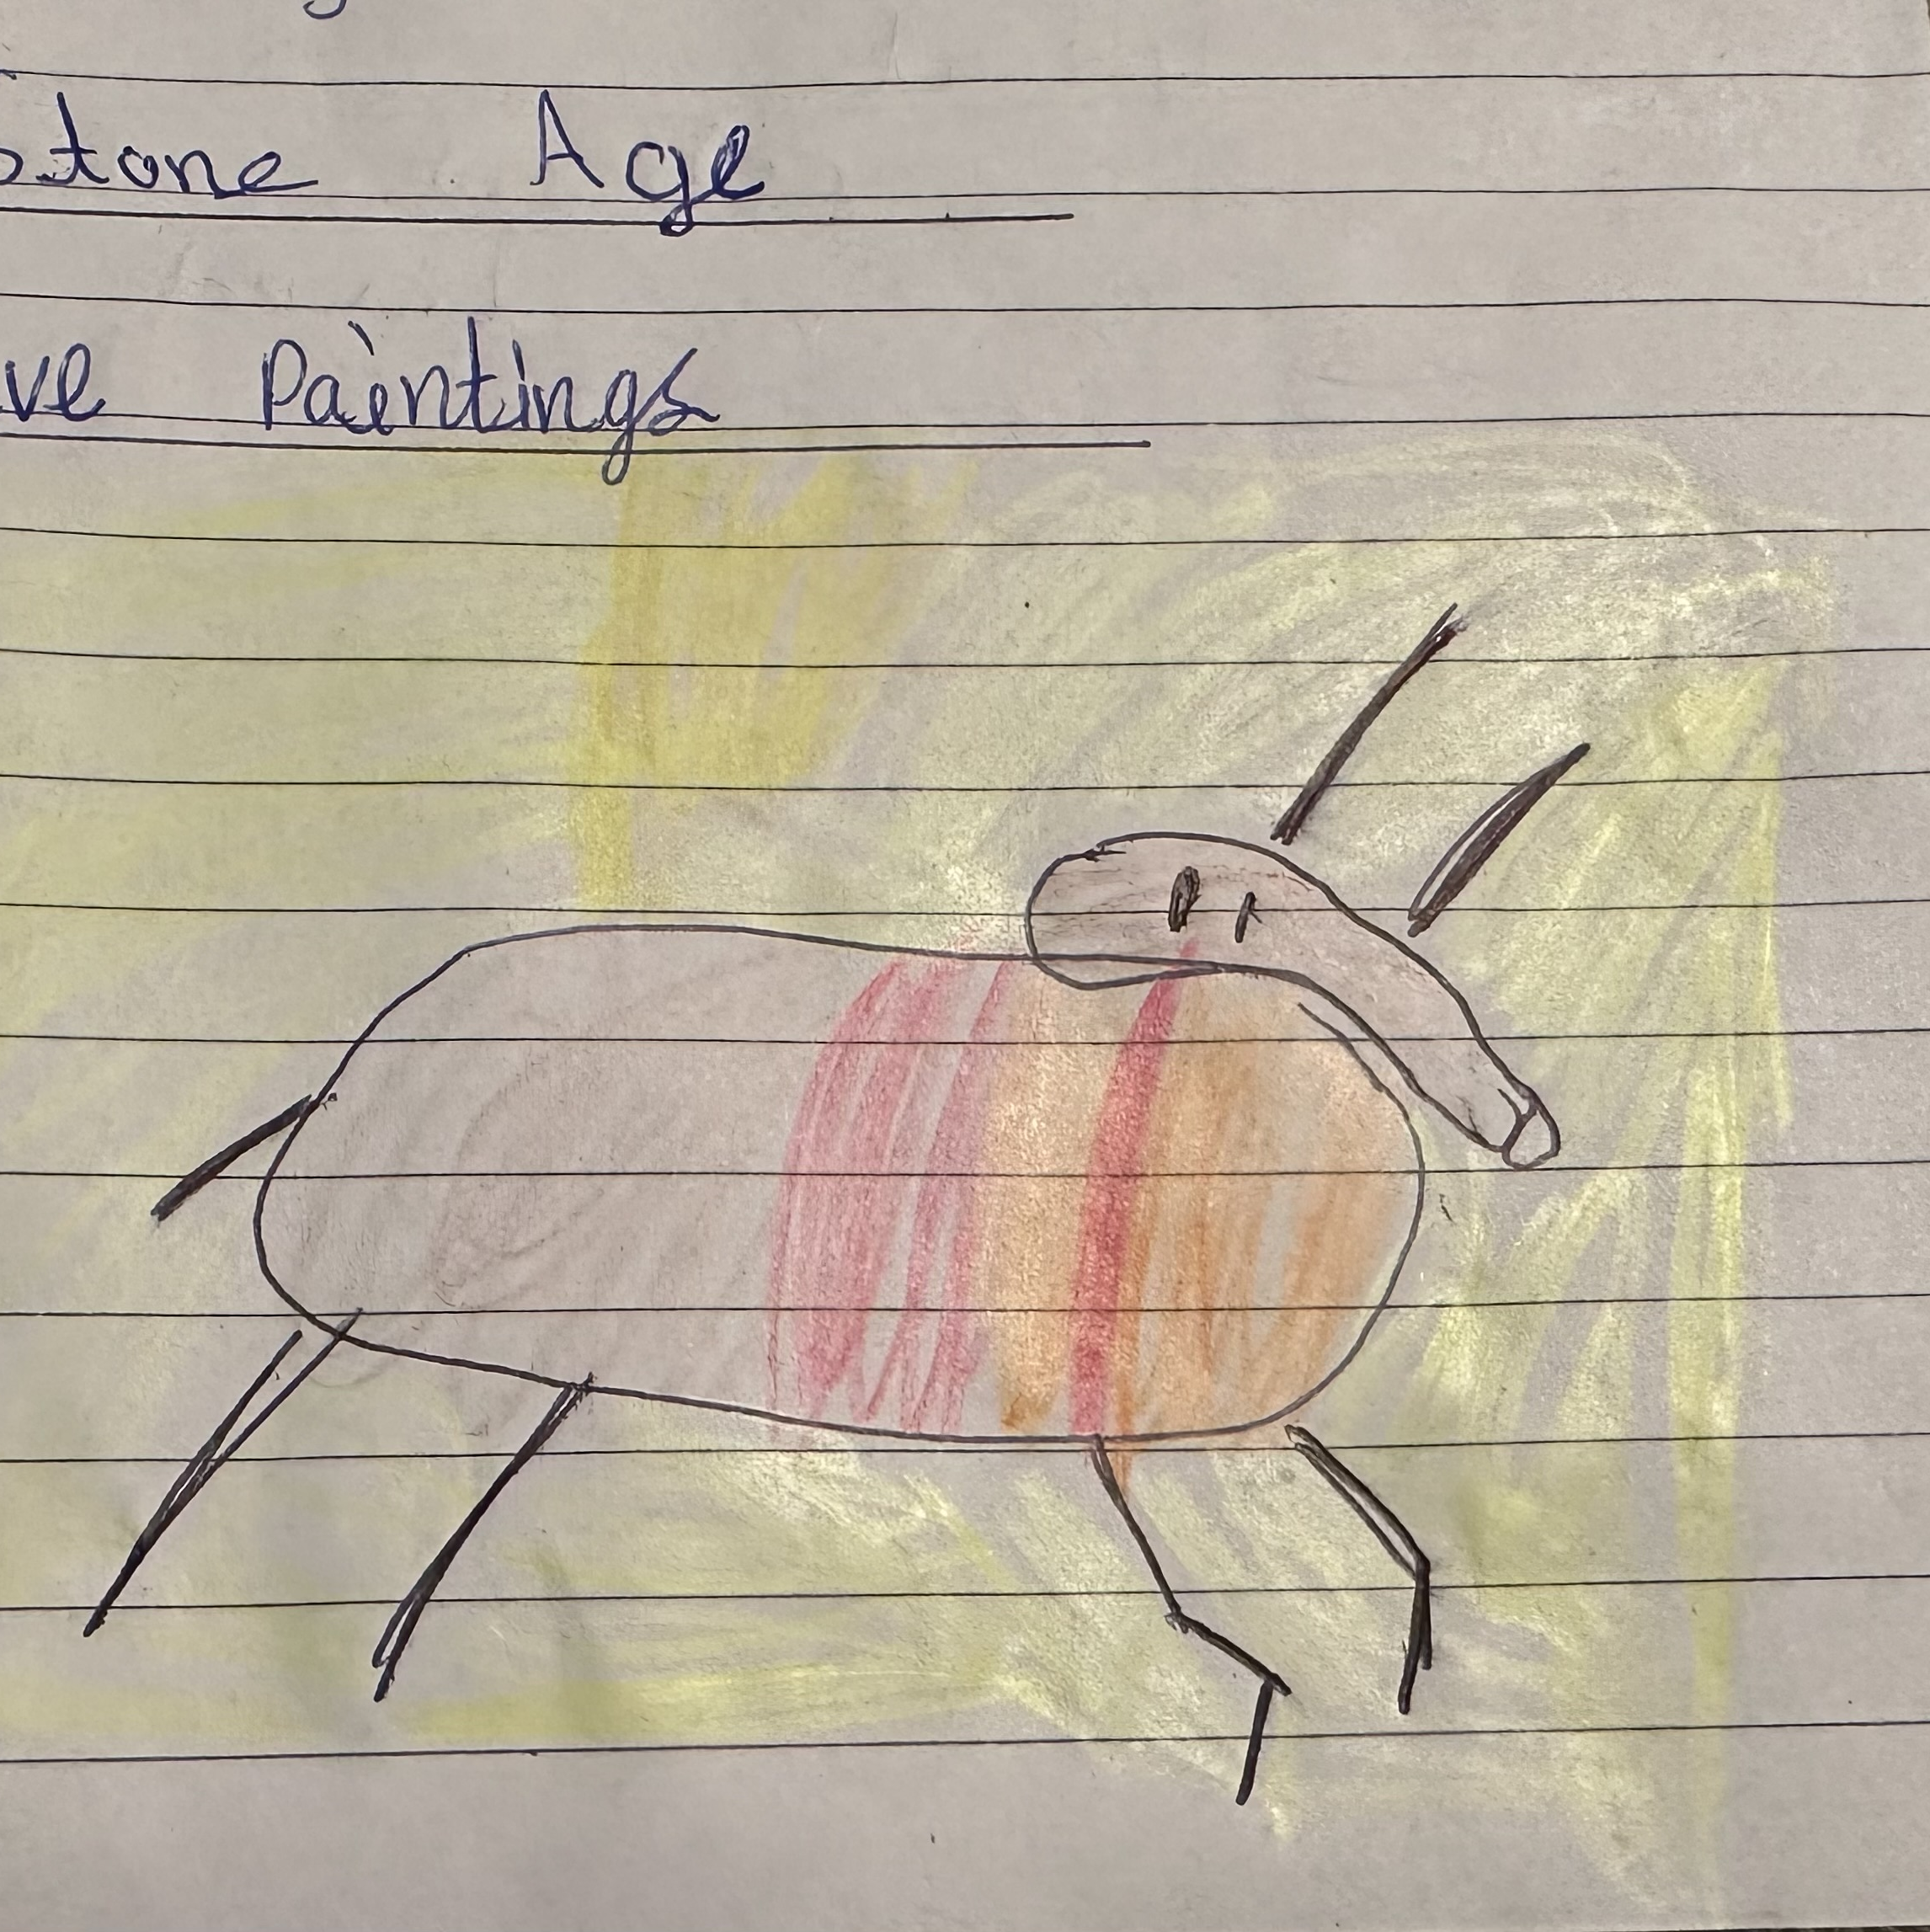
Stone Age
Stone Age people made cave paintings – they used charcoal and other natural pigments for colours

Slide 5
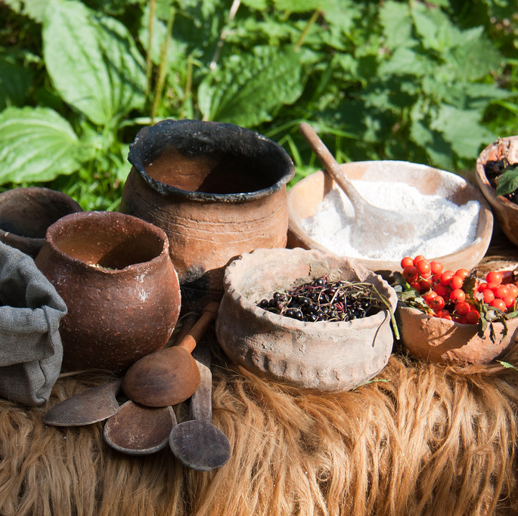
Stone Age diet
The Stone Age people only ate what they could hunt or forage.
They ate meat, fish, berries and nuts
This Photo by Unknown author is licensed under CC BY-ND.

Slide 6
Finished
That’s what I think is strange about history.

