Slide 1
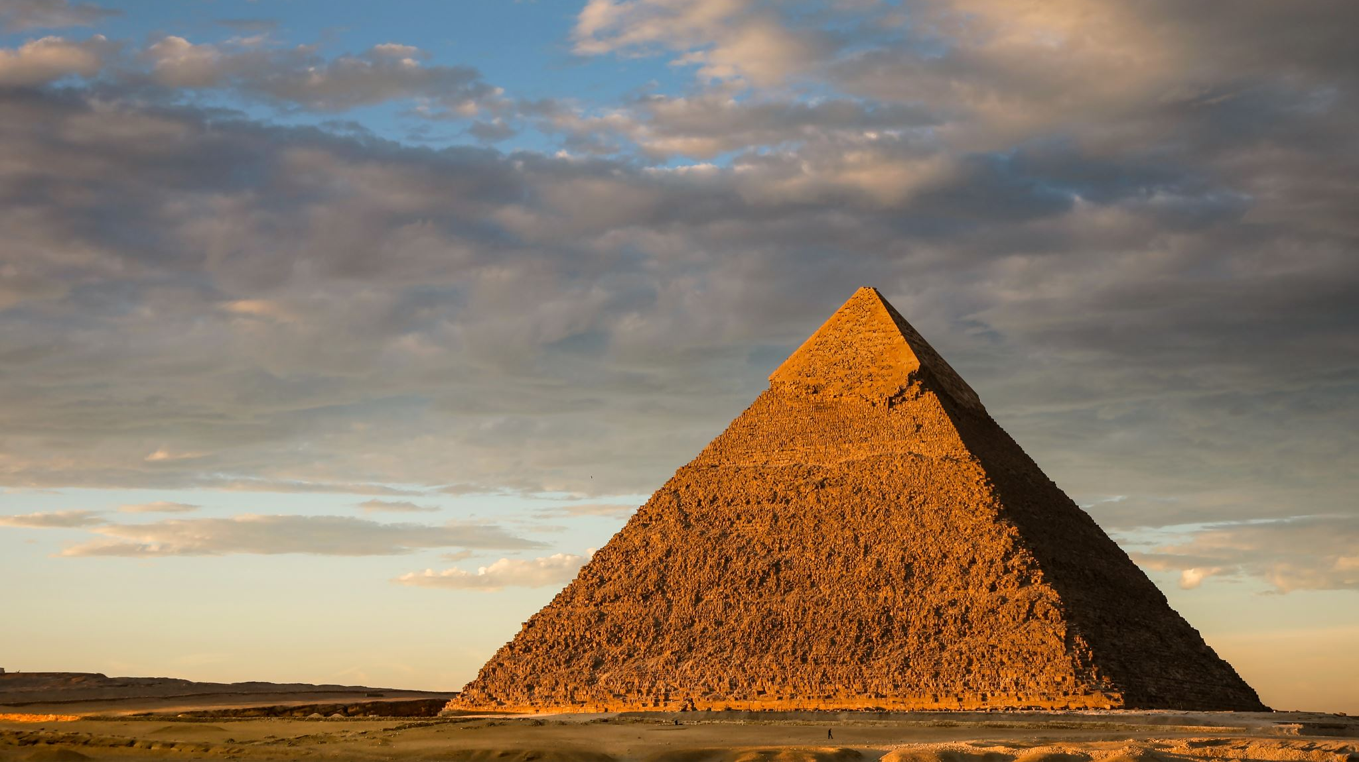
The strangest thing about Egypt and how people lived there.
Egypt is a massive place with ginormous pyramids. It is extremely famous.

Slide 2
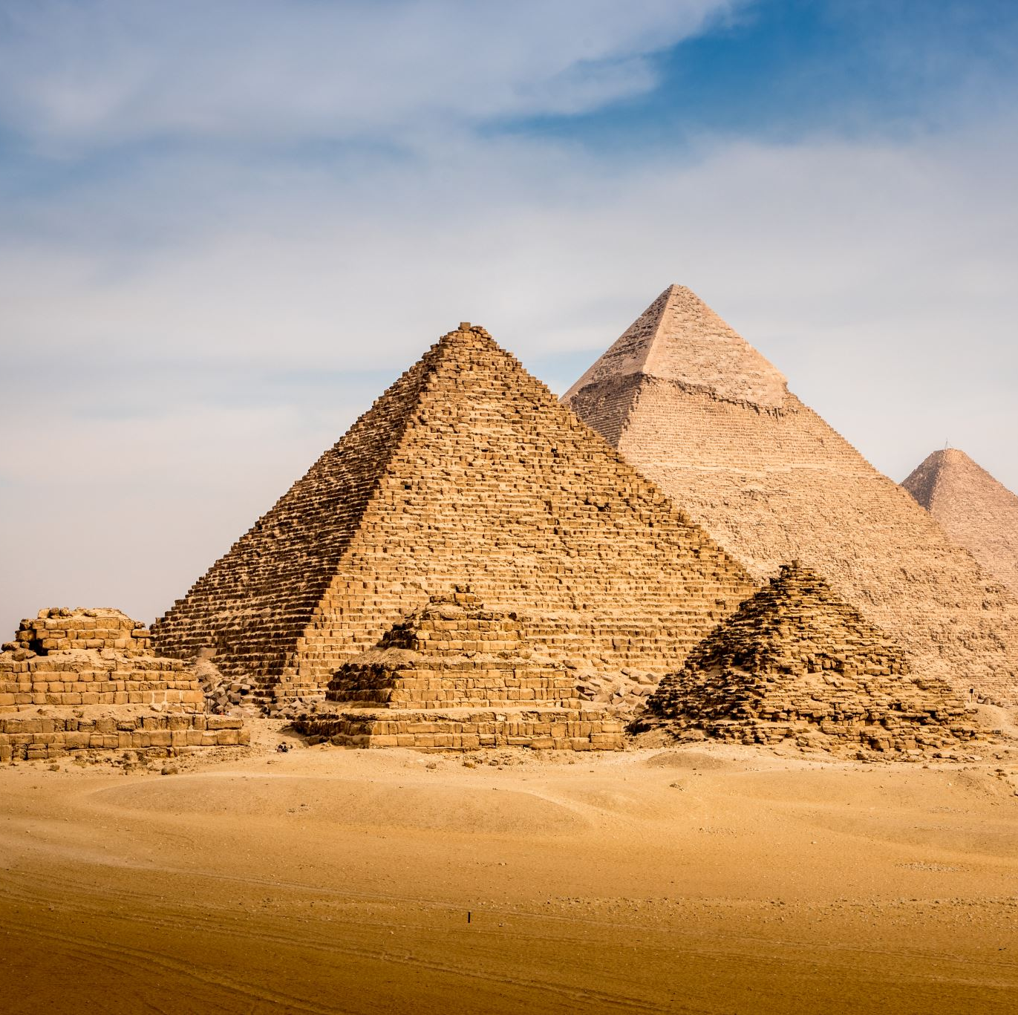
what is the strangest thing about how people lived life in Egypt?
You see the strangest thing is that almost everyone believes that Egyptians (the people who lived in Egypt) had extremely strange burials and life was so strange!
Also, instead of graveyards they had tunnels.
(See more on death at the next slide)

Slide 3
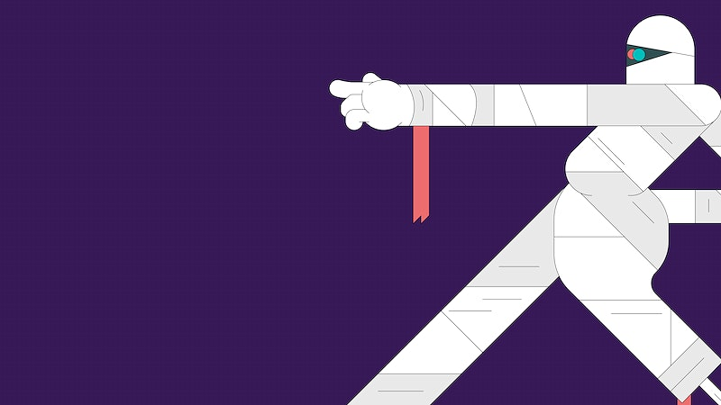
Mummification
Before being buried Egyptians would be mummified (wrapped in bandages) to prepare them for their next life.
How to mummify:
Remove internal organs
Pull brain out from nose
Cover in salt leave for 40 days
Wrap in tight linen bandages
Now you’re ready for your funeral!
Important Egyptians were buried in pyramids.

Slide 4
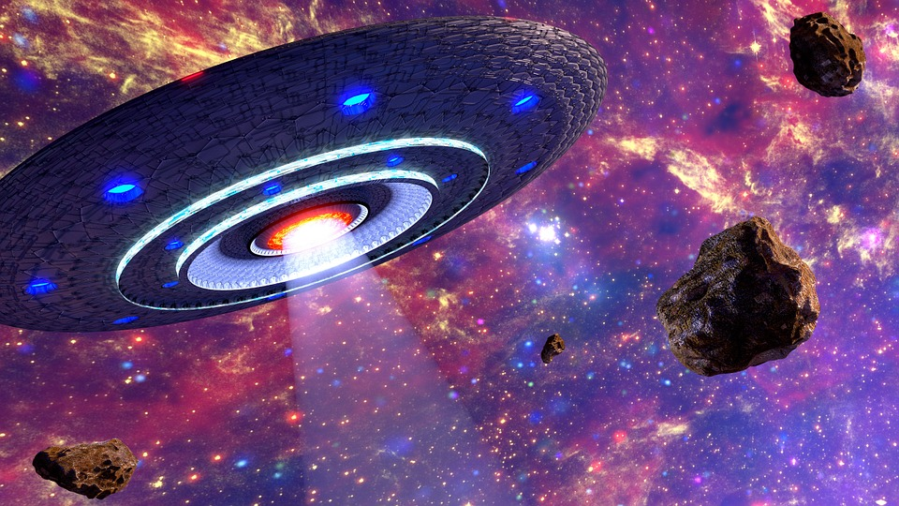
How did they build all the pyramids?
They built the pyramids by heaving humongous stones. Some people believe they were created by aliens !
It would take 20 years to build a pyramid and it took at least 50,000 people!

Slide 5
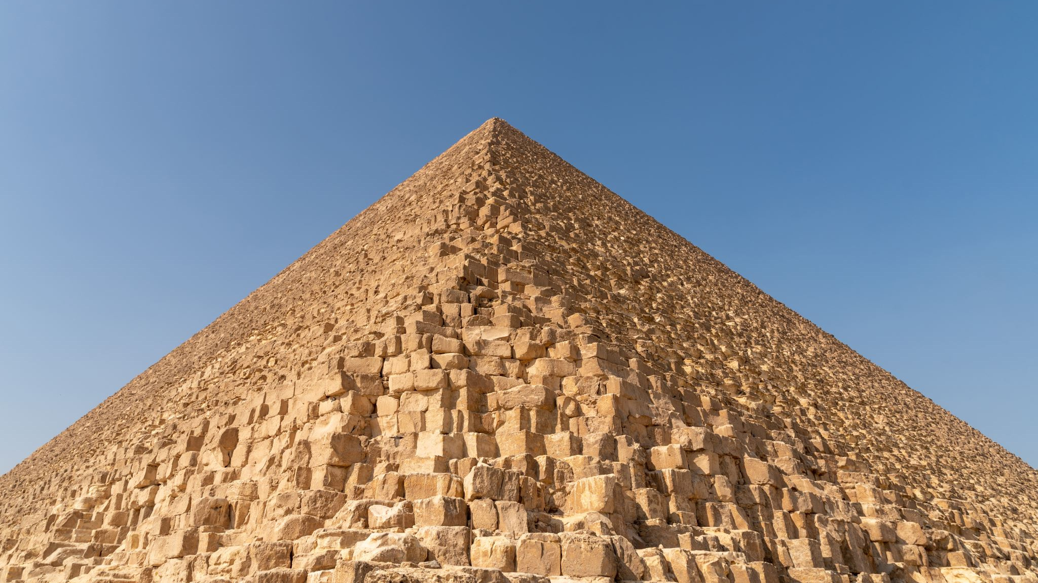
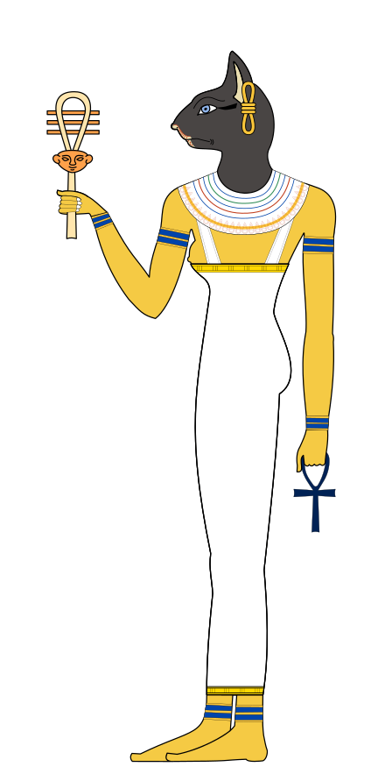
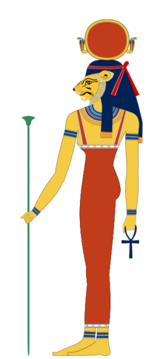
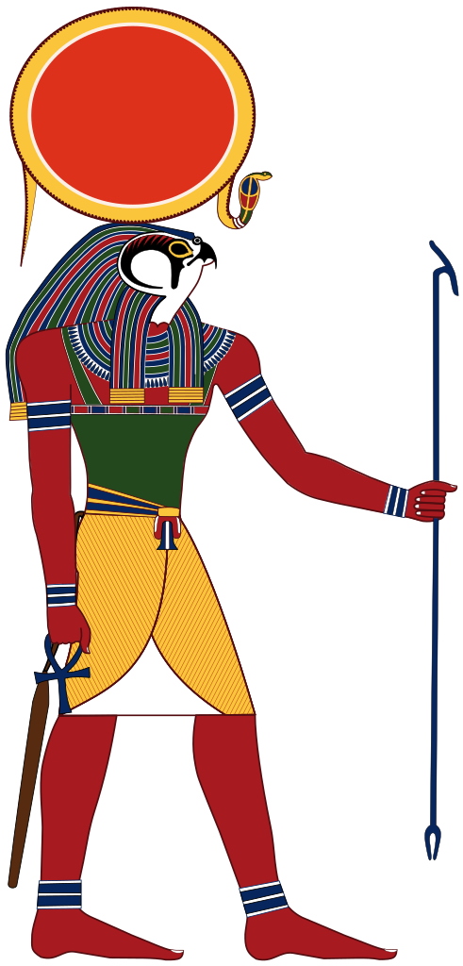
What are all the Egyptian god’s names?
There are thousands of gods and goddesses so we simply cannot name them all but here are a few: Bastet goddess of cats, Tefnut goddess of moisture and Ra god of sun.
Bastet
Tefnut
Ra

Slide 6
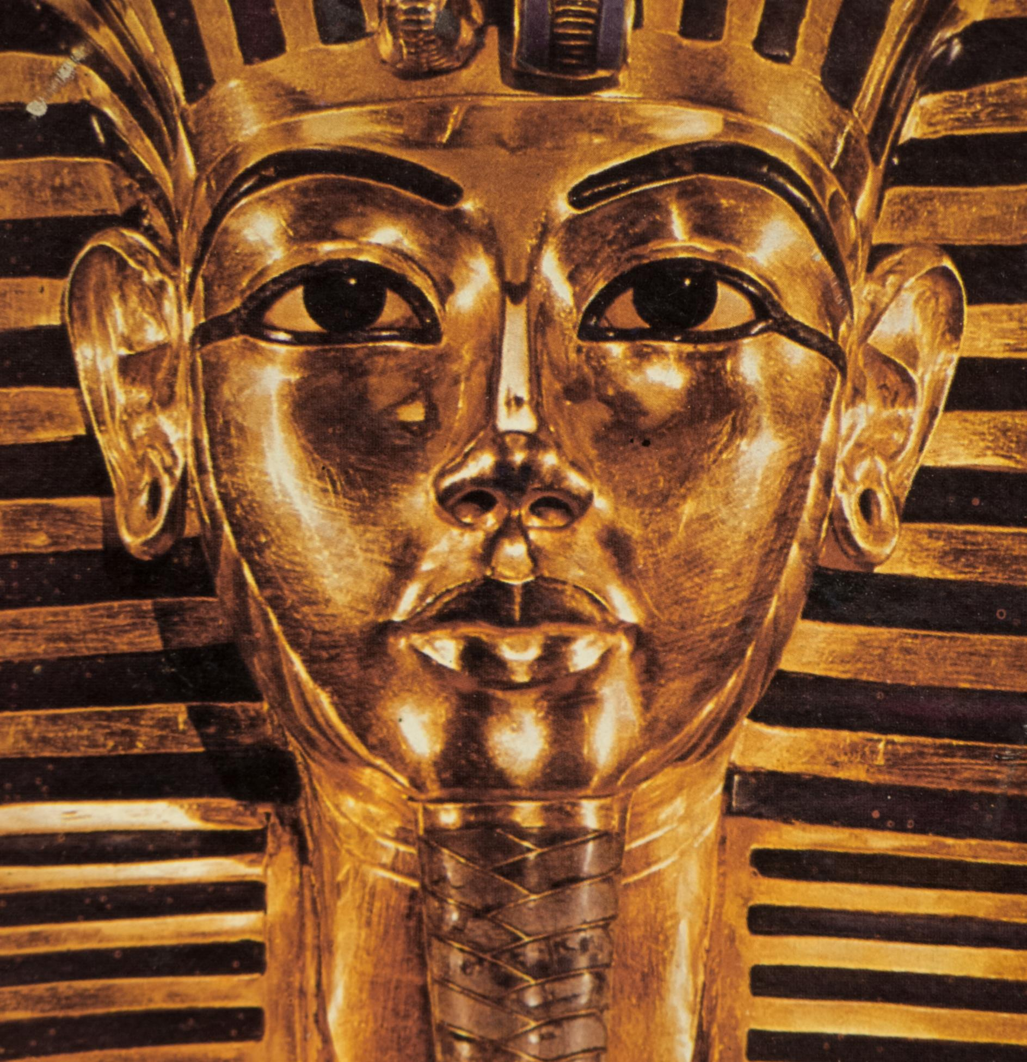
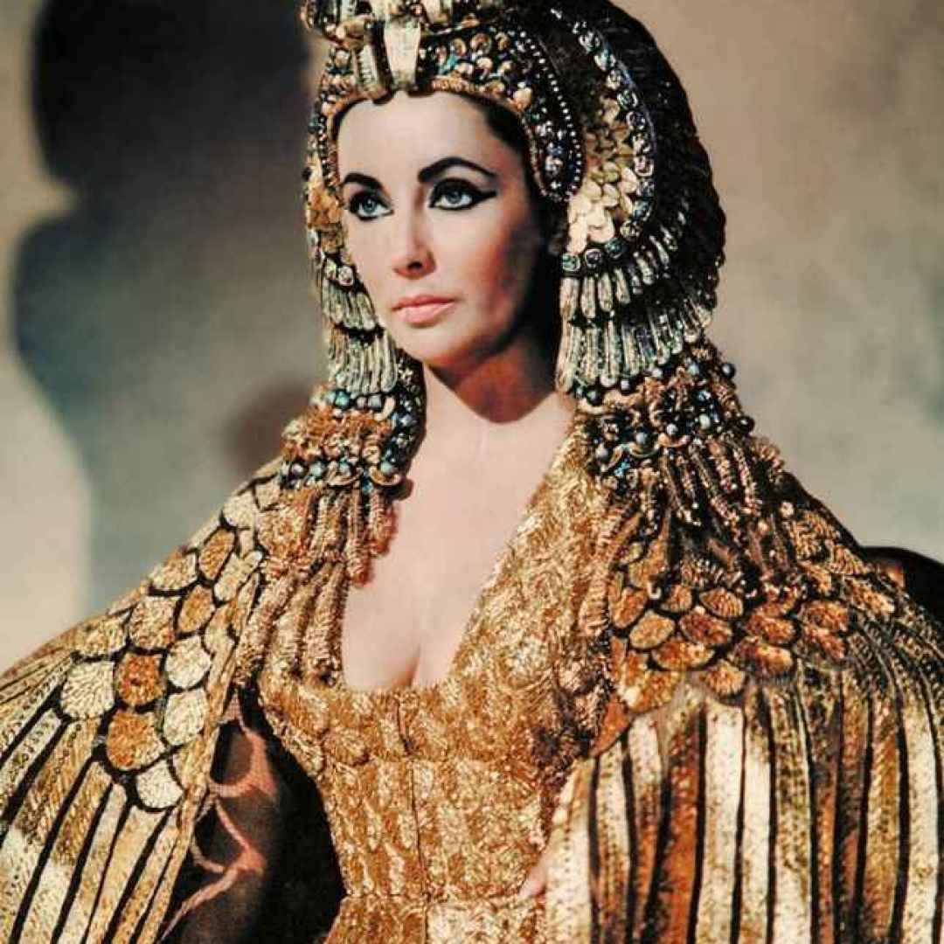
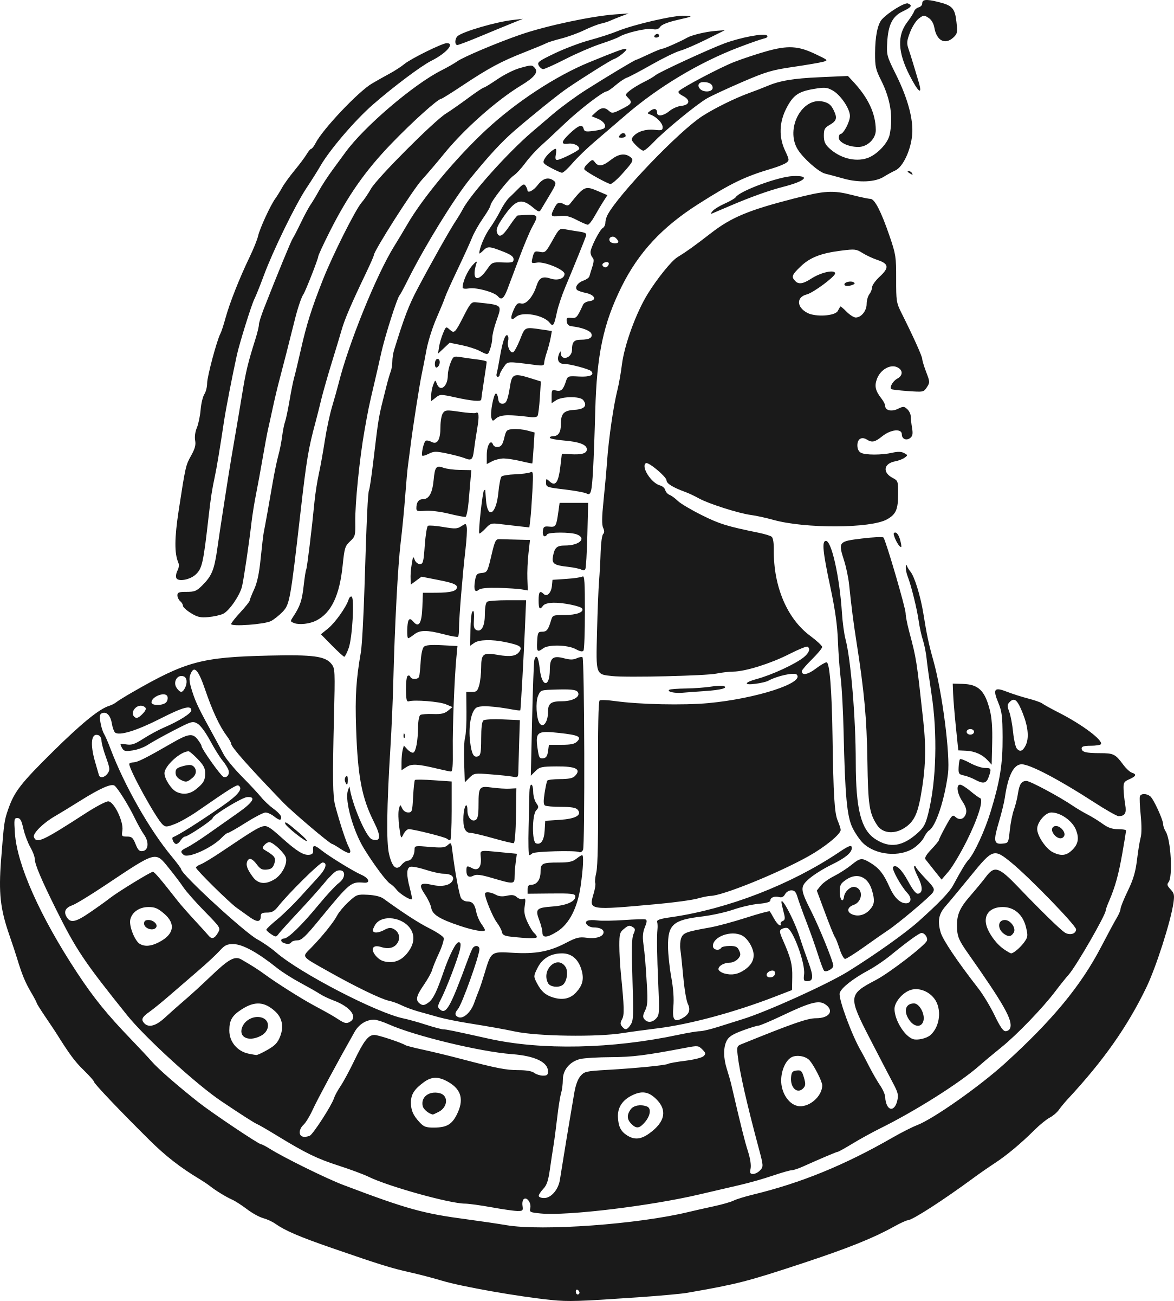
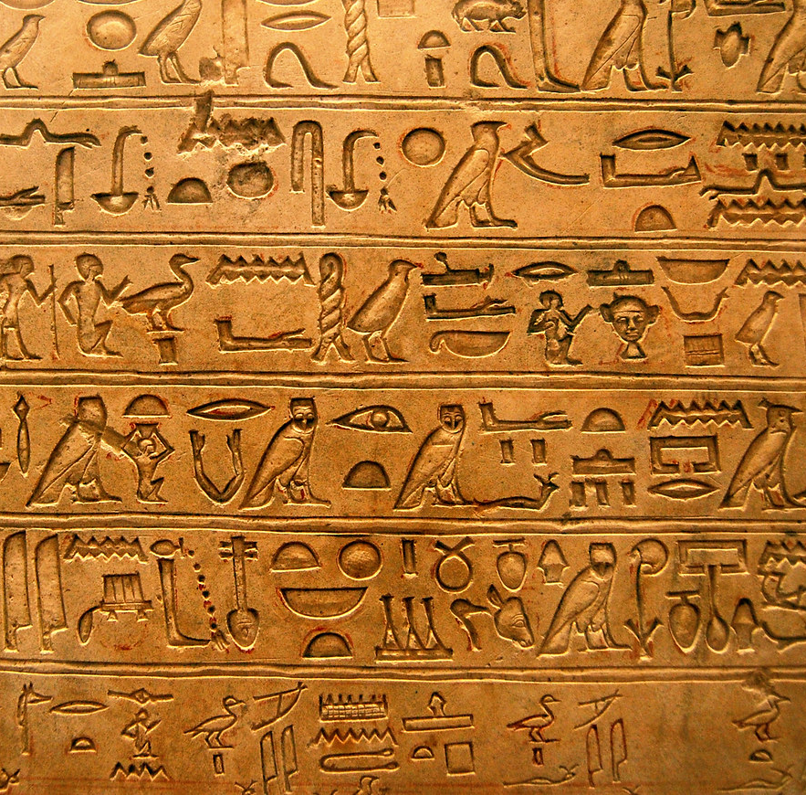
Here’s a few pictures!

