Slide 1
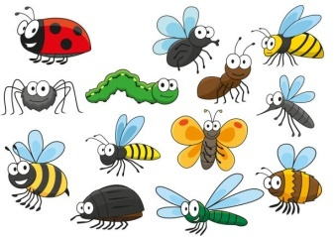

Expressive Arts & Design
Communication,
Language & Literacy
Activities
Communication,
Language & Literacy
Text
The Very Hungry Caterpillar
What the Ladybird Heard
The Very Busy Spider
Mad About Minibeasts
Model making
Painting different mini beasts
Labelling
Story Board/Paths
Retelling familiar stories
Making a list
Maths
More than/Fewer than
One more
One less
2D shape
Revisit Pattern
3D shape
I Wonder What Moves?
Nursery Summer 1 2025
PSED
Tick Box – Doodle Makes Plans - Creative
The World
Healthy Eating
Exploring how things work
Exploring different countries
Investigating different forces
RE
Life Values
Physical Development
Sport Day Races
Friendship

