Slide 1
My perfect world
Toby

Slide 2
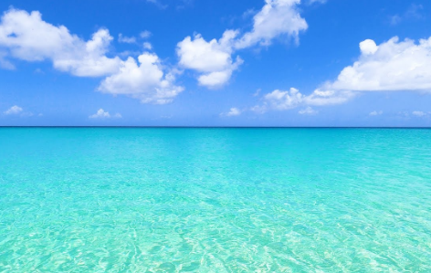
How does it look.
Sunny
Clean air
Green fields
Clear water

Slide 3
What is not allowed
No smoking
No vaping
No bad guys
No littering

Slide 4
Everyone would be
Kind
Healthy

Slide 5
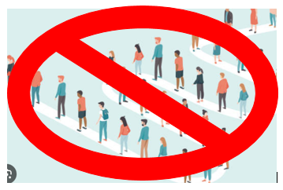
There also would be
No queues
No wasps
McDonald’s

Slide 6
By Toby.

