Slide 1
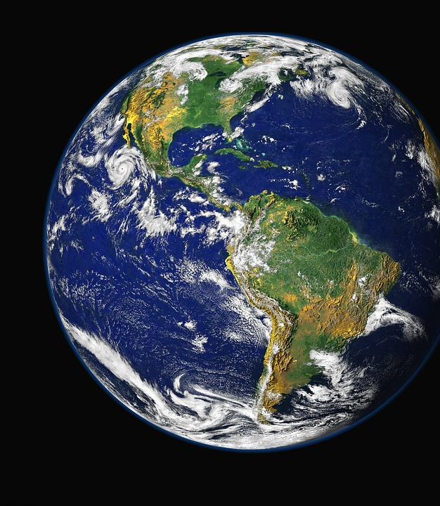
What would a perfect world be like?

Slide 2
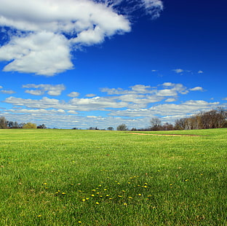
School
I think we should have longer play time and lunch.
We should have more toys and more field time.
And people to be more kind.

Slide 3
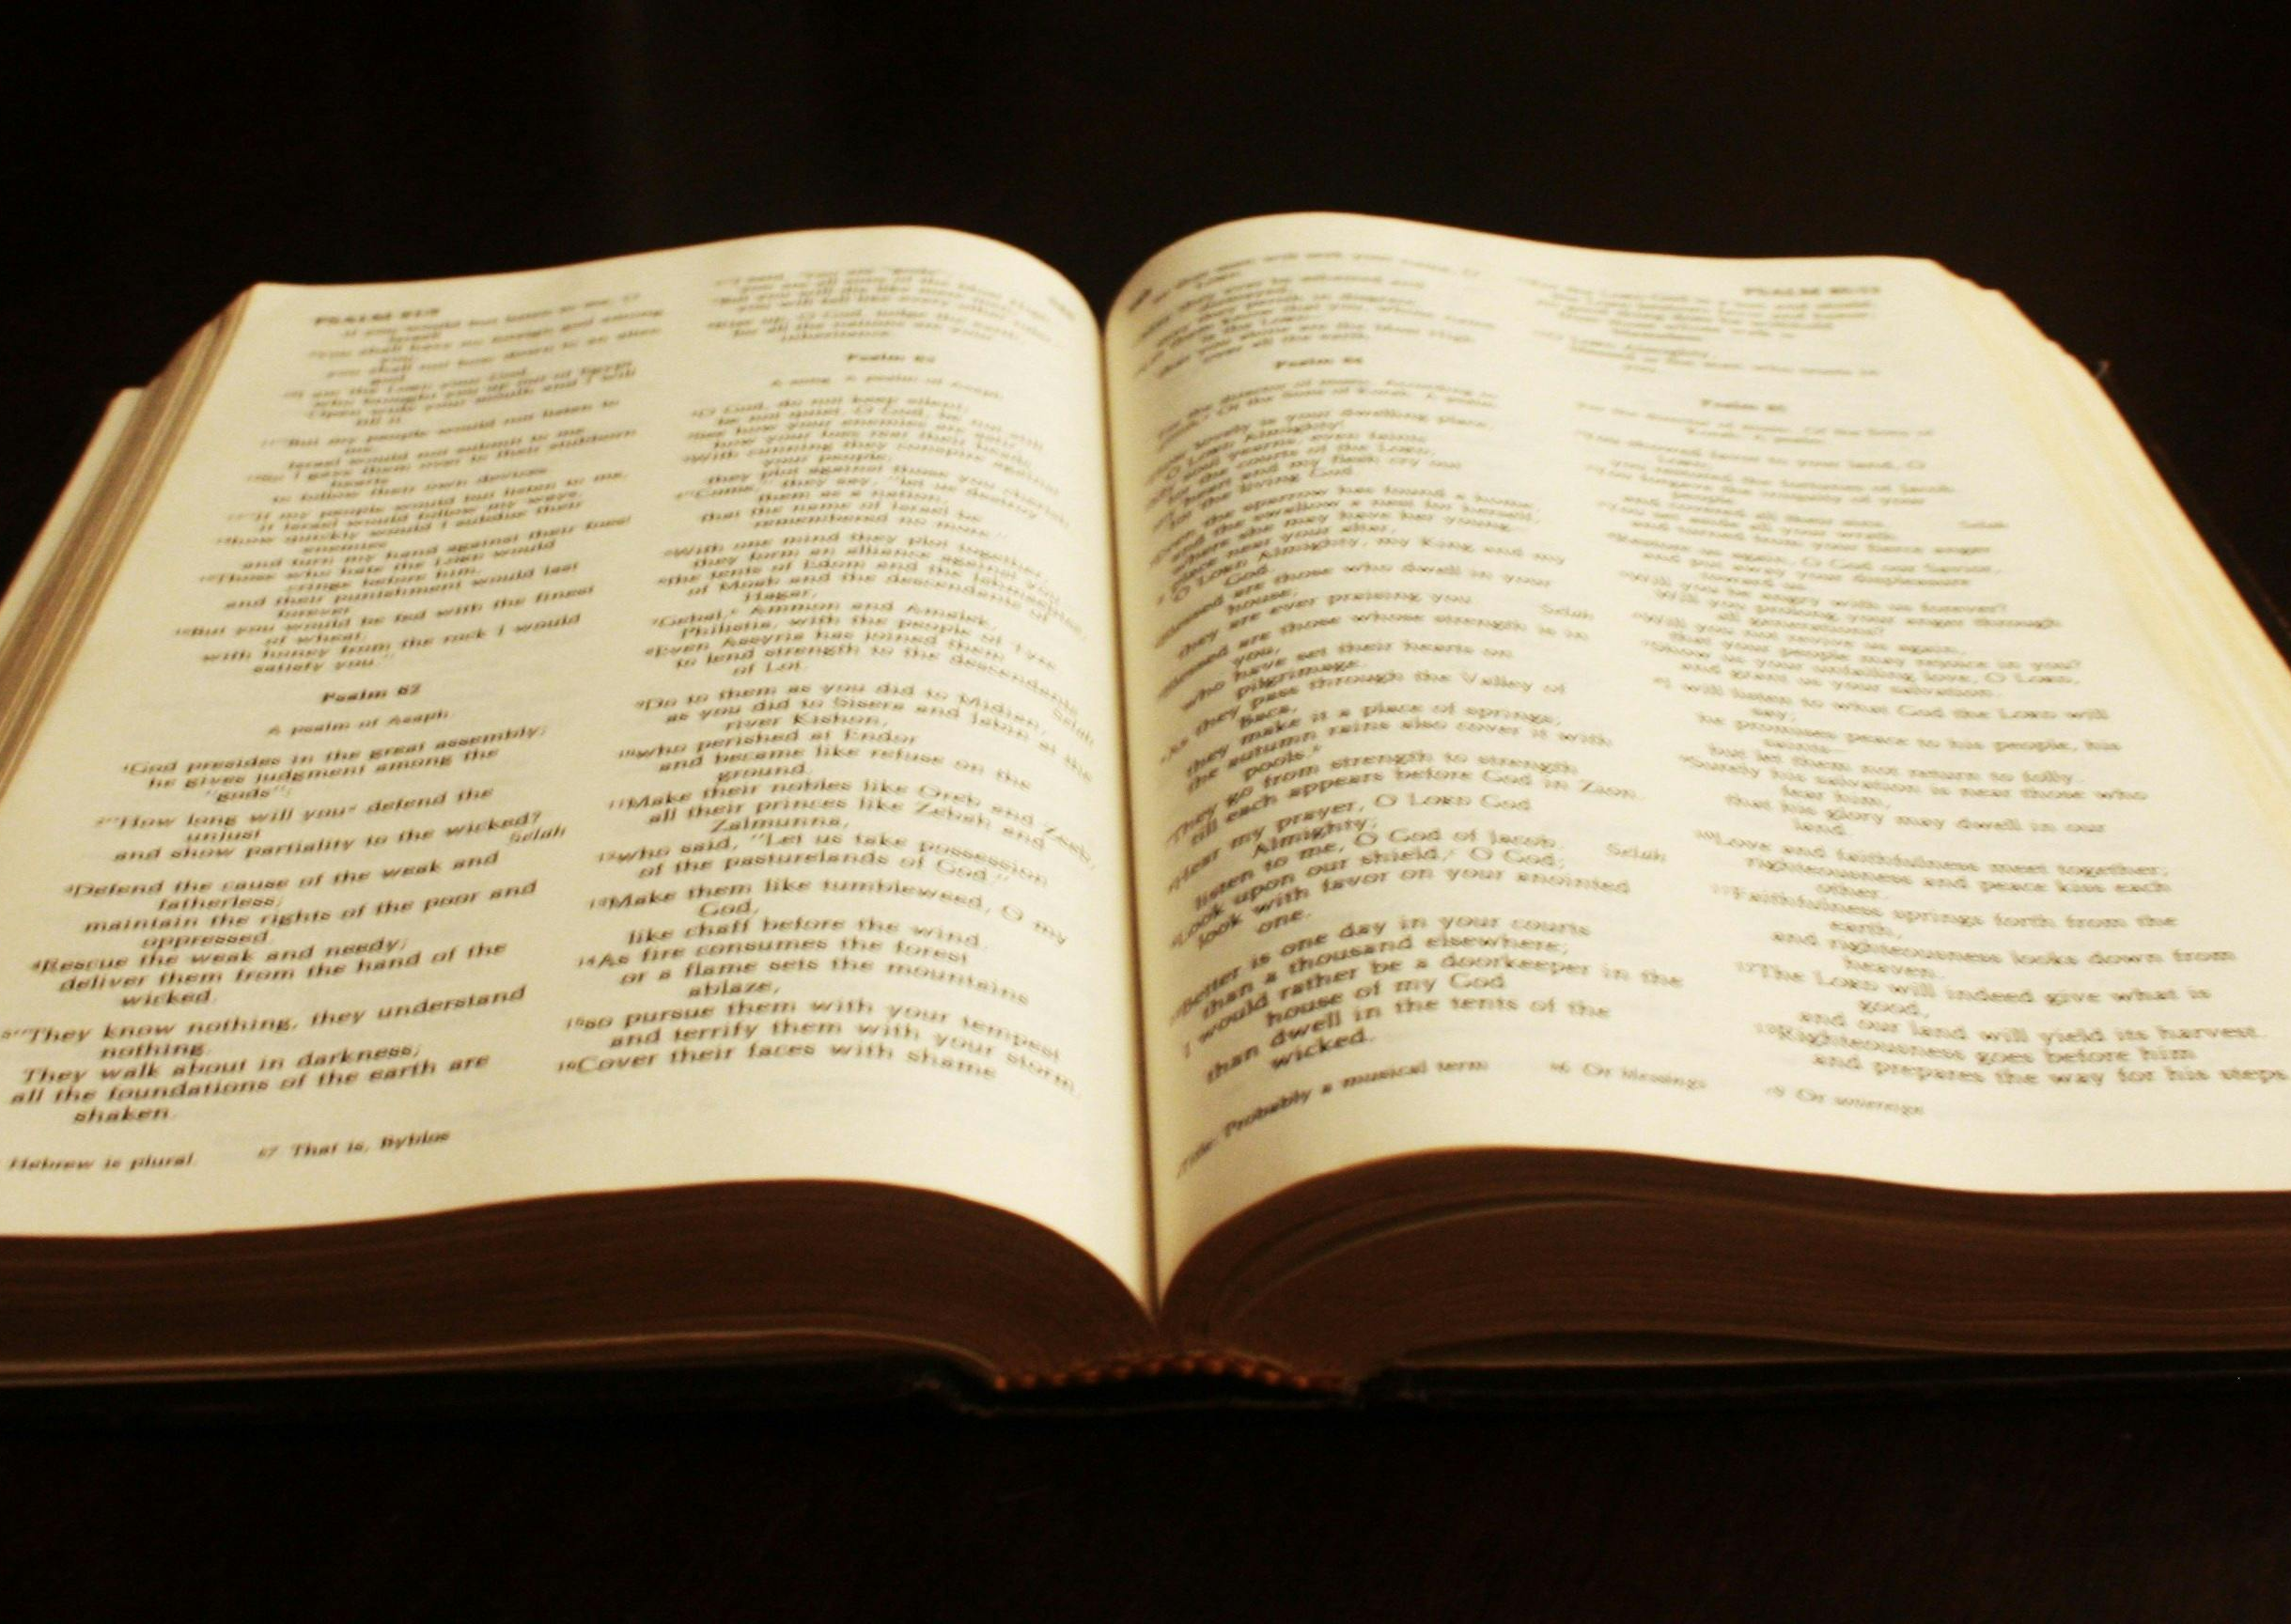
A perfect World in the bible
In the Bible, God made a Perfect, Peaceful and nice Environment for us to enjoy. Little did we know, came in litter which is all around us- by that I mean on the floor, in the Sea and yeh.

Slide 4
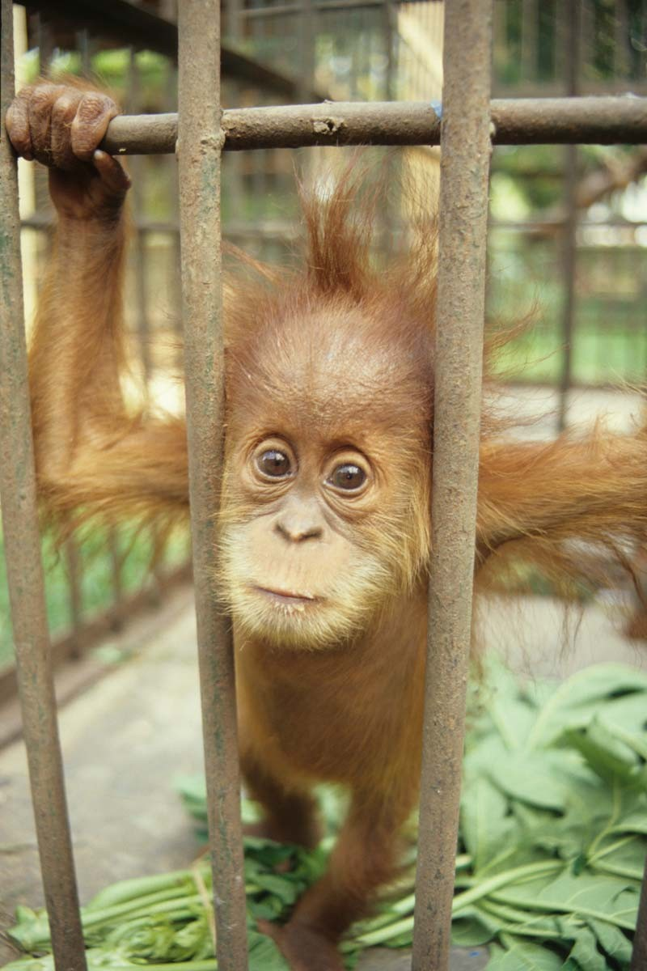
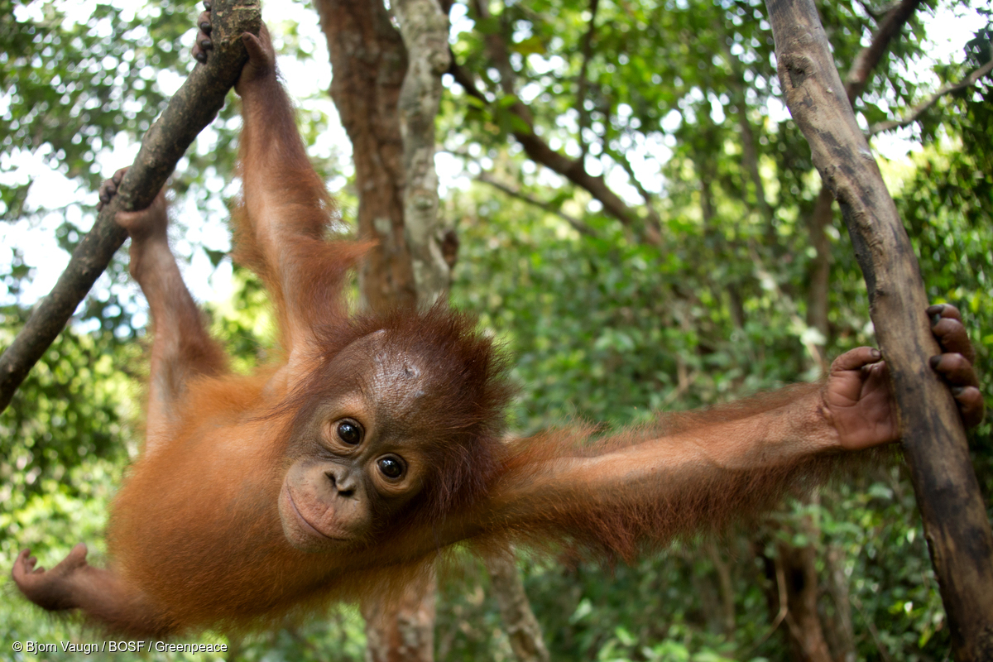
Climate Change
So far all we know is that Climate change is very affective. across the Globe, Deforestation is the one to keep your eye on.
THE POOR ORANGUTANS!!!!!!!!!!!!!!!!
This Photo by Unknown Author is licensed under CC BY-NC-ND
This Photo by Unknown Author is licensed under CC BY-NC-ND

Slide 5
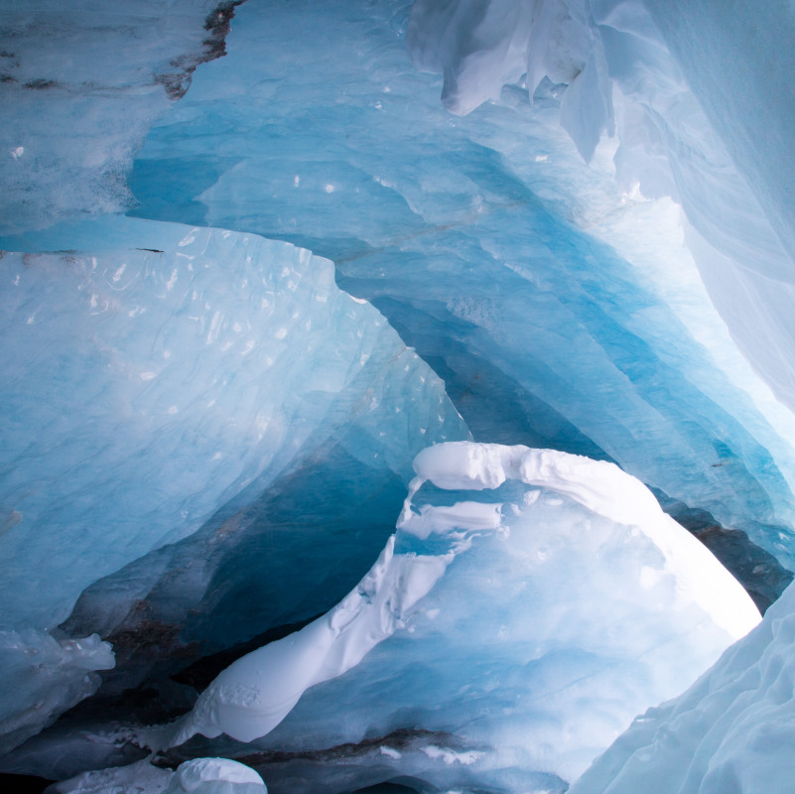
Ice Caps
Sadly, the Ice caps are melting because of harmful gasses.I think that we should use more electric cars.

Slide 6
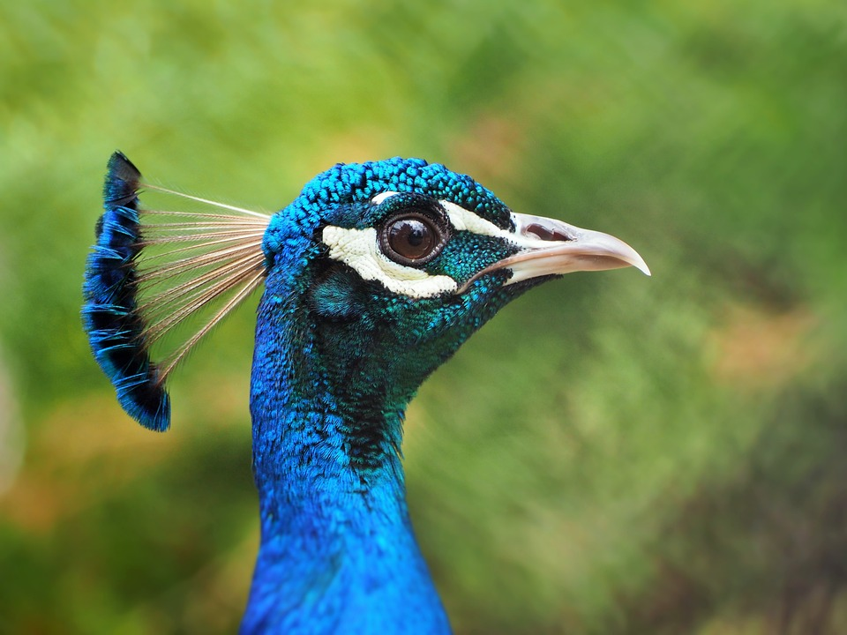
THE END!!!!!!!!!!!!!!!!!!!!!!!!!!!!!!!!!!!!!
HOPE YOU ENJOYED MY SLIED!!!!

