Slide 1
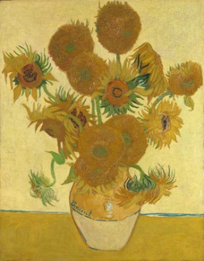
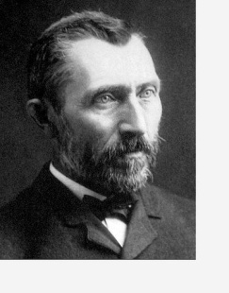
Communication, Language & Literacy
Sam’s Sunflower
Katie and the Sunflowers
Why I love my Mummy
All About Spring
Easter Story
People & Communities
Vincent Van Gogh
PSED
Tick Box – Doodle Makes Choices
Maths
Number 6
Height and Length
Mass
Capacity
Expressive Arts & Design
Mixing colours to make winter pictures
Joining materials together
Painting Sunflowers
I wonder what is new?
Nursery Spring 2 2024
RE
I Wonder what is new during Easter Time -
Reverend Freddie Fisher Stories – Puddles and the Happy Easter
Seven New Kittens – A Muslem story reflecting on the beauty and wonder of new life and the natural world. Puddles and the Christening Splash
Physical Development
Sports Xplorers
Balancing Bella
The World
Life Cycle of a Sunflower Seed
Spring
World Book Day
Global Christianity Day
Mother’s Day

