Slide 1
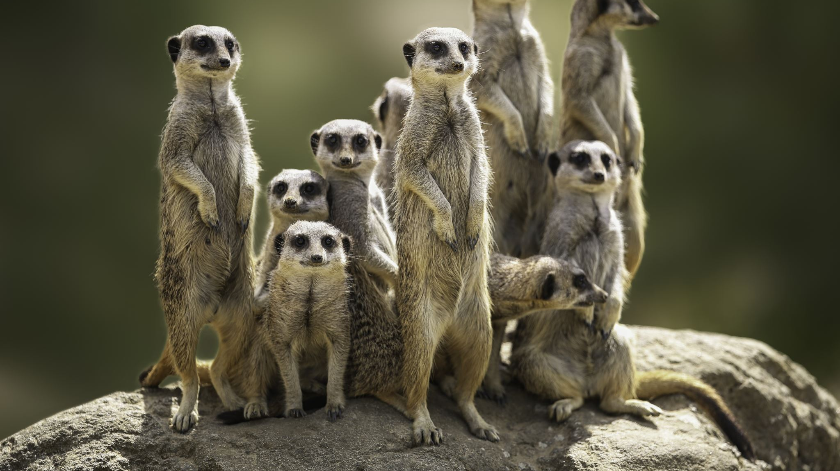
What if the animals around the world had a voice?
What would they say?

Slide 2
Orangutan
This Photo by Unknown Author is licensed under CC BY

Slide 3
Elephant

Slide 4
Turtle

Slide 5
Dog

Slide 6
The end. Thank you. Bye.

