Slide 1
What’s the strangest thing about how people lived in the past?

Slide 2
What’s the strangest thing about how people lived in the past?
At my age.
By Toby Elms, age 7.

Slide 3
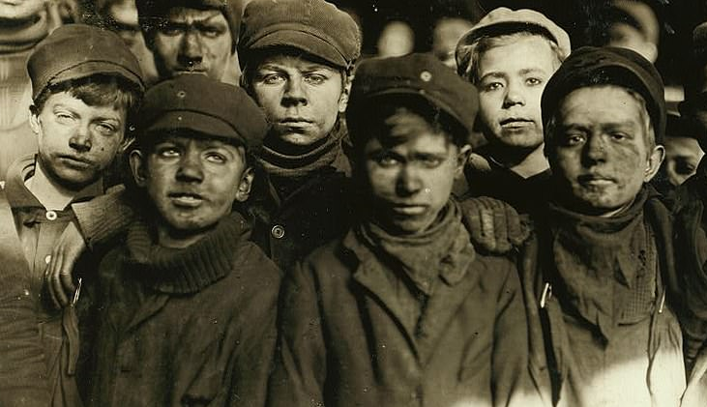
Strange 1 – We would already be working.

Slide 4
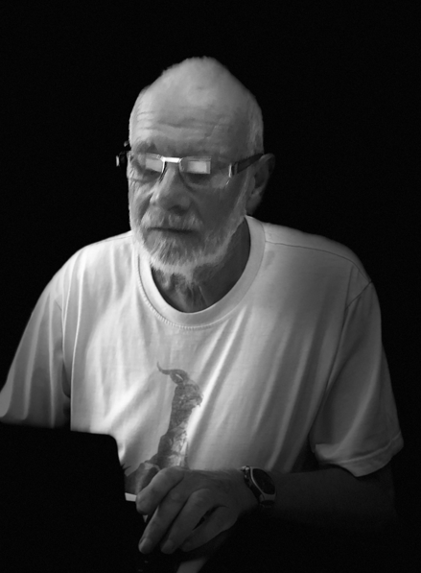
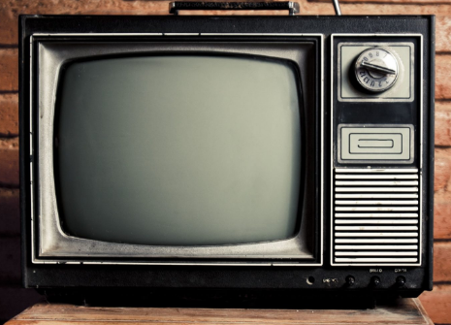
Strange 2 – My Grandad only had 2 TV channels.

Slide 5
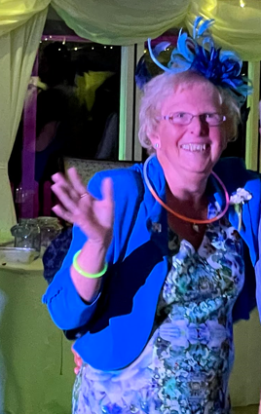

Strangest OF ALL – Outside toilet.

Slide 6
Old times were strange.
THANK YOU.
BYE.

