Slide 1
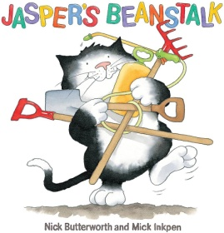
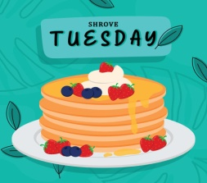

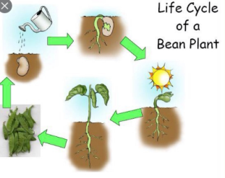
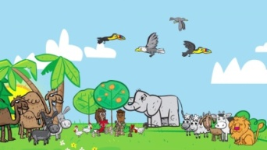
People & Communities
Shrove Tuesday – What is it all about
Communication, Language & Literacy
Jasper’s Beanstalk
Jack and the Beanstalk
The Little Red Hen
The Little Red Hen makes a Pizza
The Runaway Pancake
Expressive Arts & Design
Mixing colours to make winter pictures
Joining materials together to make snowflake shapes
Chinese Dragons
Maths
Number 3 – Subitising, 1:1 Counting, Numerals, Triangles
Number 4 – 1:1 Counting, Numerals, Squares, Rectangles, Composition of 4
Number 5 - 1:1 Counting, Pentagon, Composition of 5
I wonder what is new?
Nursery Spring 1 2026
Physical Development
Sports Explores
Fast Freddie
The World
Taking care of the environment
From Seed to Beanstalk
RE
Looking after Gods creation
The Baby Birds – Muslim Story about the World in which we Live
The Tiny Ants – A Muslim story about the importance of caring for the natural world.
A Christening Wish for Puddles
PSED
Tick Box – Doodle Feels Calm
Safer Internet Day
Mental Heath Week

